Slide 1

Weather Data Base analysis using Python.
CEIS 110- December 2021
Ashley Kennedy

Slide 2
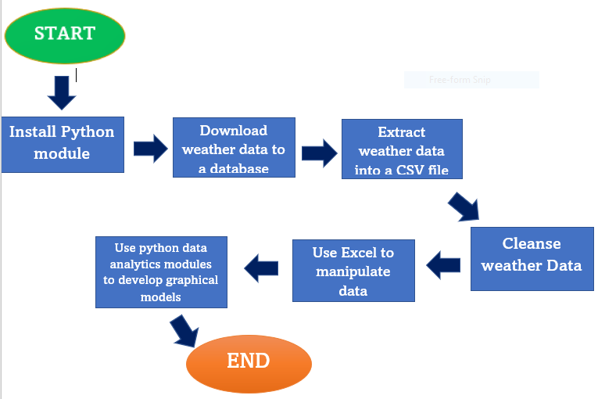
Goals and what we will accomplish in this project.
Install python
Download weather data to a database.
Extract weather data from database into a comma separated file with python
Cleanse weather data
Use Excel to manipulate data
Use python data analytics modules to develop graphical models

Slide 3
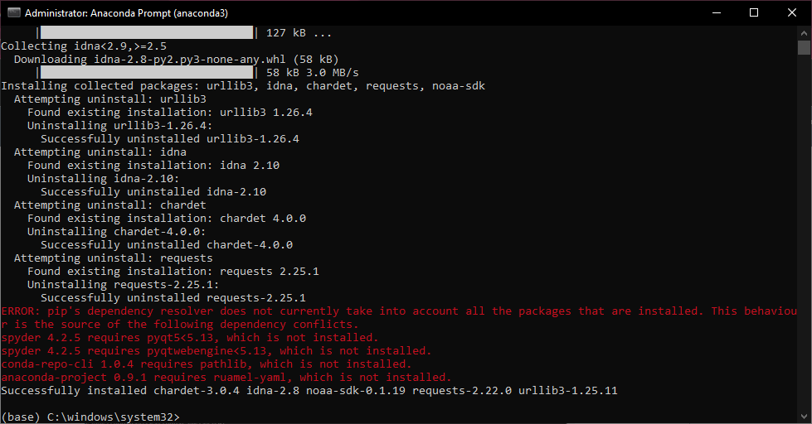
Software Inventory
screenshot of NOAA-SDK library installed
Ensure result "Successfully installed noaa-sdk" of pip install command is visible in your screenshot.

Slide 4
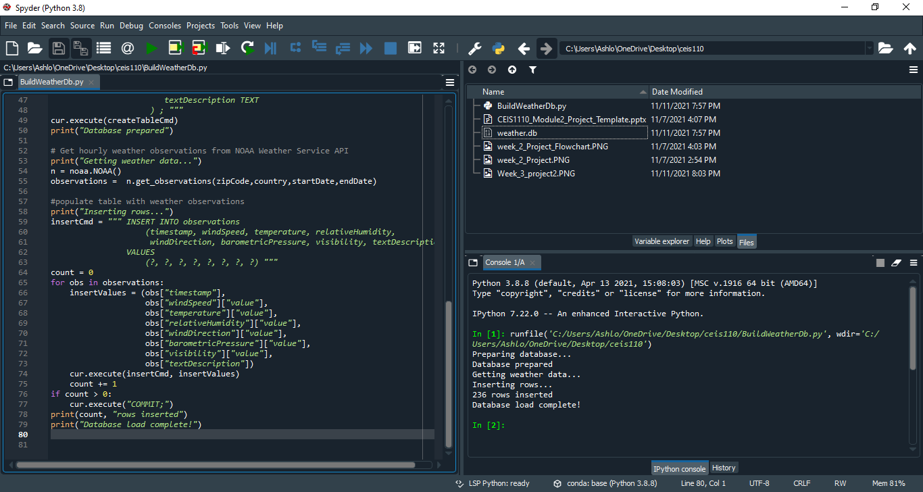
BuildWeatherDb.py Code
Building a weather data base. The code used to create it. Using Anaconda spider.

Slide 5
Python Console
(Screenshot)
Screenshot of program output in Python console showing program executed successfully

Slide 6
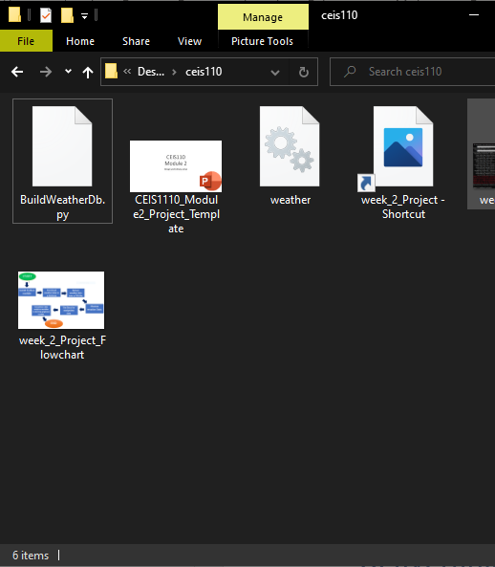
Weather.db File
Screenshot of Windows Explorer showing database file Weather.db was created

Slide 7
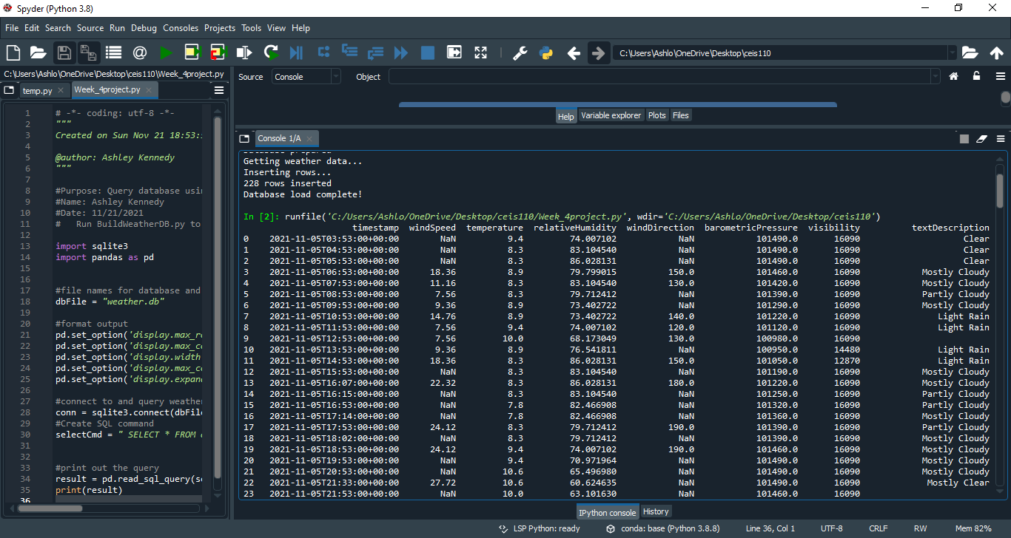
Query to retrieve all columns and all rows
Screenshot of SQL query command and results

Slide 8
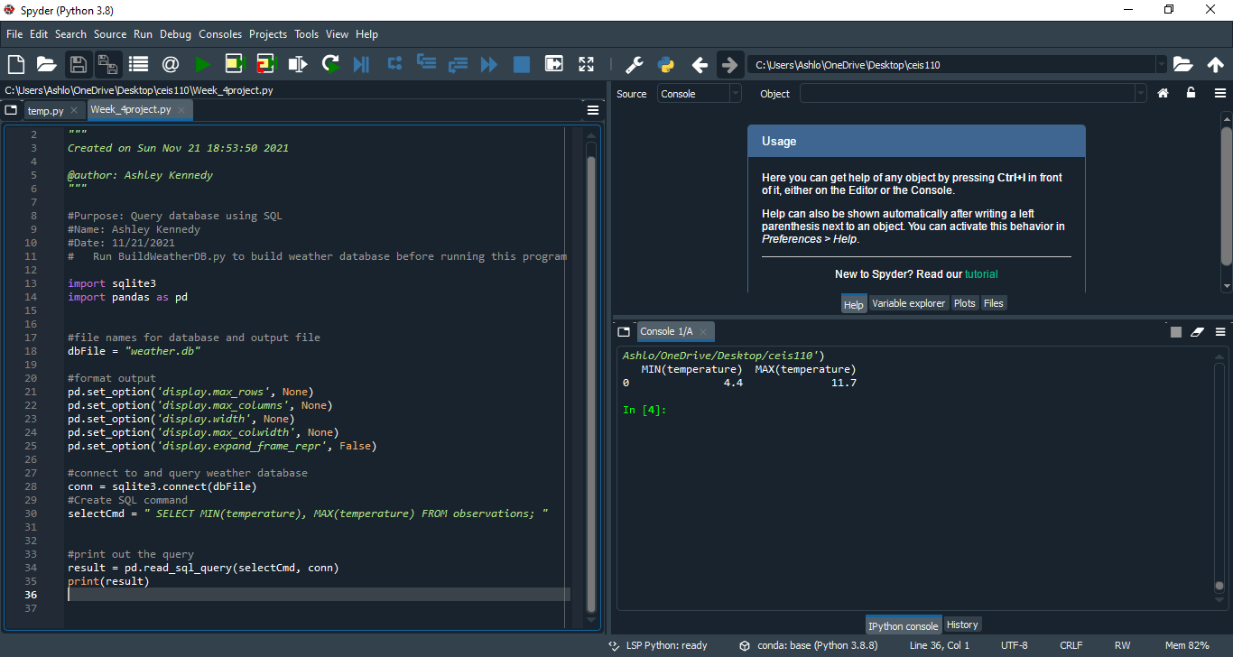
Query to retrieve lowest and highest temperatures
Screenshot of SQL query command and results

Slide 9
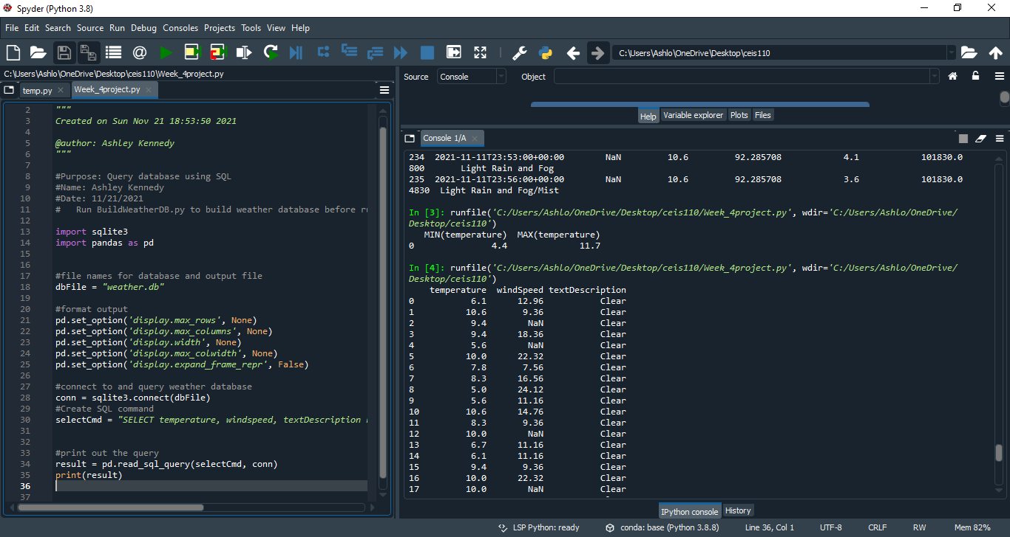
Query to retrieve all clear days
(Screenshot)
Screenshot of SQL query command and results

Slide 10

CEIS110
Module 5
Querying and manipulating data with SQL and Python

Slide 11
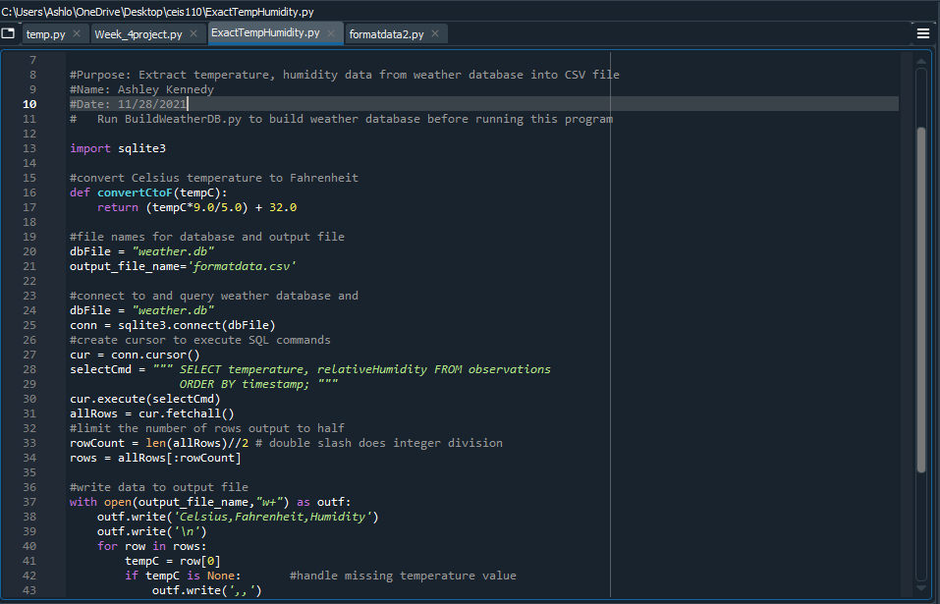
Python code
ExtractTempHumidity.py Python code with your name and date in comments

Slide 12
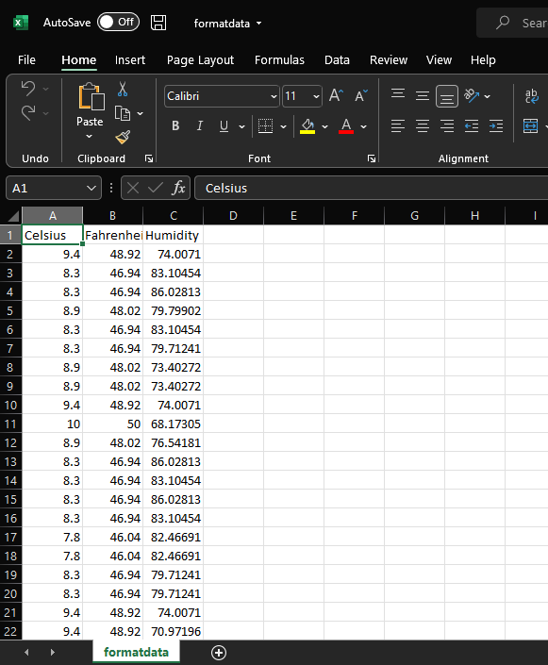
Retrieve and Convert Data to CSV Format
Formatdata file open in Excel showing 3 columns of data

Slide 13
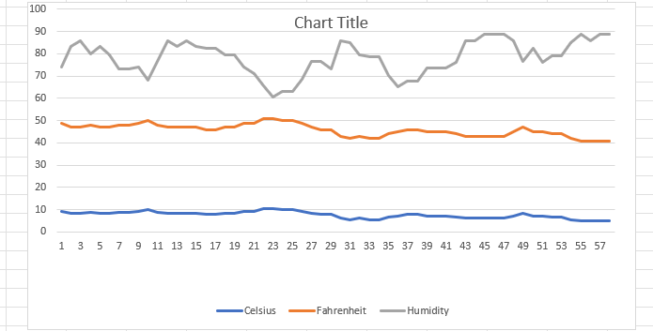
Temperature and Humidity Chart
(Graph)
Excel chart based on temperature and humidity data from database

Slide 14
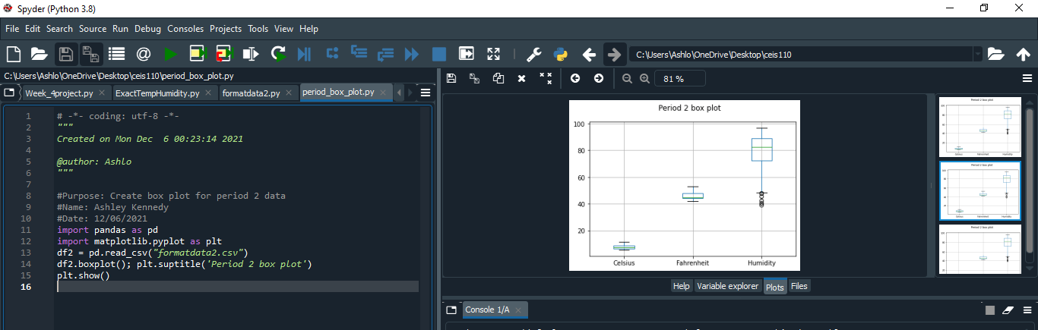
Plot #1
Plotting the data

Slide 15
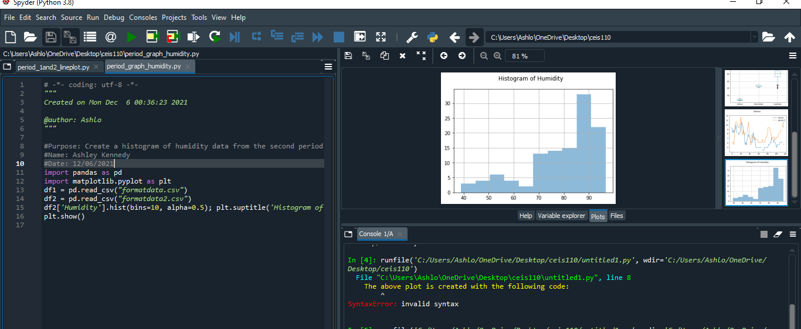
Analysis
Think of your own question and create a chart/graph to answer it
Your own question:
-What has the humidity been like recently?
Answer supported by Chart:
Histogram bar graph

Slide 16
Prediction
Develop a prediction based on the data. What variations in temperature and humidity do you expect over the next few hours or days? How would humidity change if temperature goes up or down?
I definitely think that humidity changes with temperature. I also predict temperatures getting cold here soon. Where I live it’s always wet going into winter.

Slide 17
What I struggled with while building this project.
This project was actually, really simple. The software used to gather the data in the weather data base was user friendly. Spyder in Anaconda is pretty up to date and great for learning to code in Python.
So I didn’t really have any struggles in this project.

Slide 18
What I learned that will be career useful.
I learned how to code in Python.
I learned how to run software that retrieves and stores data.
Building the plots and graphing the data will be extremely useful in the future.
Gathering my information and presenting it in a power point.

Slide 19
The End~ Thank you

