Slide 1

CEIS101-Final Project
Ashley Kennedy

Slide 2

Introduction
Using Tinkercad, Arduino controller and C++ programming for this project we've developed a Home security prototype.
This Photo by Unknown author is licensed under CC BY.

Slide 3

Virtual Design
Initially we used Tinkcad to learn about the Arduino controller and sensors. Using Tinker cad to create virtual circuits gave us a better understanding of how all components work together and teaches us how to avoid mistakes that could damage and short out our controller and bread board.

Slide 4
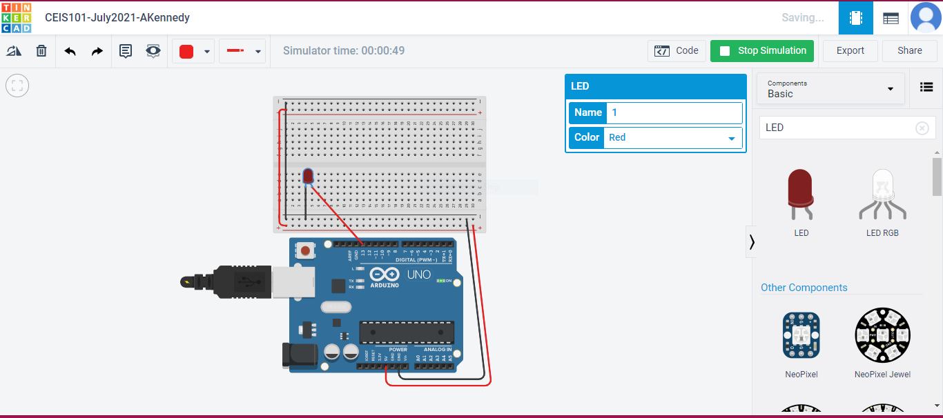

Tinkercad Circuit
This Photo by Unknown author is licensed under CC BY-SA-NC.

Slide 5
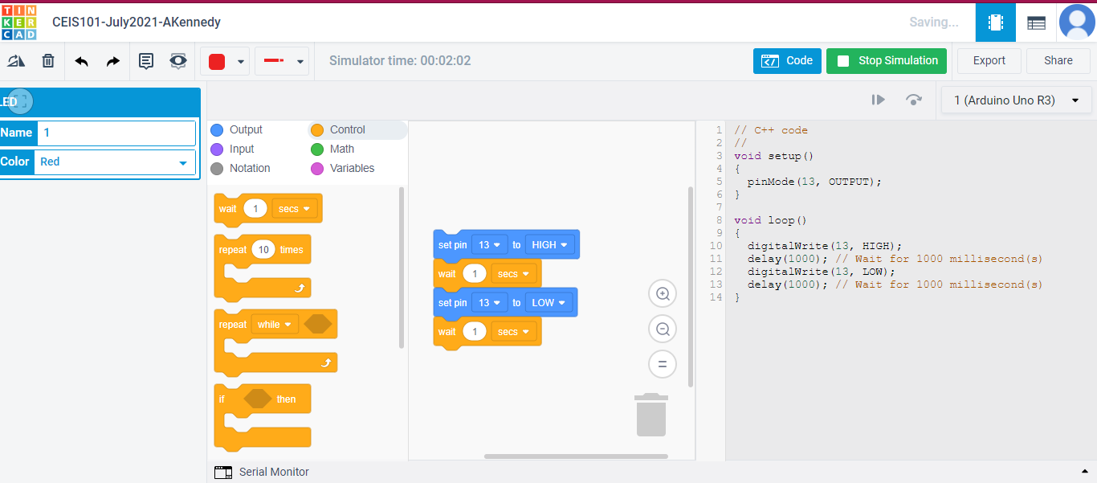
Tinkercad Code

Slide 6

Live IoT Hardware
Inventory of all electronic components in Tech Core kit
Organized Inventory of project components
Set up of Arduino and power to bread board
Red LED wired
C++ programing language code in Arduino IDE
Red LED programmed when to light up

Slide 7
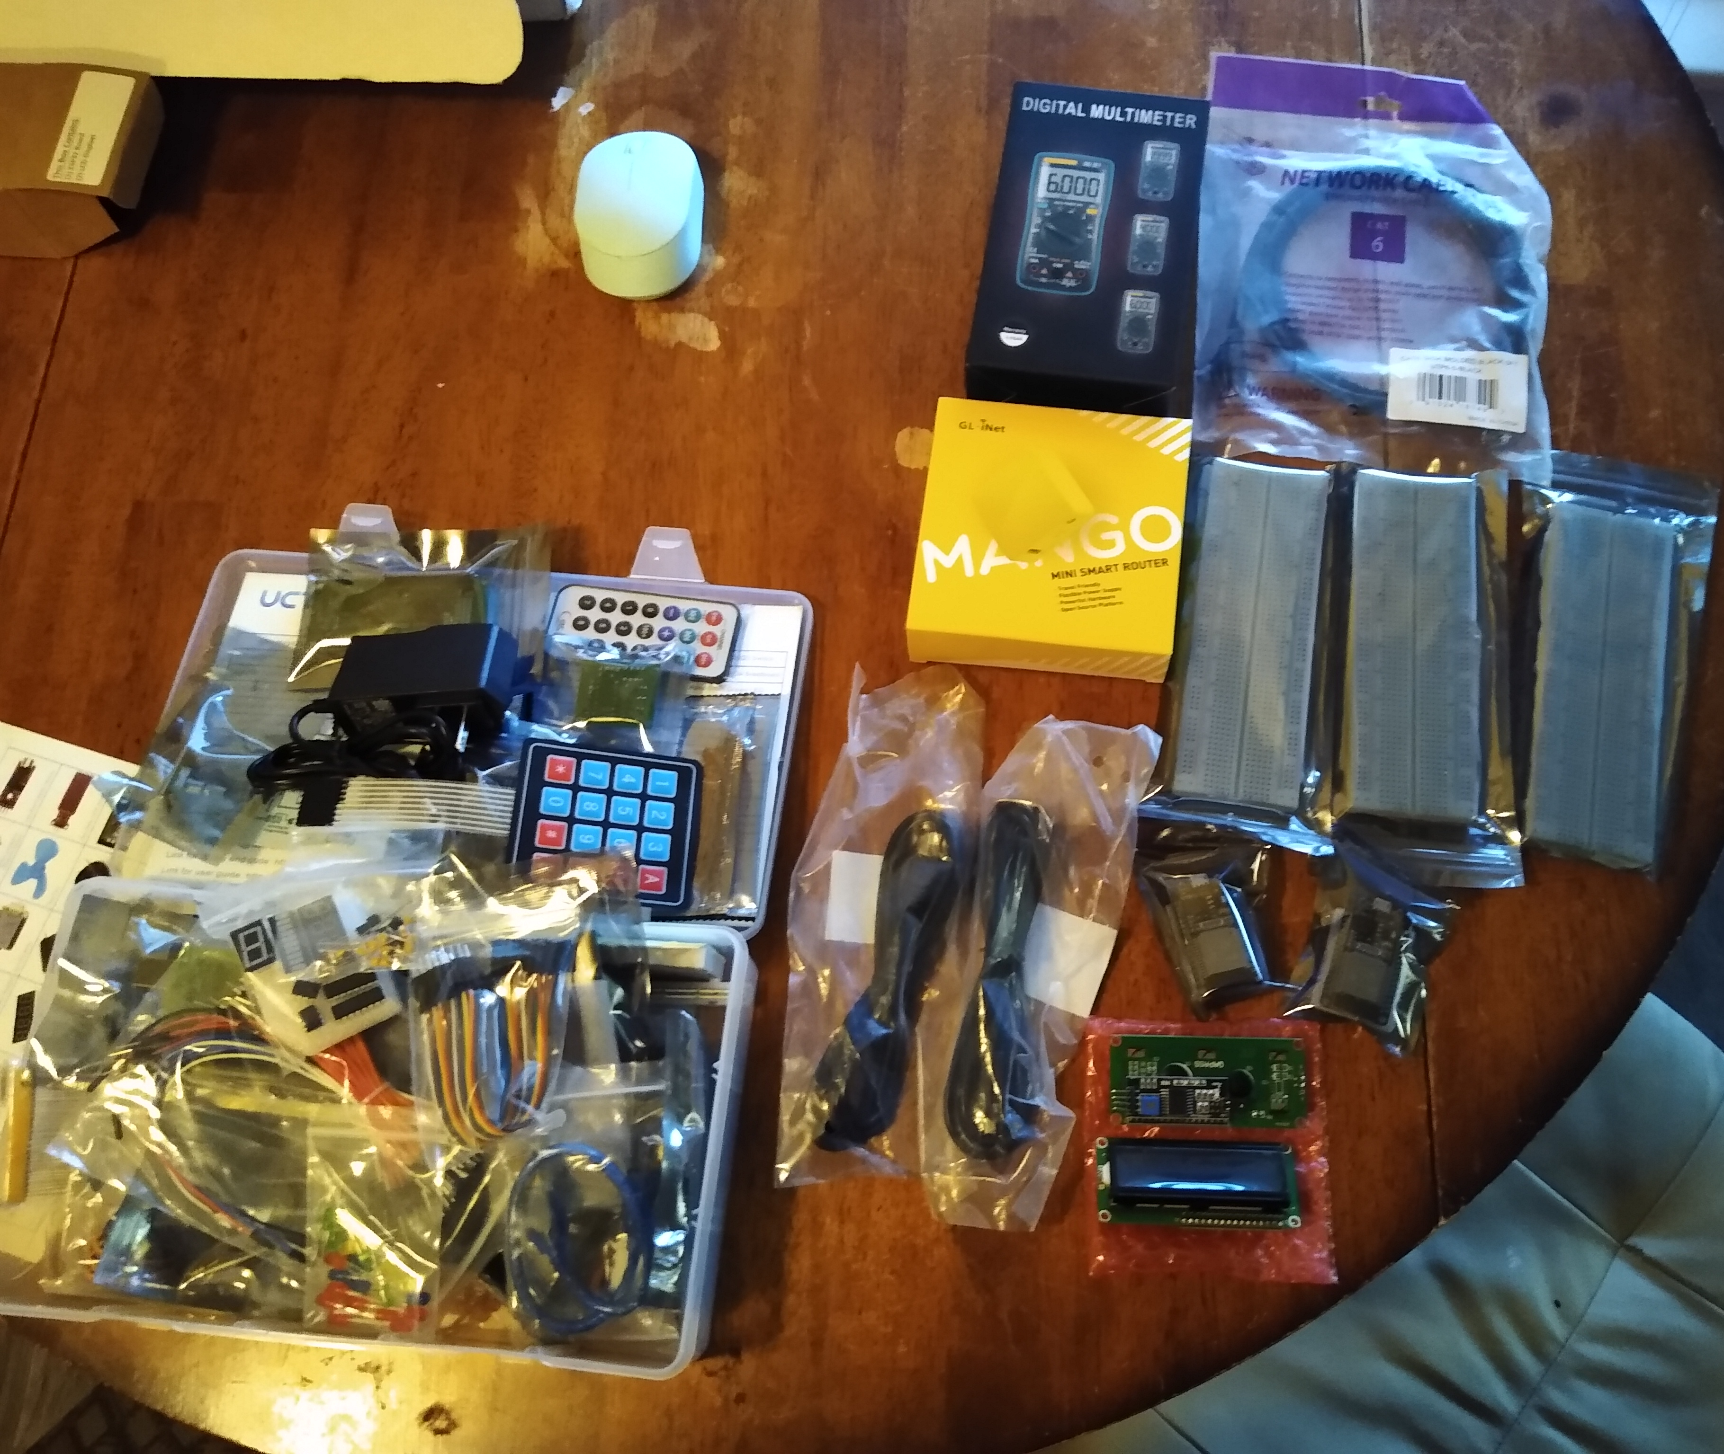
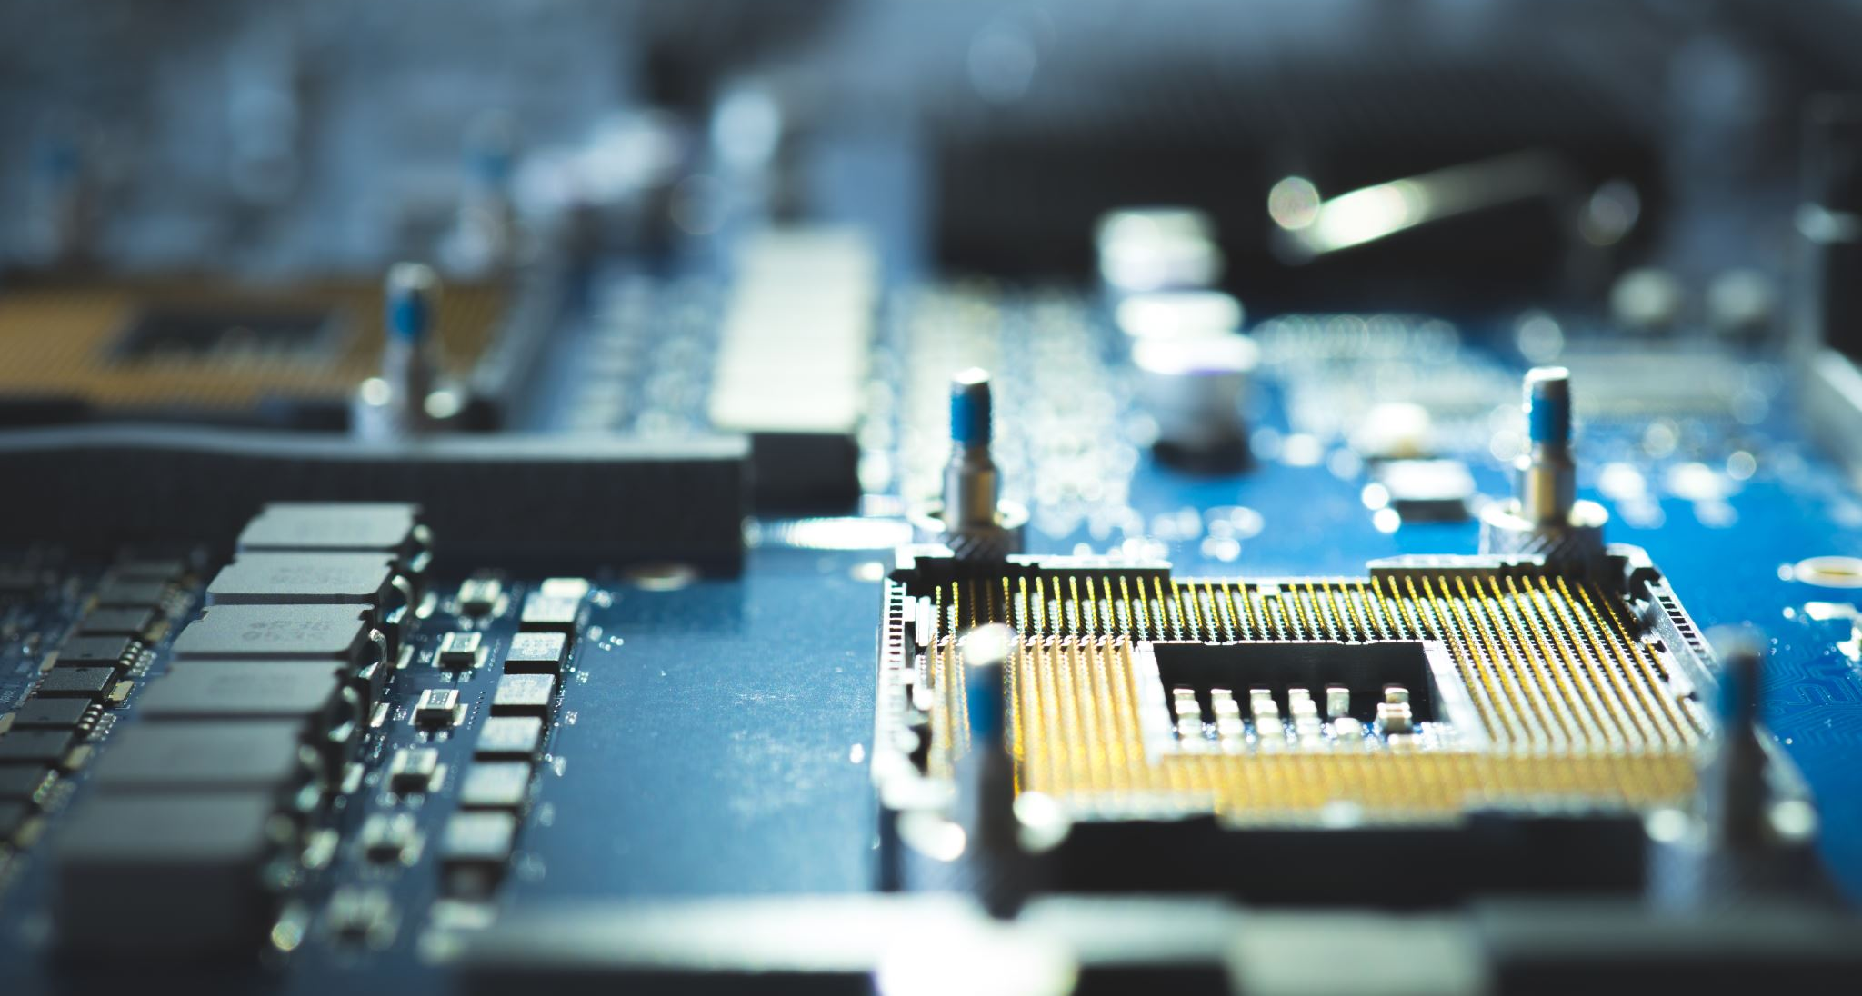
Invetory of Tech Core Kit
UCTRONICS Kit
Digital Multi meter
Mini router
3 bread boards
2 LCD modules
Patch cable
2 USB to micro USB cables
2 ESP32's

Slide 8

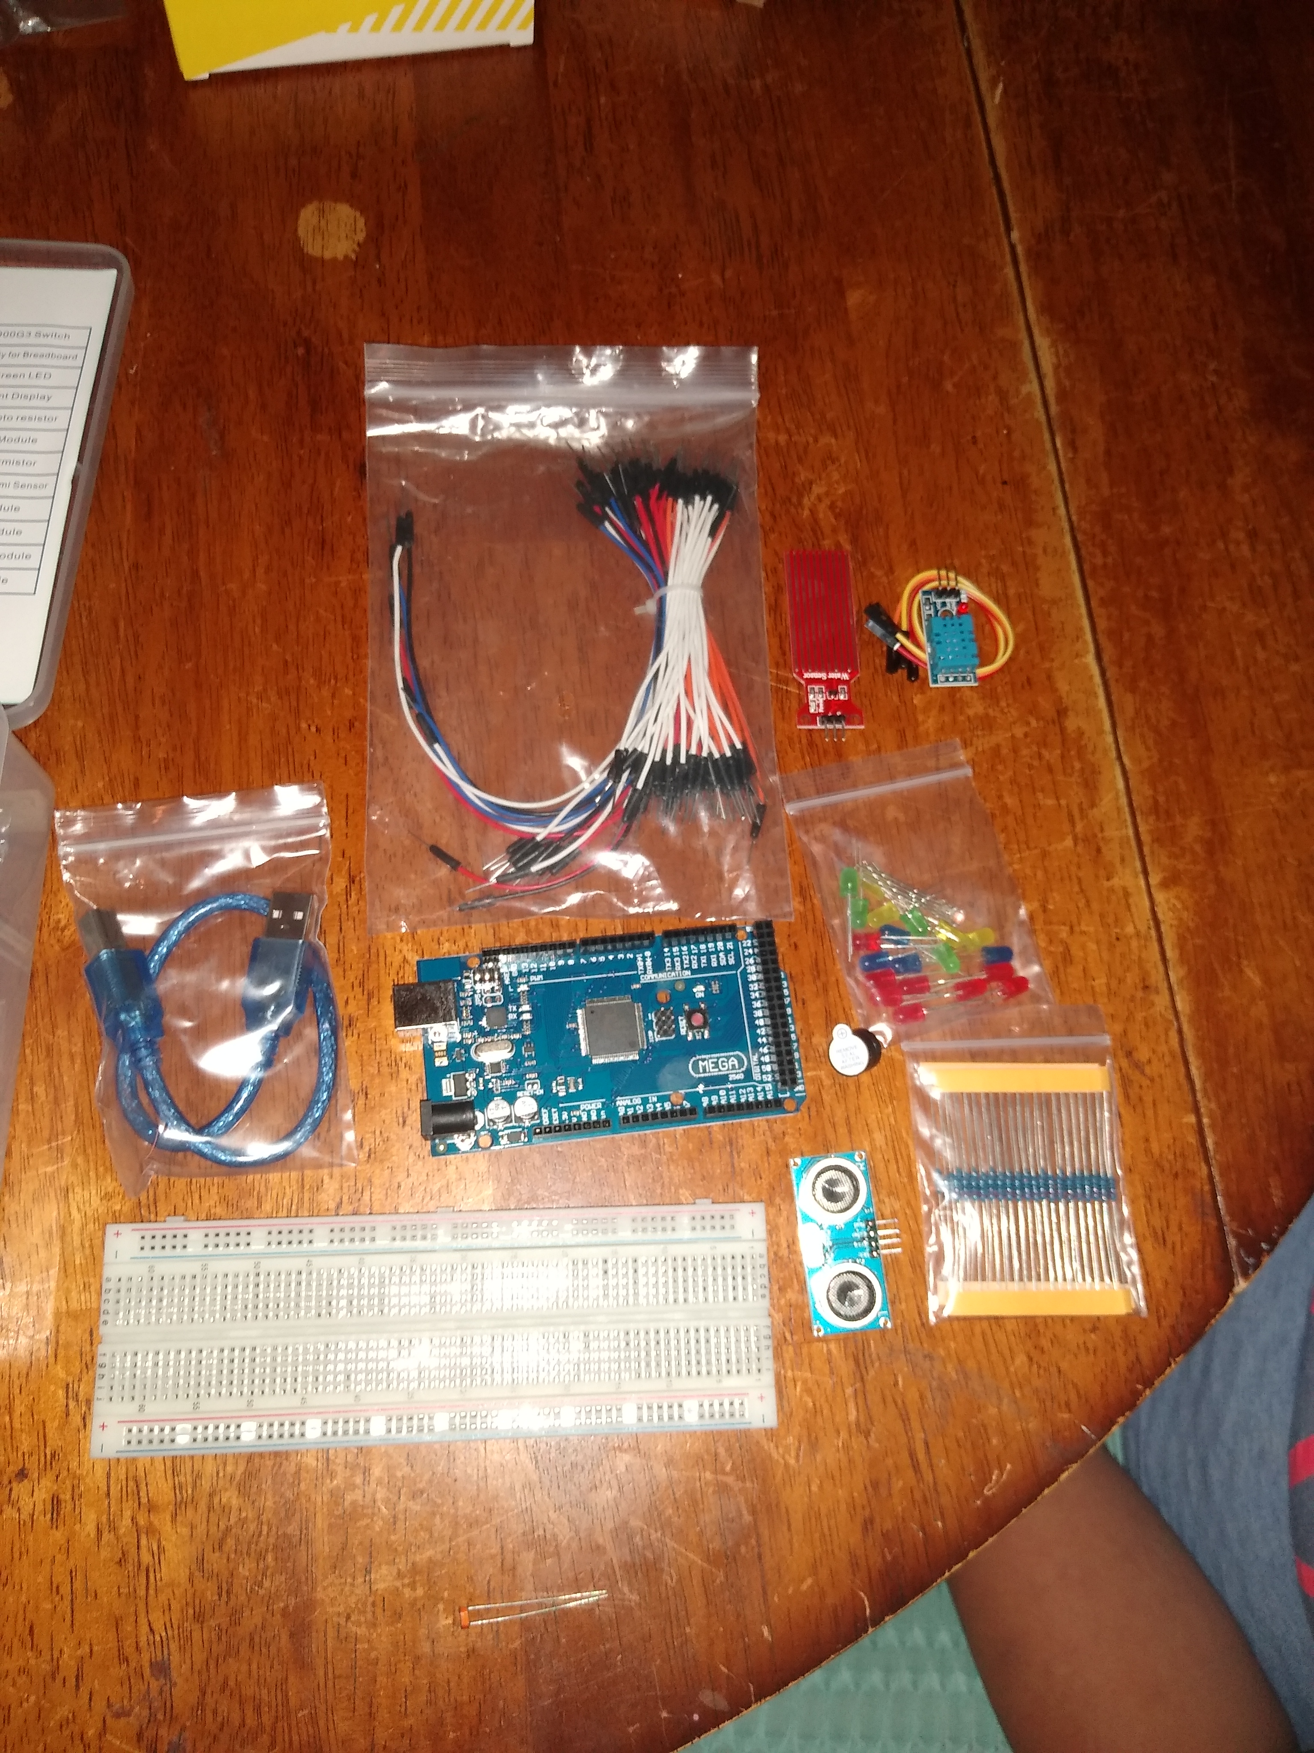
Project components
Arduino Mega 2560
USB type B cable
Photoresistor
LED's
Wires
Distance sensor
Buzzer
Water sensor
Temp sensor
Resistors 10k
Bread board
This Photo by Unknown author is licensed under CC BY-SA-NC.

Slide 9

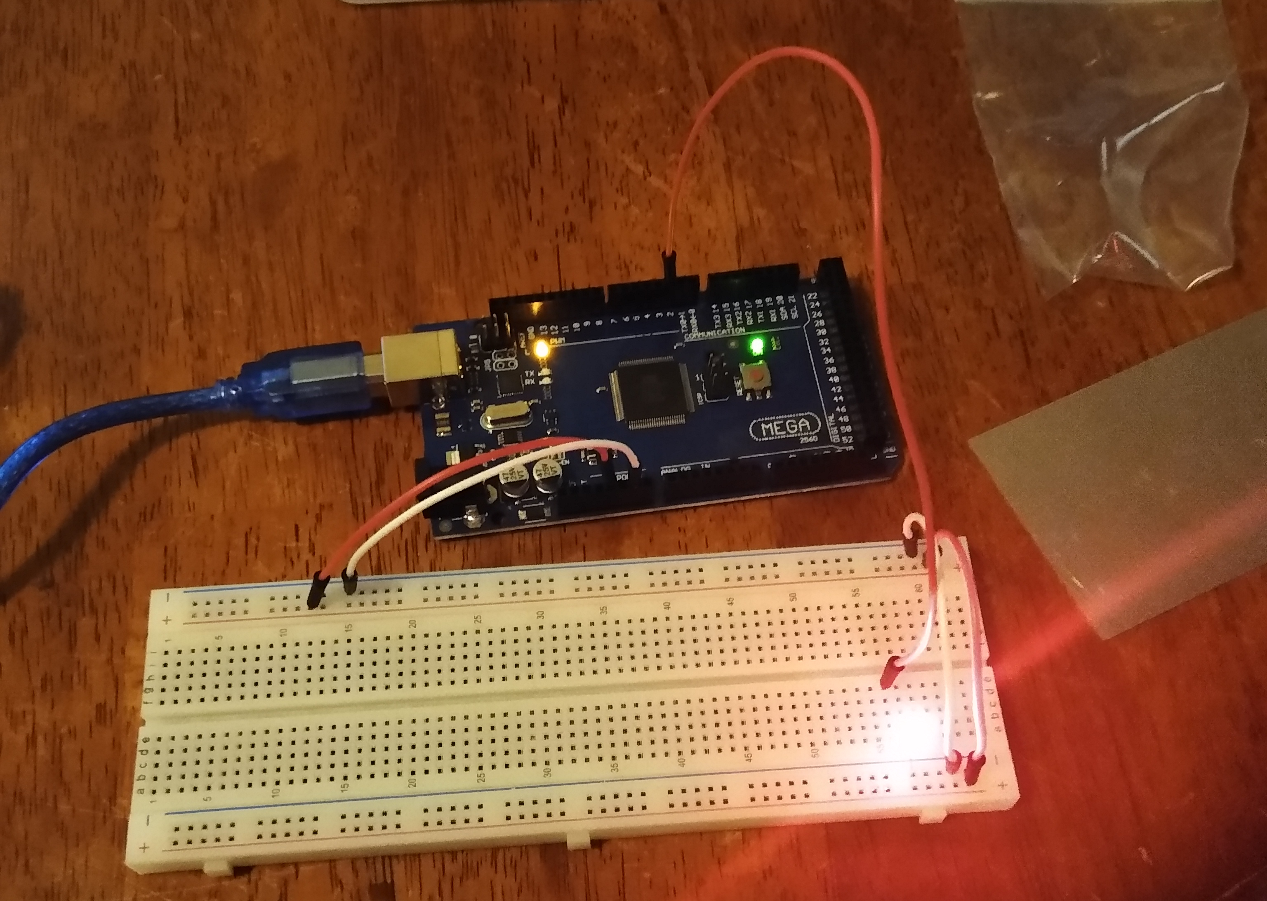
Circuit with Red LED on

Slide 10

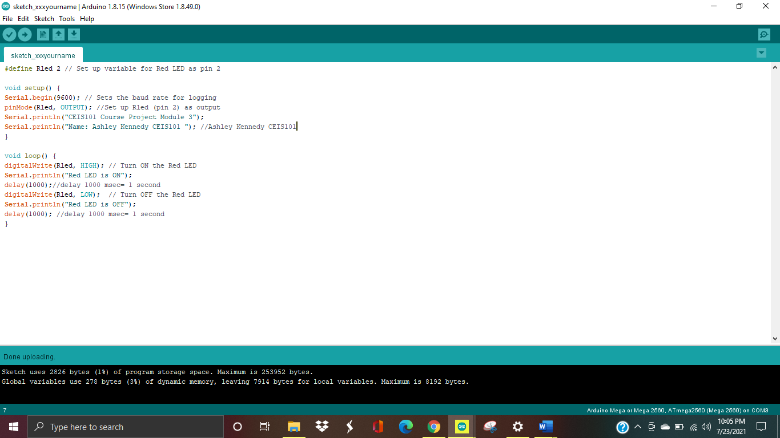
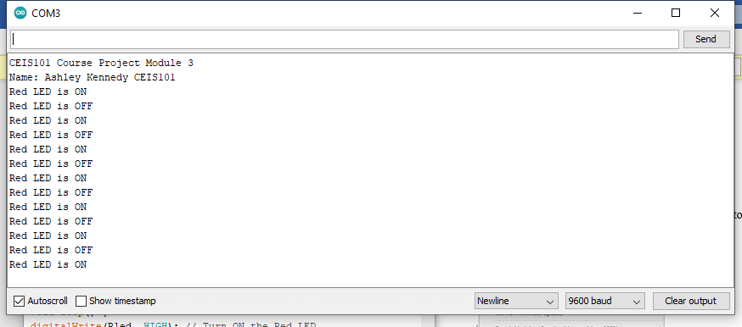
C++ Code and Serial monitor Data

Slide 11
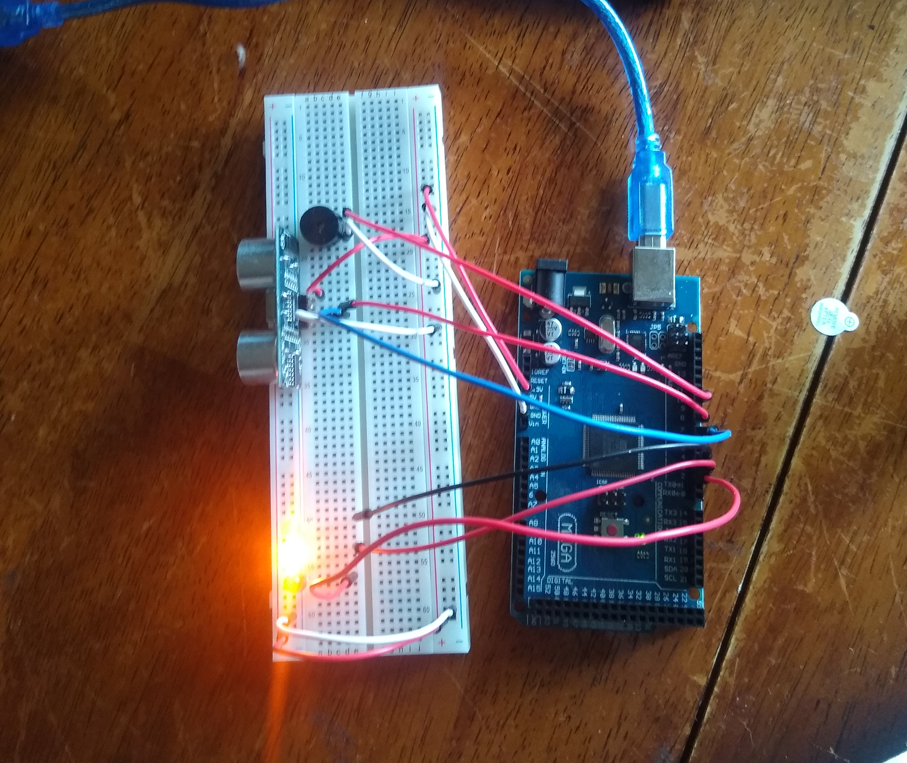
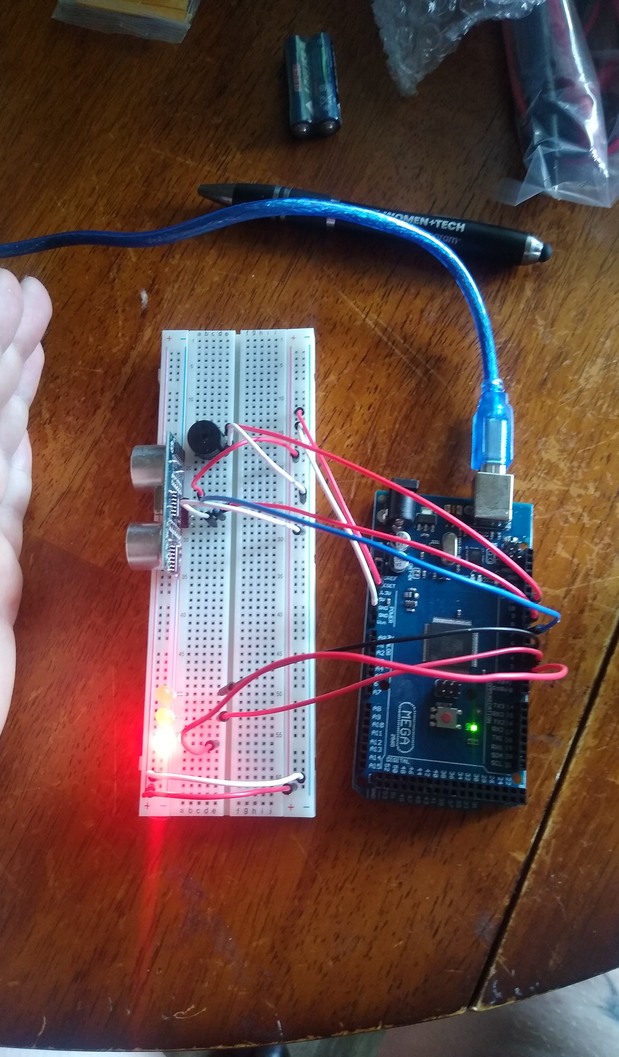
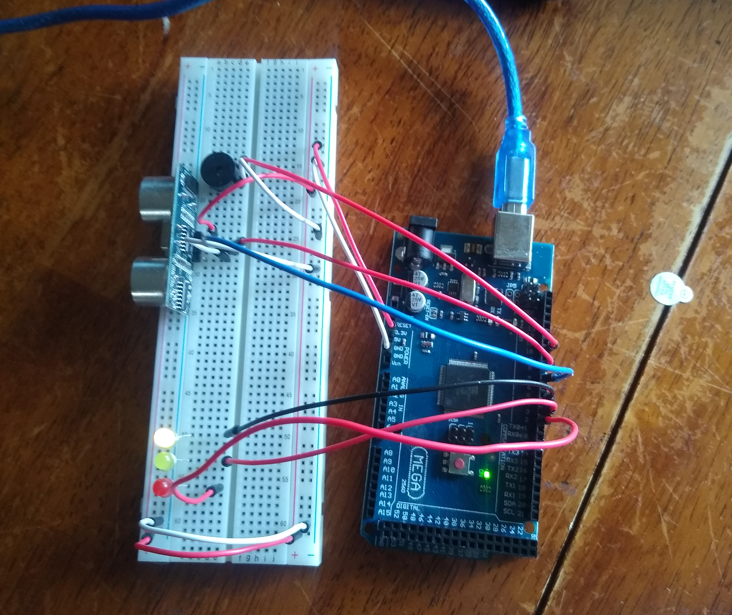
Adding distance sensor and green & yellow LED's and Buzzer
Adding the buzzer gives the circuit the alarm sound
The distance sensor reads the distance of objects within 12 inches
The circuit is programmed to flash the red LED with object within 6 inches of the sensor (my hand) and yellow within 6-12 inches of an object.
The closer the object the faster the buzzer beeps
When the distance sensor is clear from objects the green LED is active indicating no security threat and the alarm (buzzer) does not sound

Slide 12

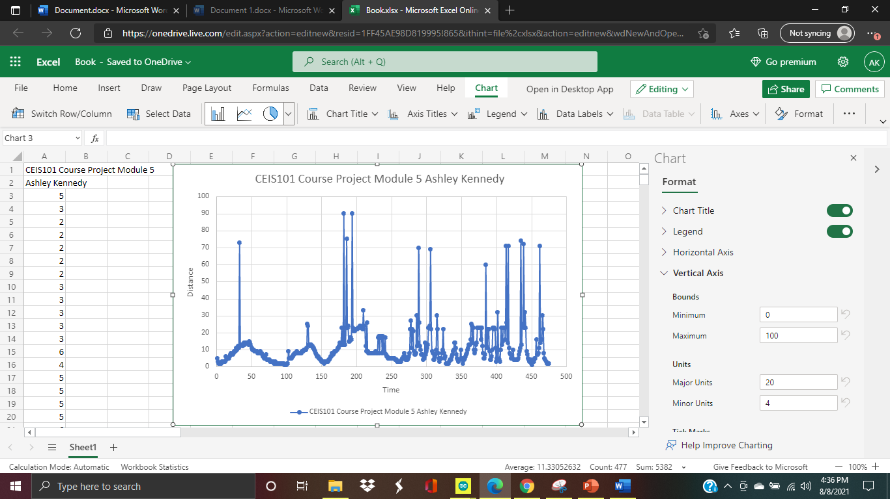
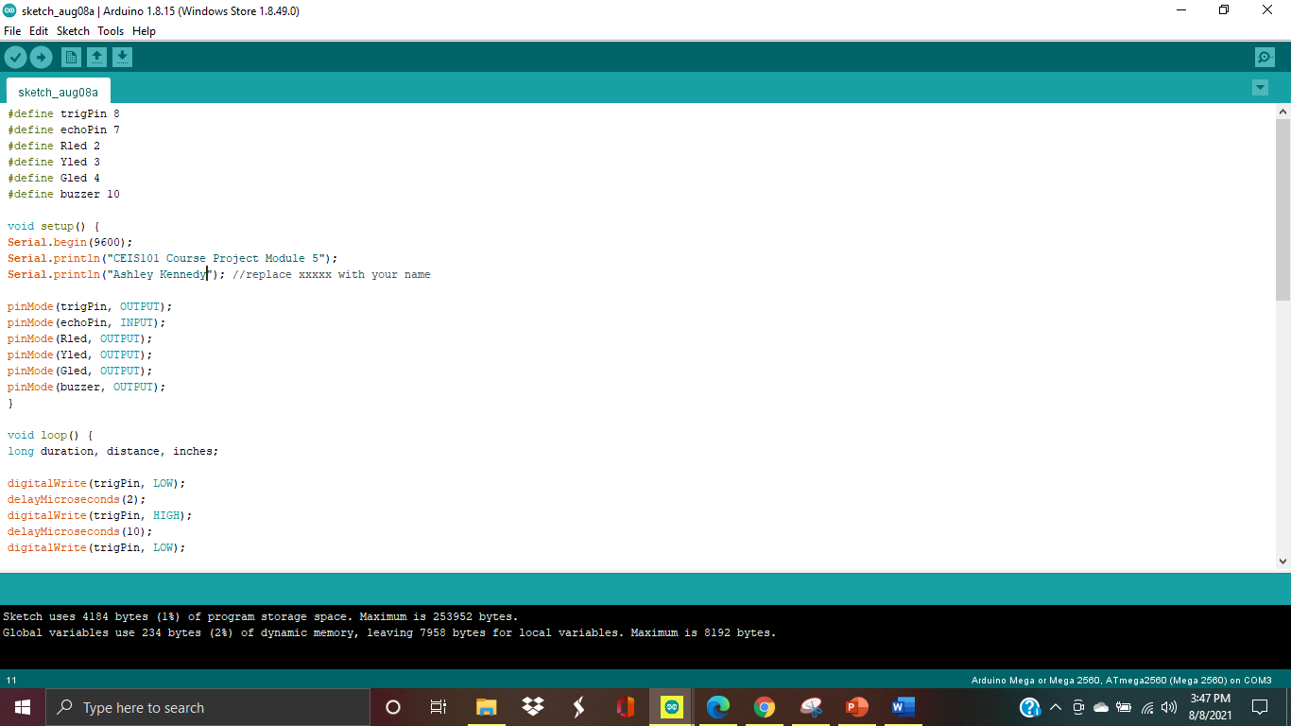
Distance sensor graph and C++ code for distance sensor, buzzer and LED's
This Photo by Unknown author is licensed under CC BY-ND.

Slide 13
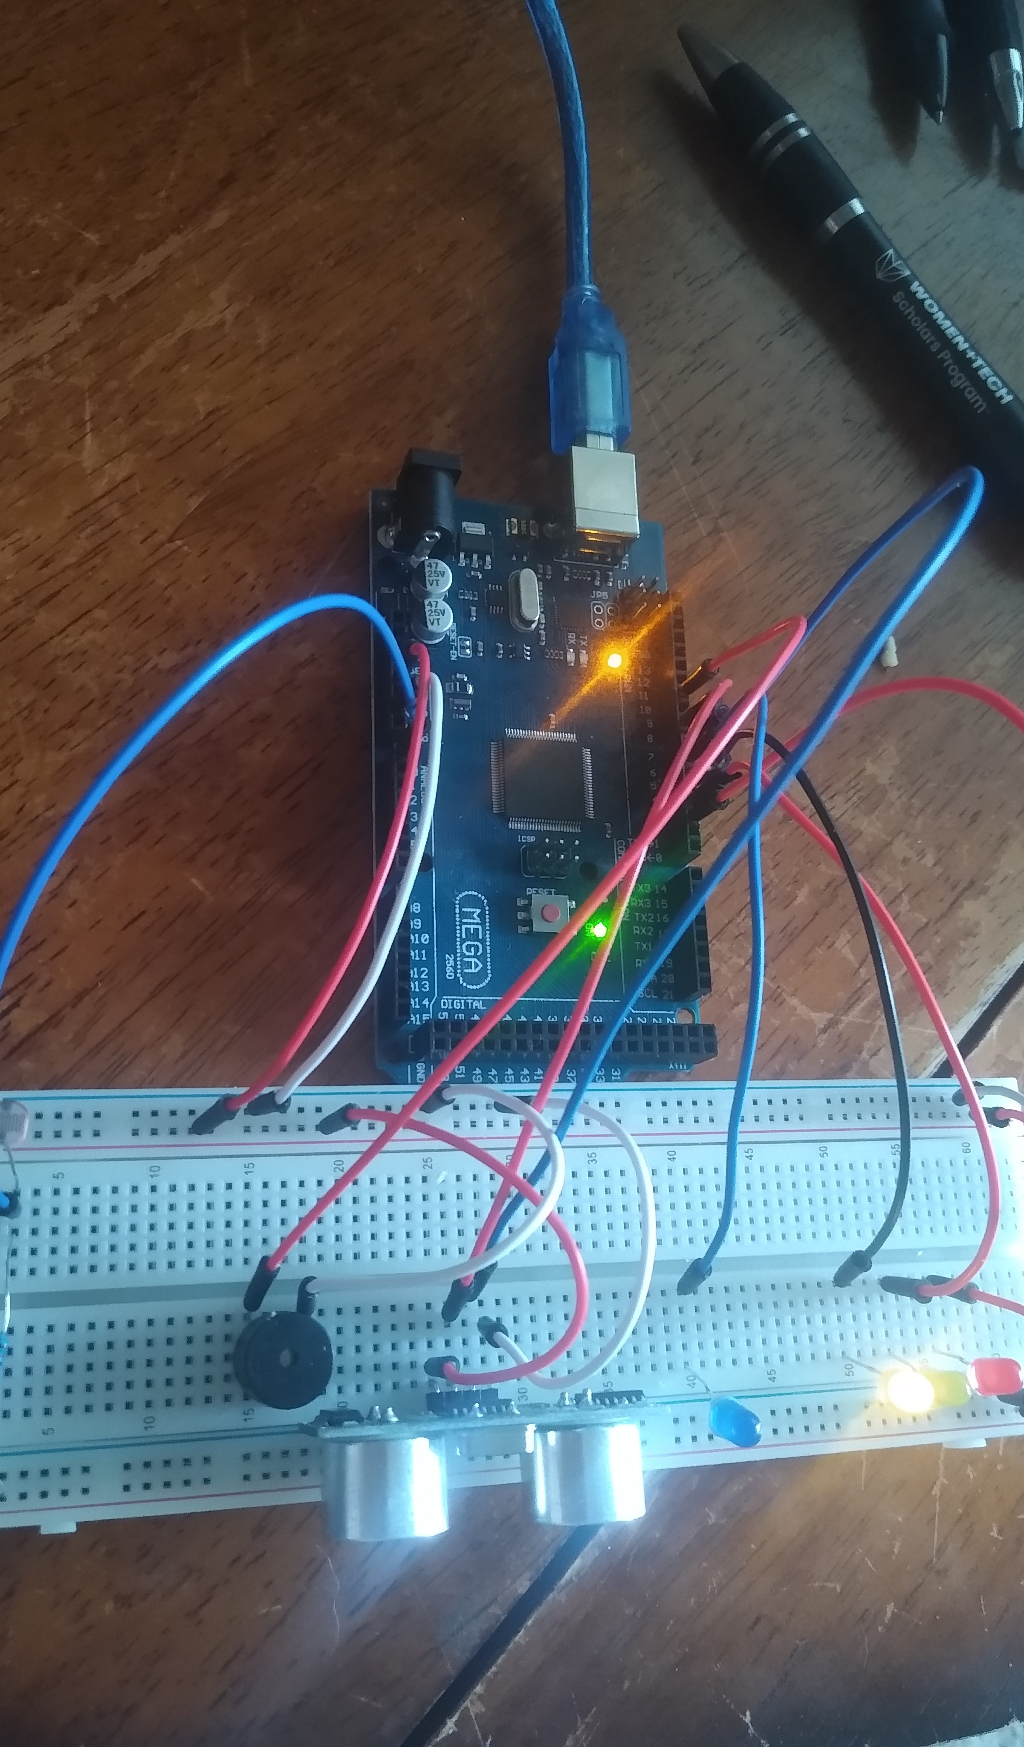
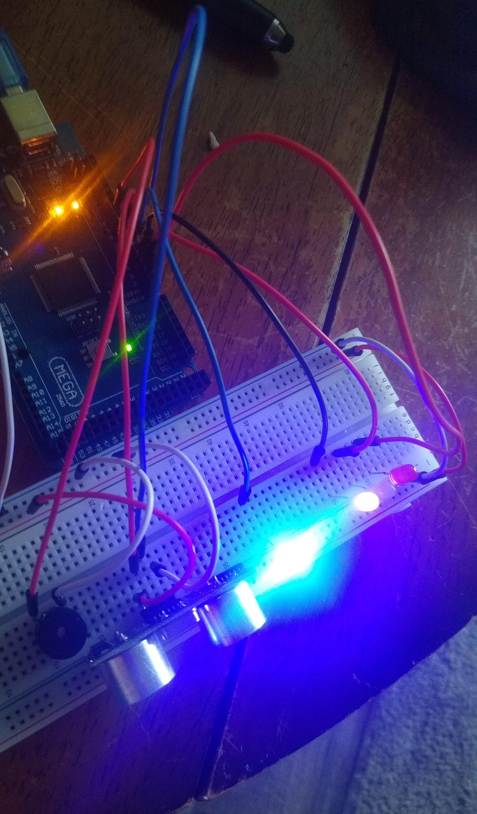
Adding a blue LED and Photoresistor (light sensor)
Adding the light sensor we can see that when theres light the blue LED is off. Covering the photoresistor or darkening the room the blue LED turns on.

Slide 14

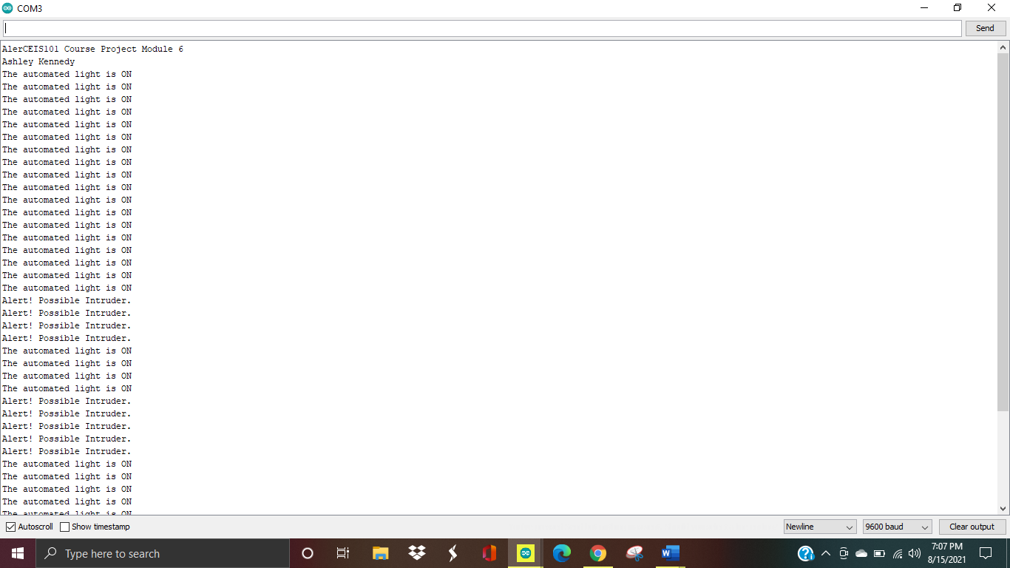
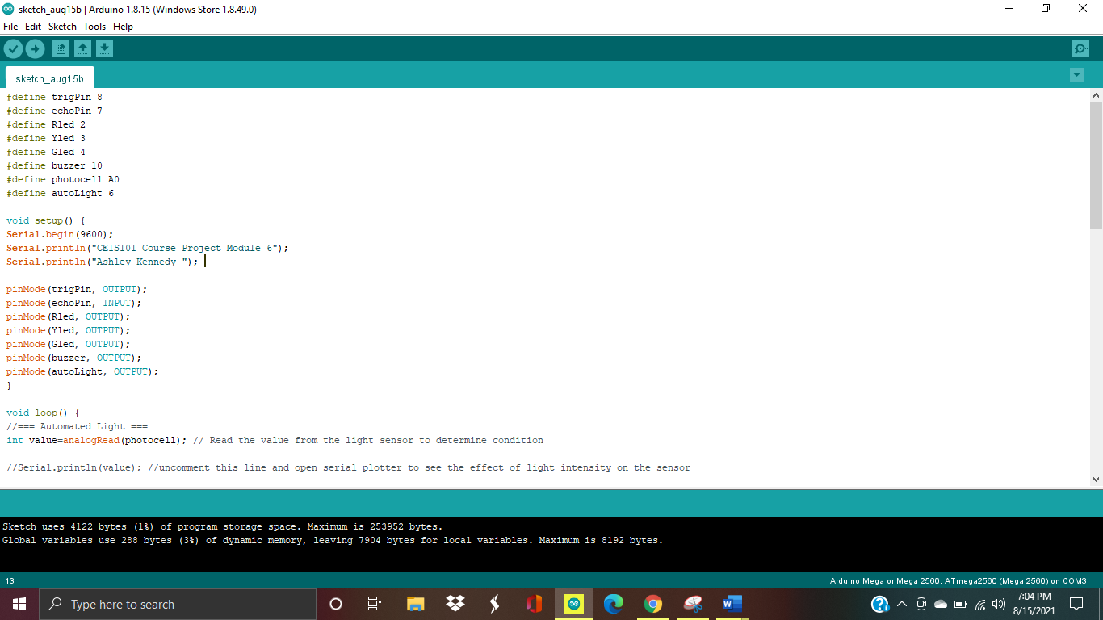
Photo resistor C++ code and Serial Monitoring
The serial monitor shows us the data of the light being on and off. When you decrease the light around the photoresistor and when you increase it. The monitor also is showing you the data of the distance sensor going off. As a "security Alert".
This Photo by Unknown author is licensed under CC BY.

Slide 15
Project Challenges
Not having long enough wires
Troubleshooting when sensors and LED's aren't working
Learning all new information

Slide 16

Career Skills
C++ language coding
Working in a virtual environment
Following instructions
Trouble shooting
Building an IoT device
Familiar with sensors and circuits
Data analysis
Working with censor components and wiring circuits
Arduino

Slide 17

Conclusion
At the beginning of this project I had a lot of anxiety. Working with components and circuits was unfamiliar to me. I gradually learned what each sensor does and the project came together so smoothley for me. I ran into a few troubleshooting problems but, they were easily fixed. Learning how to troubleshoot and understanding what each component does and what it needs to function helped so much. I have definitely taken an interest in prototyping and assembling hardware. I look forward to using these new skill and this new found knowledge in my future career.
This Photo by Unknown author is licensed under CC BY.

