Slide 1

Applied Physics 204
Course Project
DeVry University
Professor- Susan Tabbaa Nachawati, Ph.D
Ashley Kennedy
April/2022

Slide 2
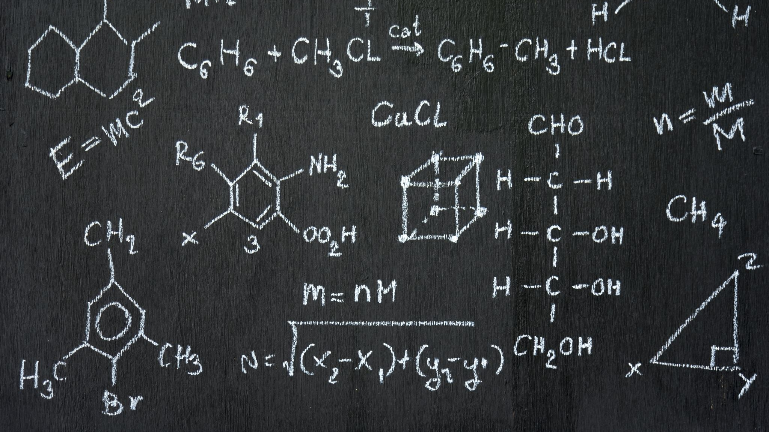
Introduction
Materials used
Precision of ultrasonic sensor
Gravitational acceleration of free falling objects
Conservation of energy from free falling objects
Rotational Motion
Hall Effect

Slide 3
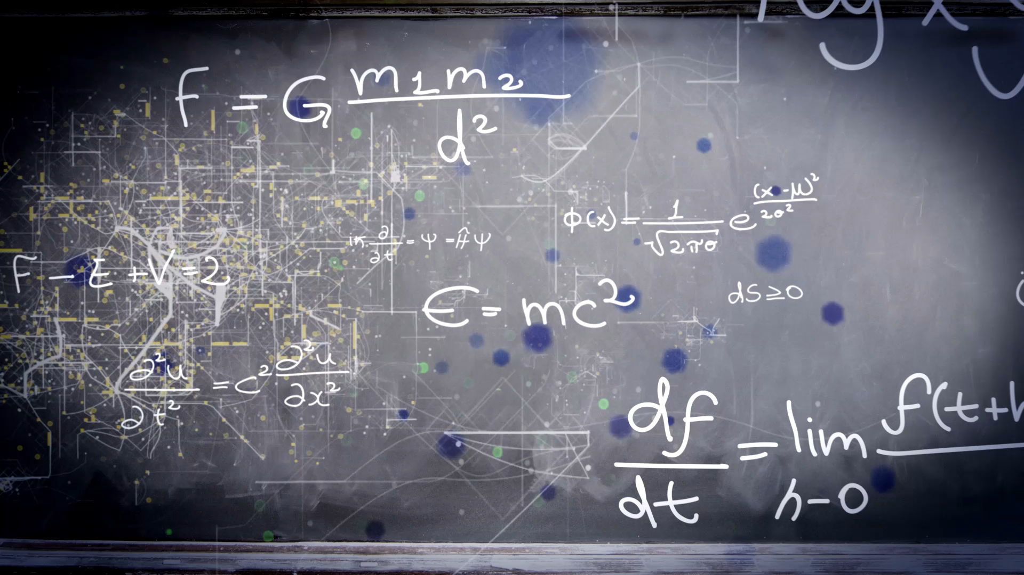
PHYS204
Project Part 1
Materials List

Slide 4
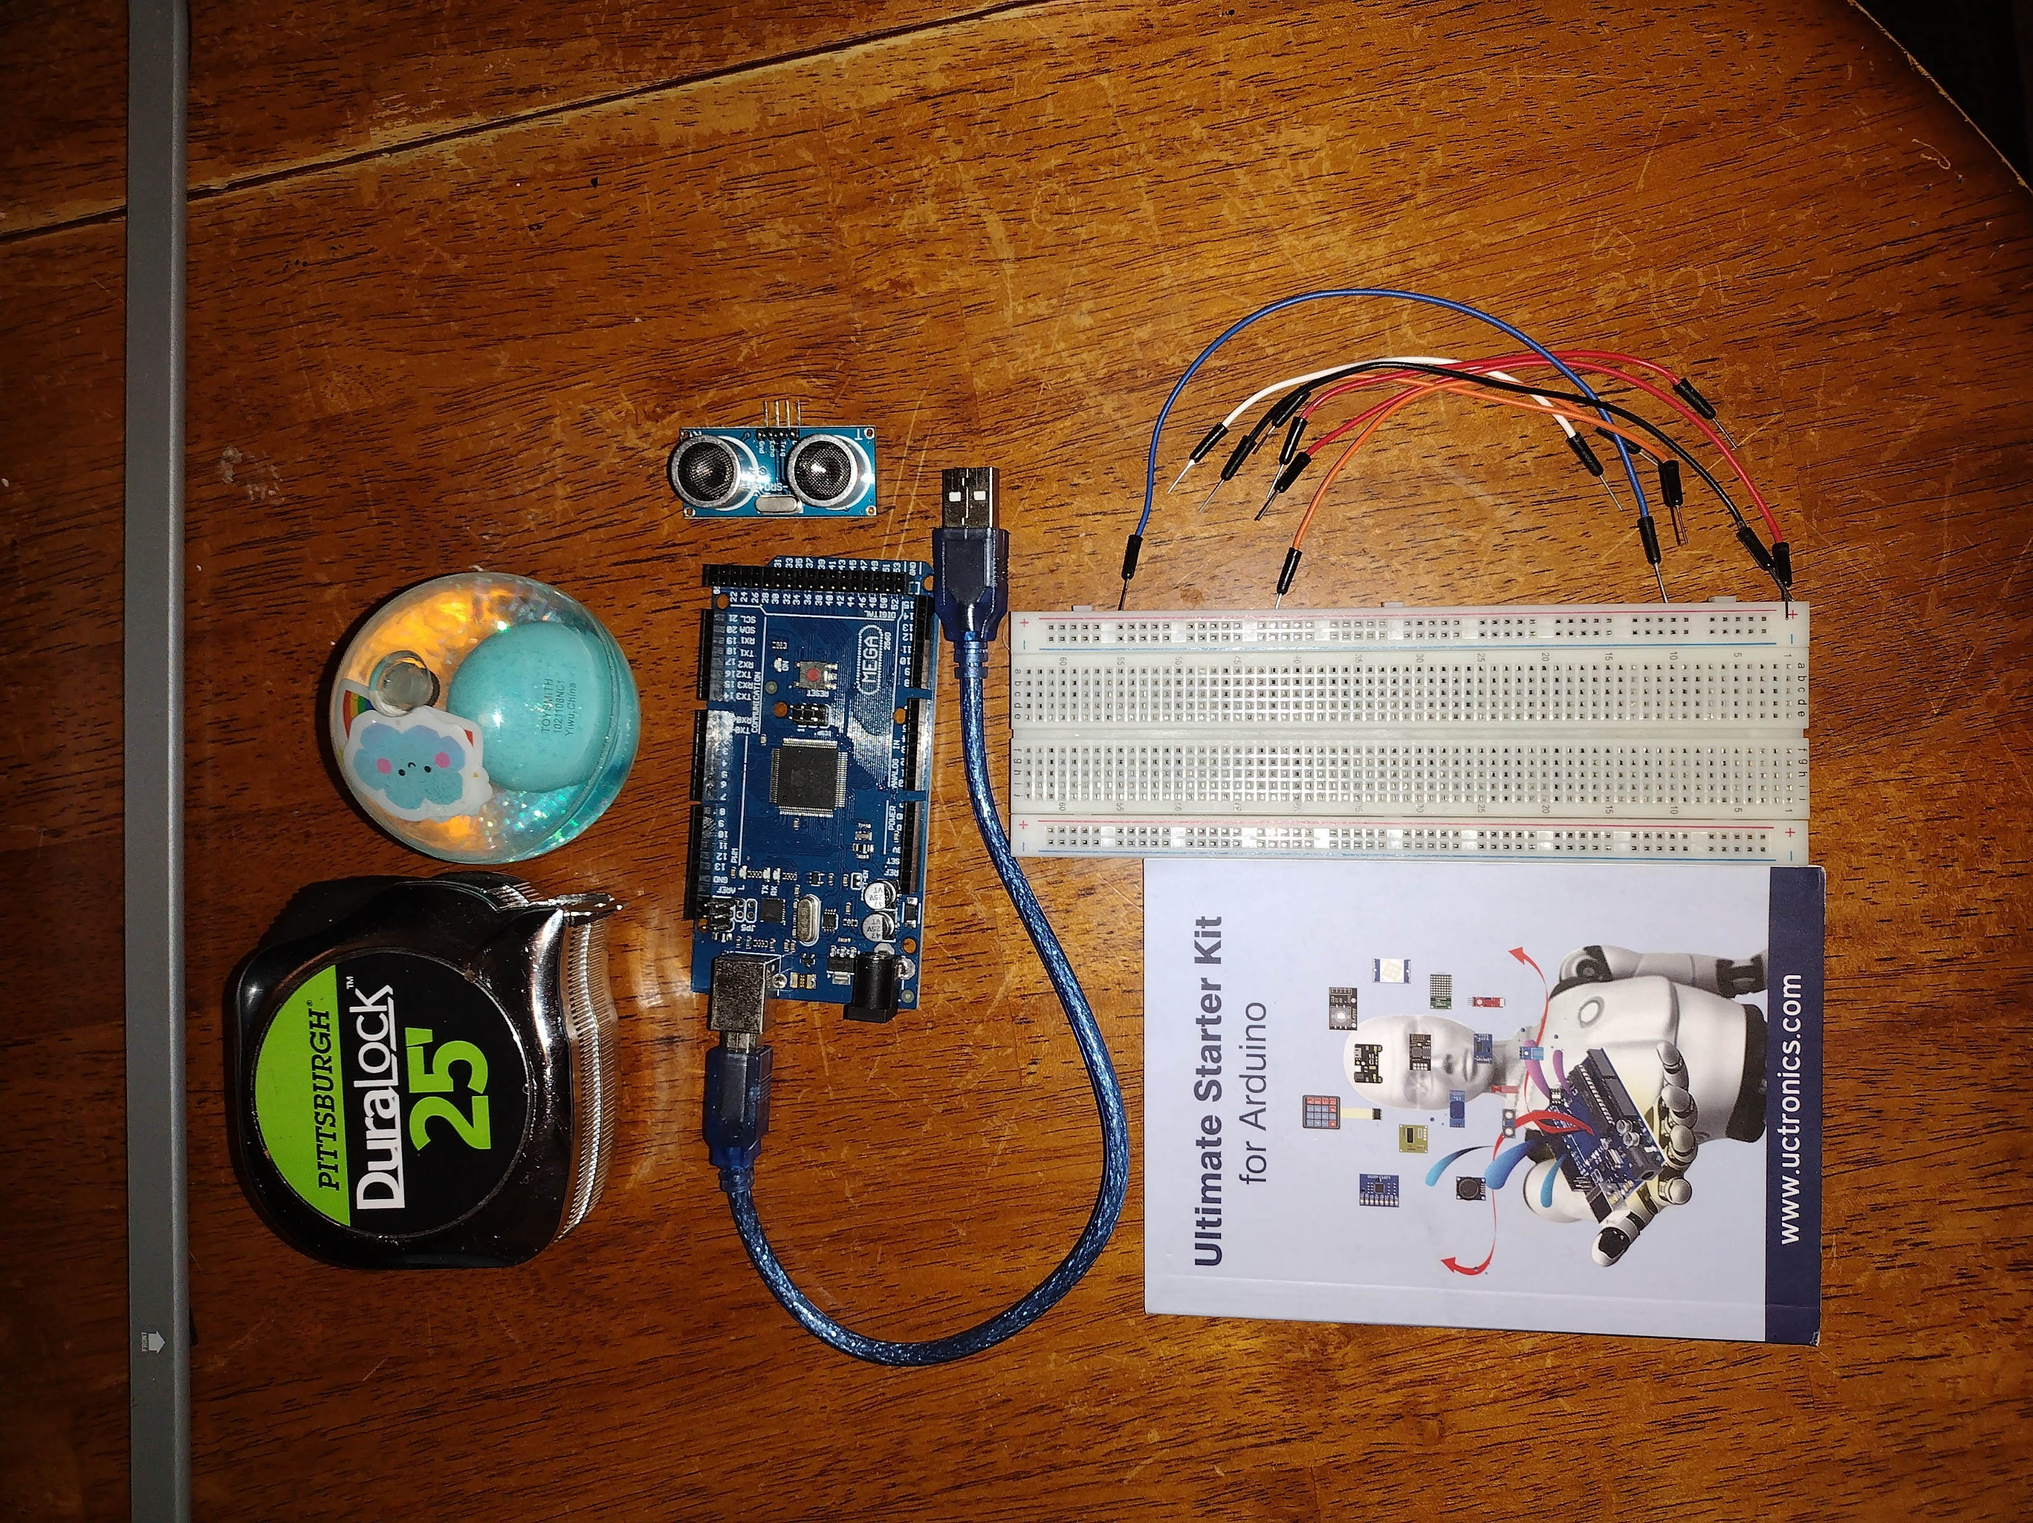
Materials List (Picture)
Mega 2560 Board
Ultrasonic sensor HC-SR04
Male to Male Wires
Breadboard
USB cable
Ruler or tape measurer
Object to act as obstacle and/or undergo free-fall

Slide 5
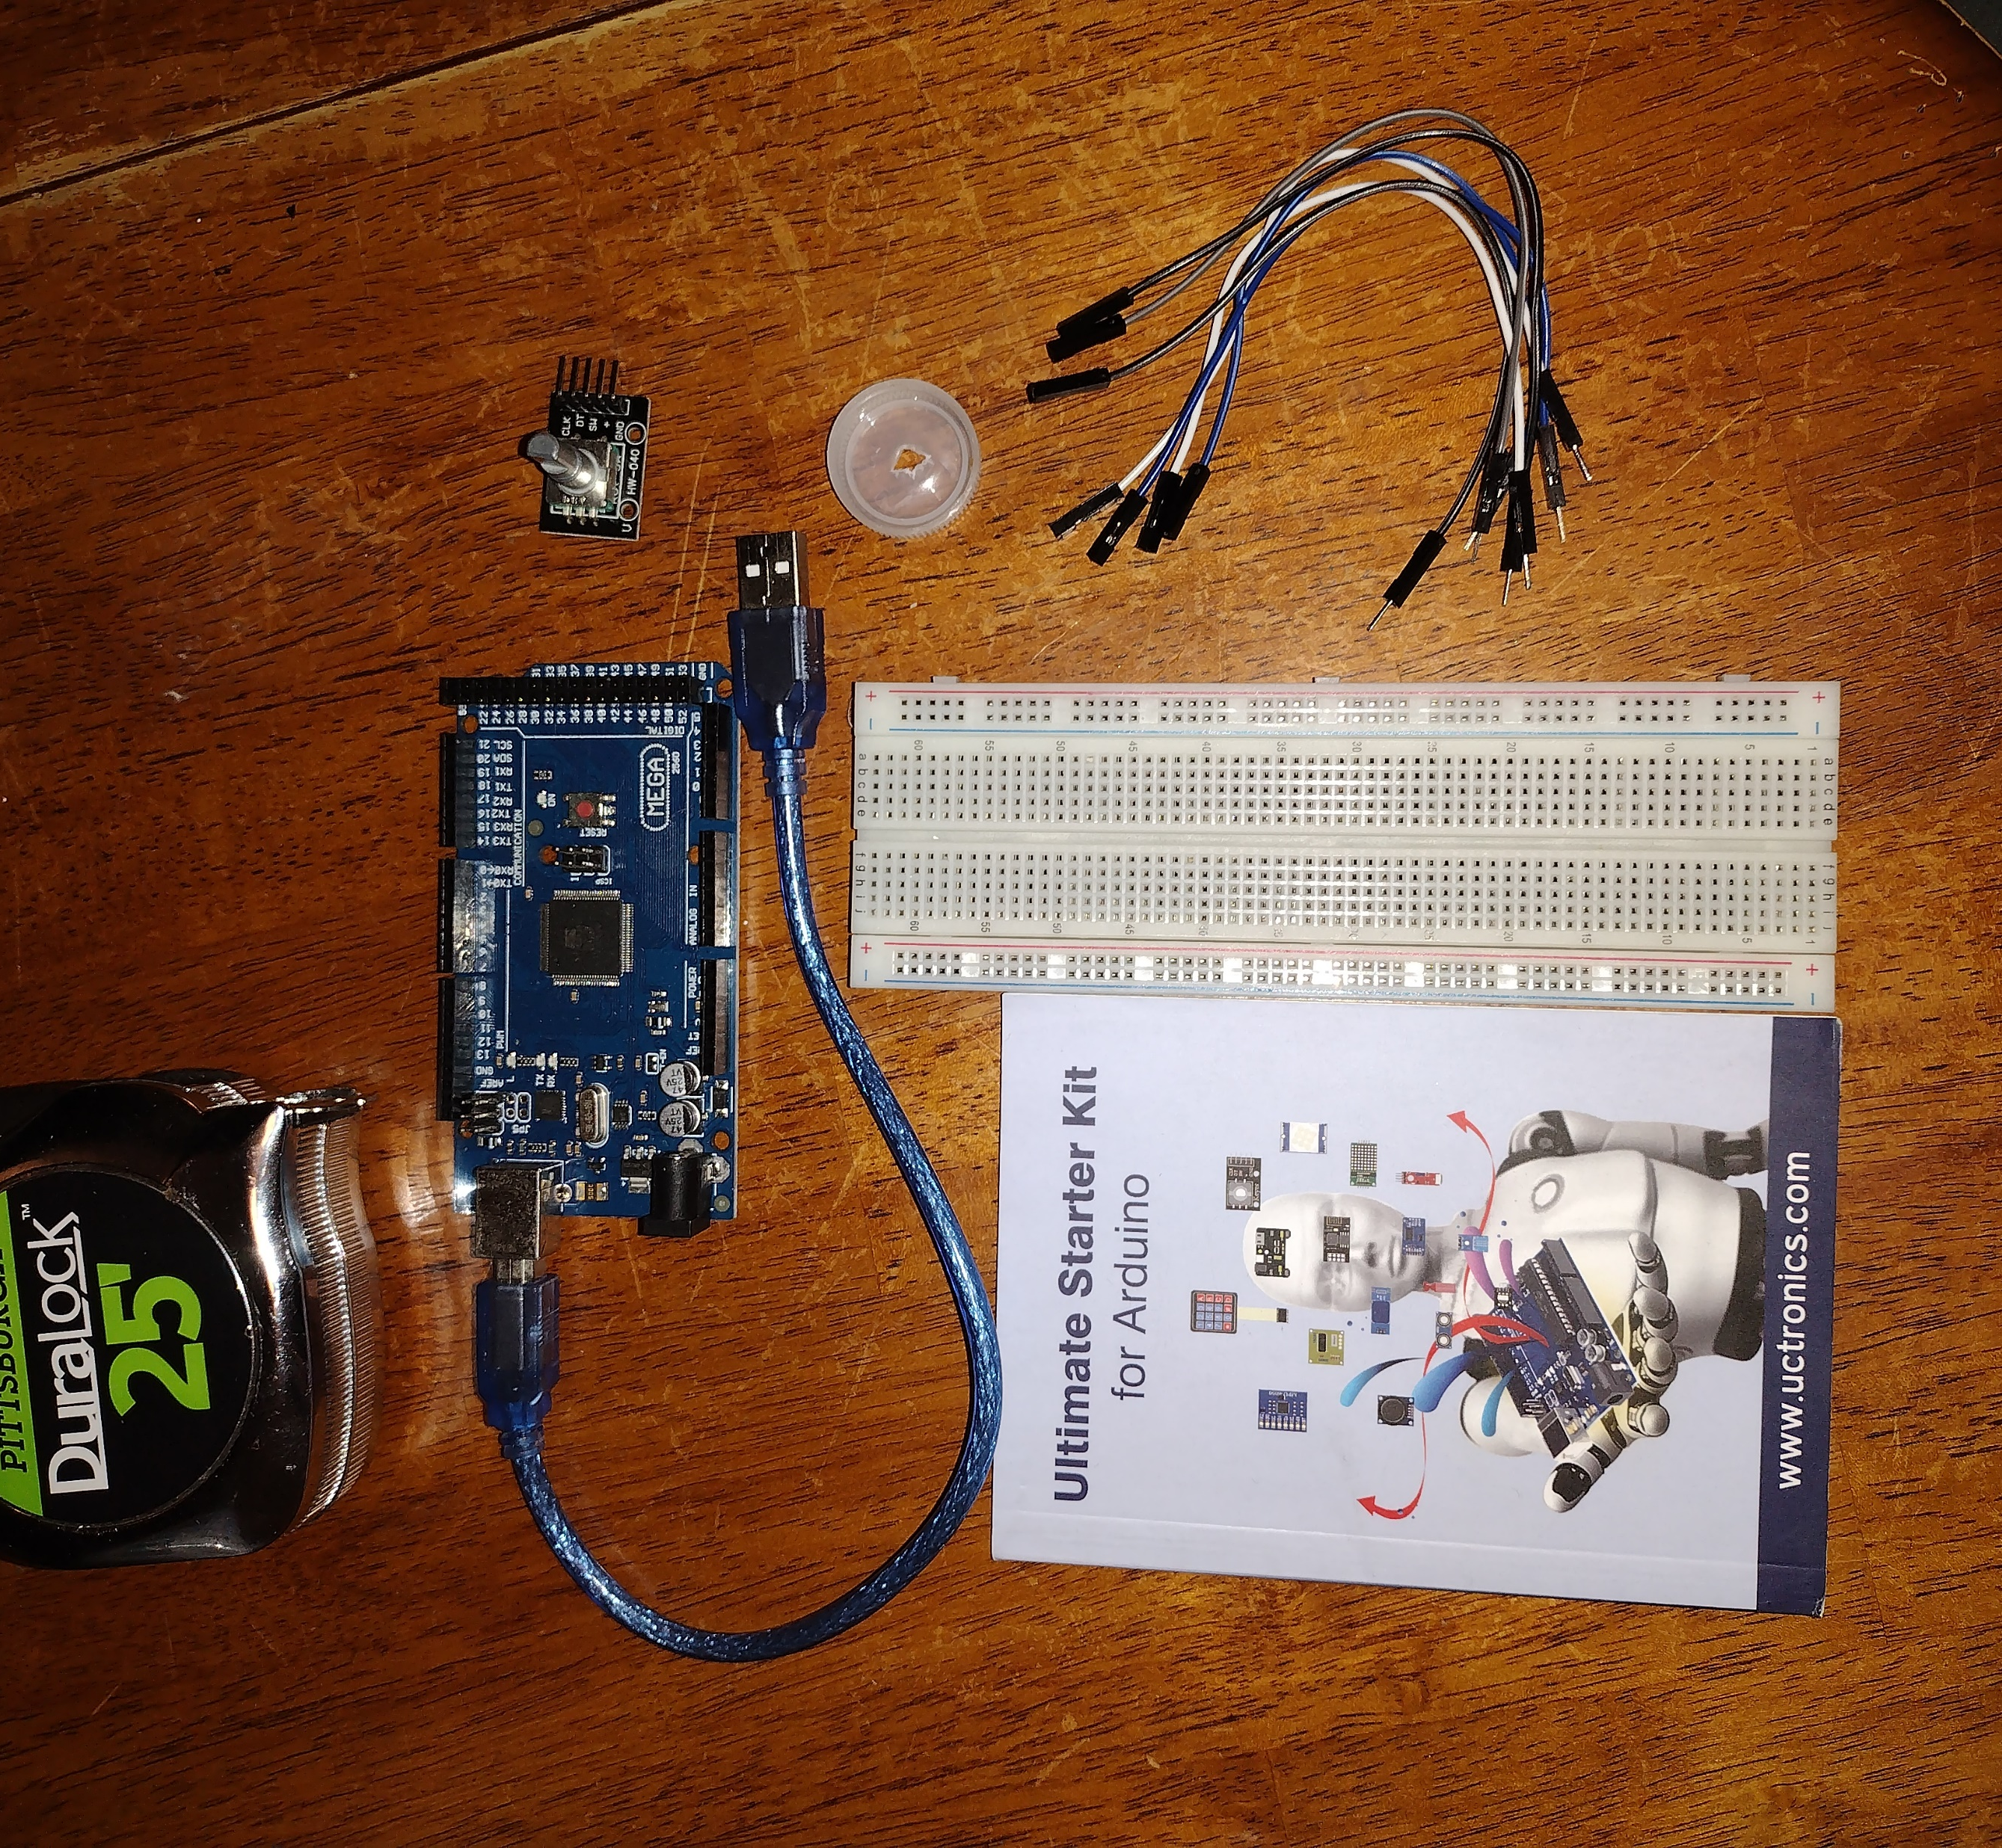
Materials List (Picture)
Mega 2560 Board
Rotary Encoder Part KY-040
Male to Female Wires
USB cable
Object to attach onto rotary encoder
Ruler or tape measurer

Slide 6
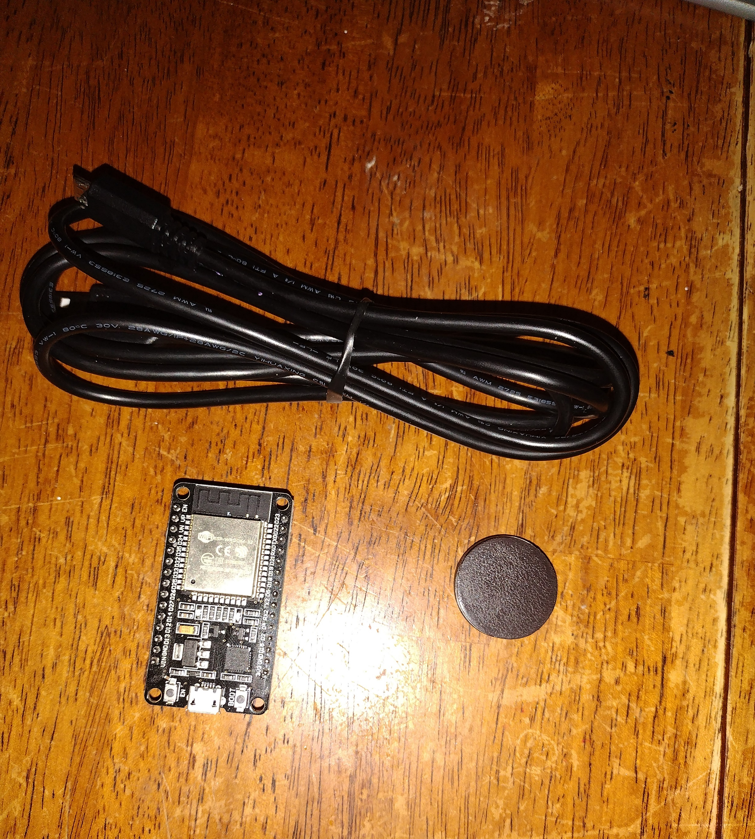
Materials List (Picture)
ESP32 microprocessor
Micro-USB to USB cable
Magnet

Slide 7

Required Software
(screenshot)
Microsoft Excel installed and running on your computer

Slide 8
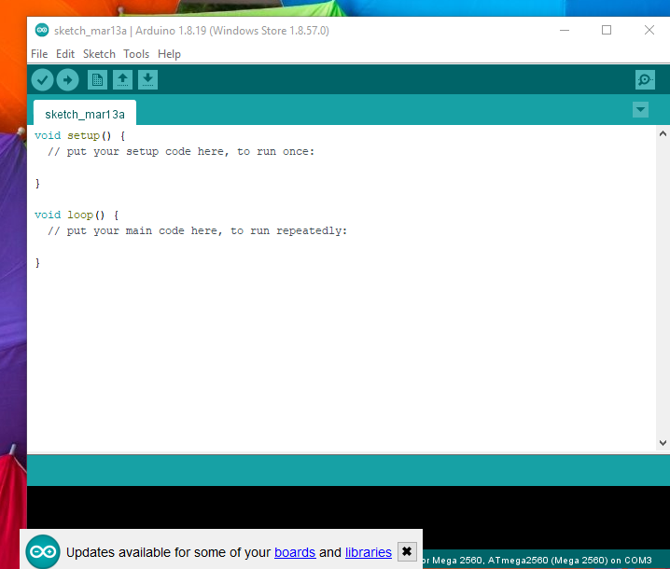
Required Software
(screenshot)
Arduino IDE installed and running on your computer

Slide 9
PHYS204
Project Part 2
Precision of the Ultrasonic Sensor

Slide 10
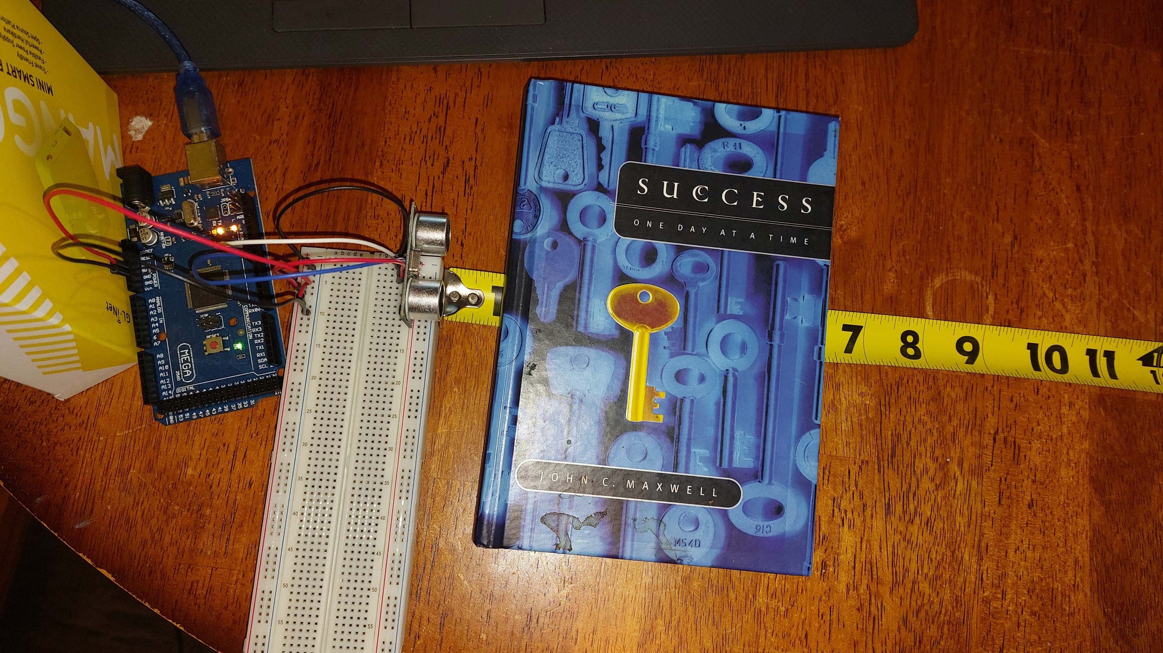
Experimental Set-up (Picture)
Materials List:
Mega 2560 Board
Ultrasonic sensor HC-SR04
Male to Male Wires
Breadboard
Ruler or tape measurer
Object to act as obstacle

Slide 11
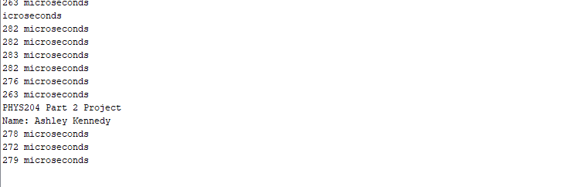
Raw Data (Screenshot)
Screenshot of Serial Monitor from Arduino IDE showing raw data.
Must include your name displayed in the serial monitor.
Make sure “show timestamp” is NOT selected.

Slide 12
Data Collection
Trial | Ruler Distance (cm) | Total Roundtrip Distance (m) | Time from Serial Monitor (microseconds) | Roundtrip time (s) | Velocity = distance/time (m/s)
1 | 2.54 | .05 | 270 | 2.70e-4 | 185
2 | 5.08 | .10 | 347 | 3.47e-4 | 288
3 | 7.62 | .15 | 566 | 5.66e-4 | 265
4 | 10.16 | .20 | 785 | 7.85e-4 | 254
5 | 15.24 | .30 | 1000 | 10.00e-4 | 300

Slide 13
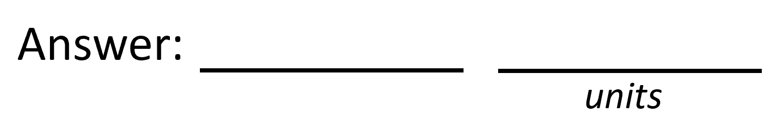

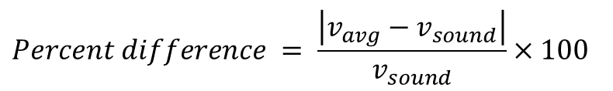

Data Analysis
Average velocity from table
Percent difference where $v_{sound}=343 m/s$
$$v_{avg}= \frac{v_{1}+v_{2}+v_{3}+v_{4}+v_{5}}{5}$$
258
m/s
$$Percent difference = \frac{\left|v_{avg}−v_{sound}\right|}{v_{sound}}×100$$
25%
m/s

Slide 14
Conclusions
Discuss the results and comment on the source of errors.
  Answer: I had the percentage because I didn’t multiply the distance by 2 for the round trip. I ran into issues with the percent difference and re-ran the numbers multiple times. I still don’t feel 100% right about the 25% difference and I’m confused how the Velocity can fluctuate down at greater distances and speeds and then also go back up.
What is the dependence of temperature, humidity, and atmospheric pressure on the speed of sound? How does it affect the results?
  Answer: Pressure and humidity don’t have a huge effect on speed of sound. Heat is a form of kinetic energy just like sound thus it causes sound to travel faster.

Slide 15
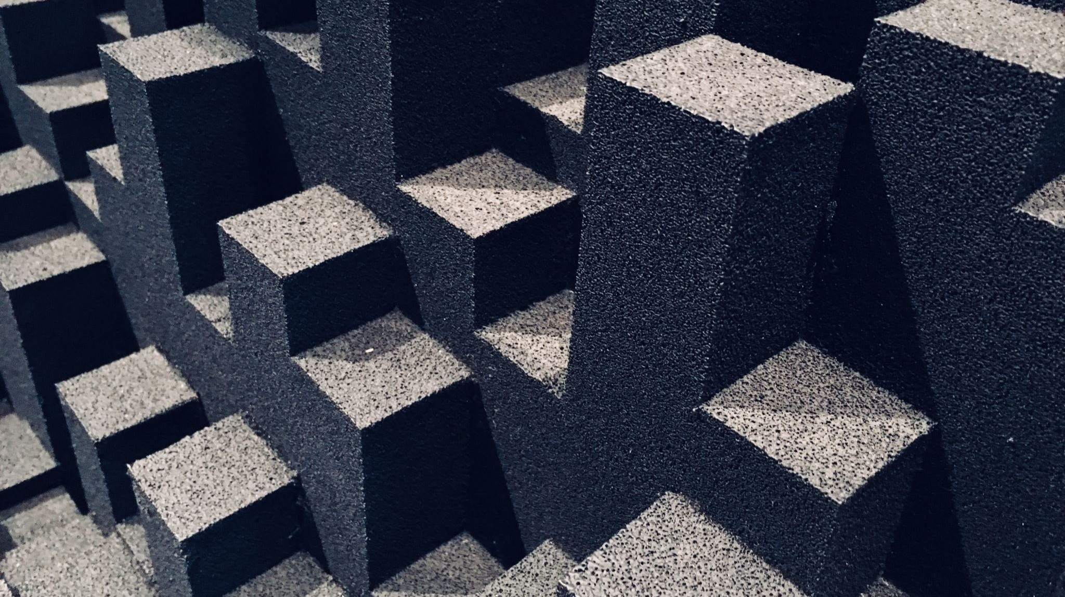
PHYS204
Project Part 3
Gravitational Acceleration of Free Falling Object

Slide 16
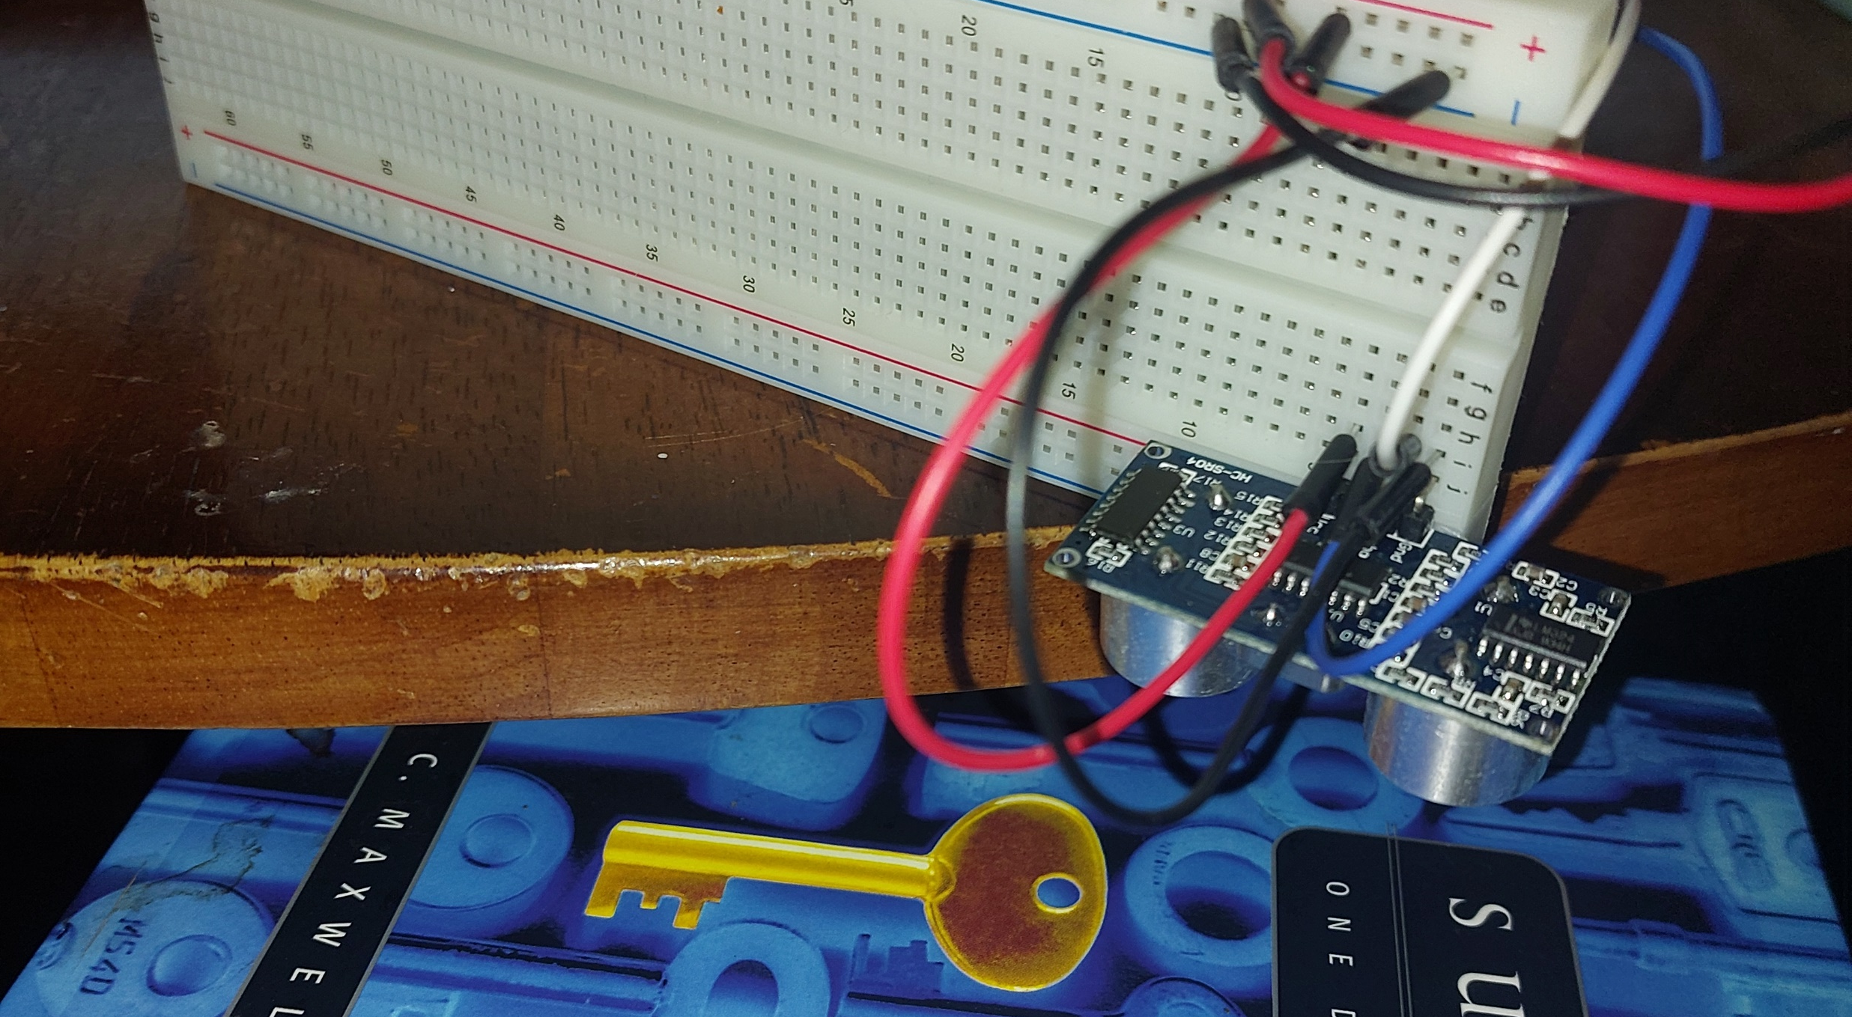
Experimental Set-up (Picture)
Materials List:
Mega 2560 Board
Ultrasonic sensor HC-SR04
Male to Male Wires
Breadboard
Object to undergo free fall motion

Slide 17
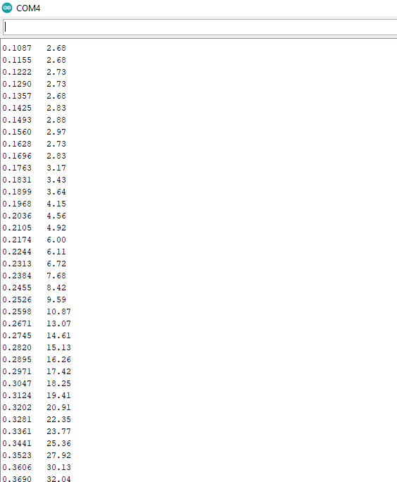
Serial Monitor (Screenshot)
Include screenshot of raw data showing the start of the fall and end of the fall of one trial.
Must include your name displayed in the serial monitor.
Make sure “show timestamp” is NOT selected.

Slide 18
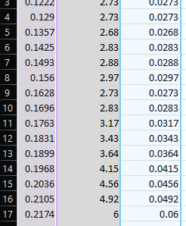
Excel Table
(Screenshot)
Include all values in the Excel table for a single trial showing the fall distance in centimeters and meters as a function of time

Slide 19
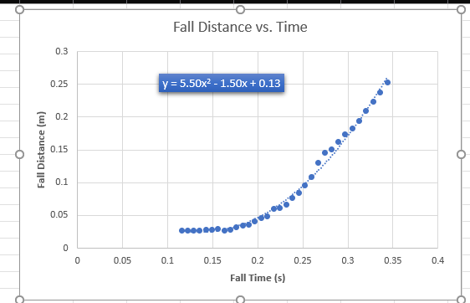
Excel Graph
(Screenshot)
Include Excel graph for a single trial showing the fall distance as a function of time.
Must include equation for curve fitting.

Slide 20
Data Collection
Trial | x² coefficient value from curve fitting | Acceleration (m/s²) = 2* (x² coefficient)
1 | 5.50 | 11 m/s²
2 | 3.98 | 7.96 m/s²
3 | 3.40 | 6.80 m/s²
4 | 4.51 | 9.02 m/s²
5 | 3.34 | 6.68 m/s²

Slide 21

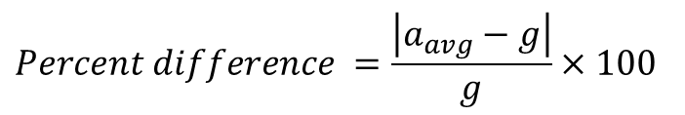
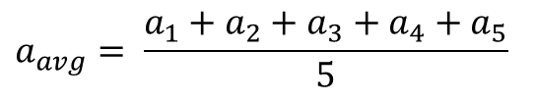
Data Analysis
Average acceleration from table
Percent difference with $g=9.8 m/s^{2}$
$$a_{avg}= \frac{a_{1}+a_{2}+a_{3}+a_{4}+a_{5}}{5}$$
8.29
m/s²
$$Percent difference =\frac{\left|a_{avg}−g\right|}{g}×100$$
15.4%
m/s²

Slide 22
Conclusions
Discuss the results and comment on the source of errors.
  Answer: Didn’t really have any errors. Hardest part was the trials and getting a clear reading.
How much variation is there from trial to trial? What does this indicate about the uncertainty of the result?
  Answer: Wide range of variation at about 15.4% Such variations could deem tests and trials unreliable as its quite the deviation.

Slide 23
PHYS204
Project Part 4
Conservation of Energy of Free Falling Object

Slide 24
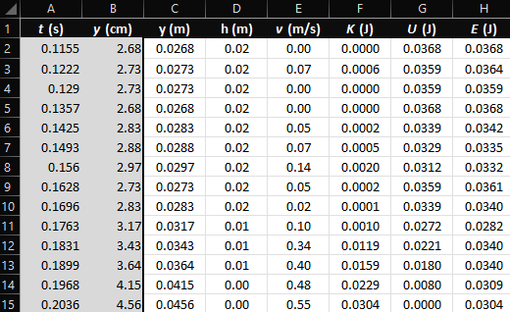
Excel Table
(Screenshot)
Include all values in the Excel table for a single trial showing the fall distance in centimeters and meters as a function of time with the values generated for kinetic energy K, potential energy U, and total mechanical energy E.

Slide 25
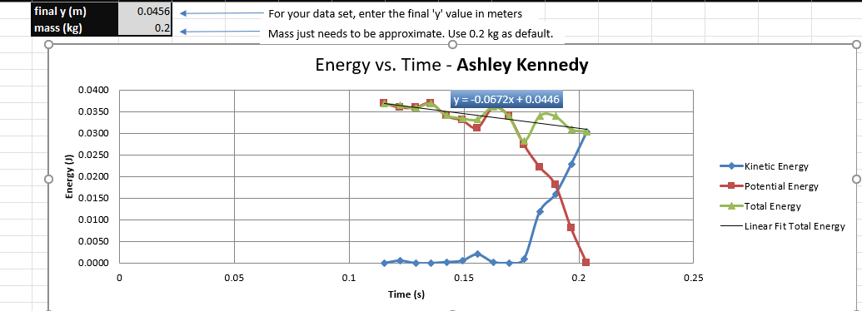
Excel Graph
(Screenshot)
Include Excel graph for a single trial showing the plots of the kinetic energy K, potential energy U, and total mechanical energy E as a function of time.
Must include your name in the title of the graph.

Slide 26

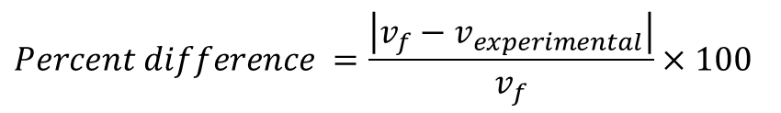


Data Validation
Theoretical value of final velocity
Final velocity from experimental data (or largest velocity)
Percent difference
$h=y_{final}−y_{initial}=$
0.0188
m
$v_{f}=\sqrt{2gh}=$
0.61
m/s
$v_{experimental}$ =
0.55
m/s
$$Percent difference =\frac{\left|v_{f}−v_{experimental}\right|}{v_{f}}×100$$
9.8%

Slide 27
Conclusions
Discuss the key characteristics of the plot. Consider the times when potential energy U is max, U is min, kinetic energy K is max, K is min, and when U and K are the same value. What is the significance of these points?
  Answer: Potential energy is at its max at the beginning and Kinetic anergy rises and reaches its max at value at the end of the trial.

Slide 28
Conclusions
What is the trend of the best fit line for the total energy E in your data? If the data is accurate, the total mechanical energy should decrease slightly. Why is that?
  Answer: I believe the total mechanical energy decreases due to forces of gravity and outside forces such as air.

Slide 29
PHYS204
Project Part 5
Rotational Motion

Slide 30
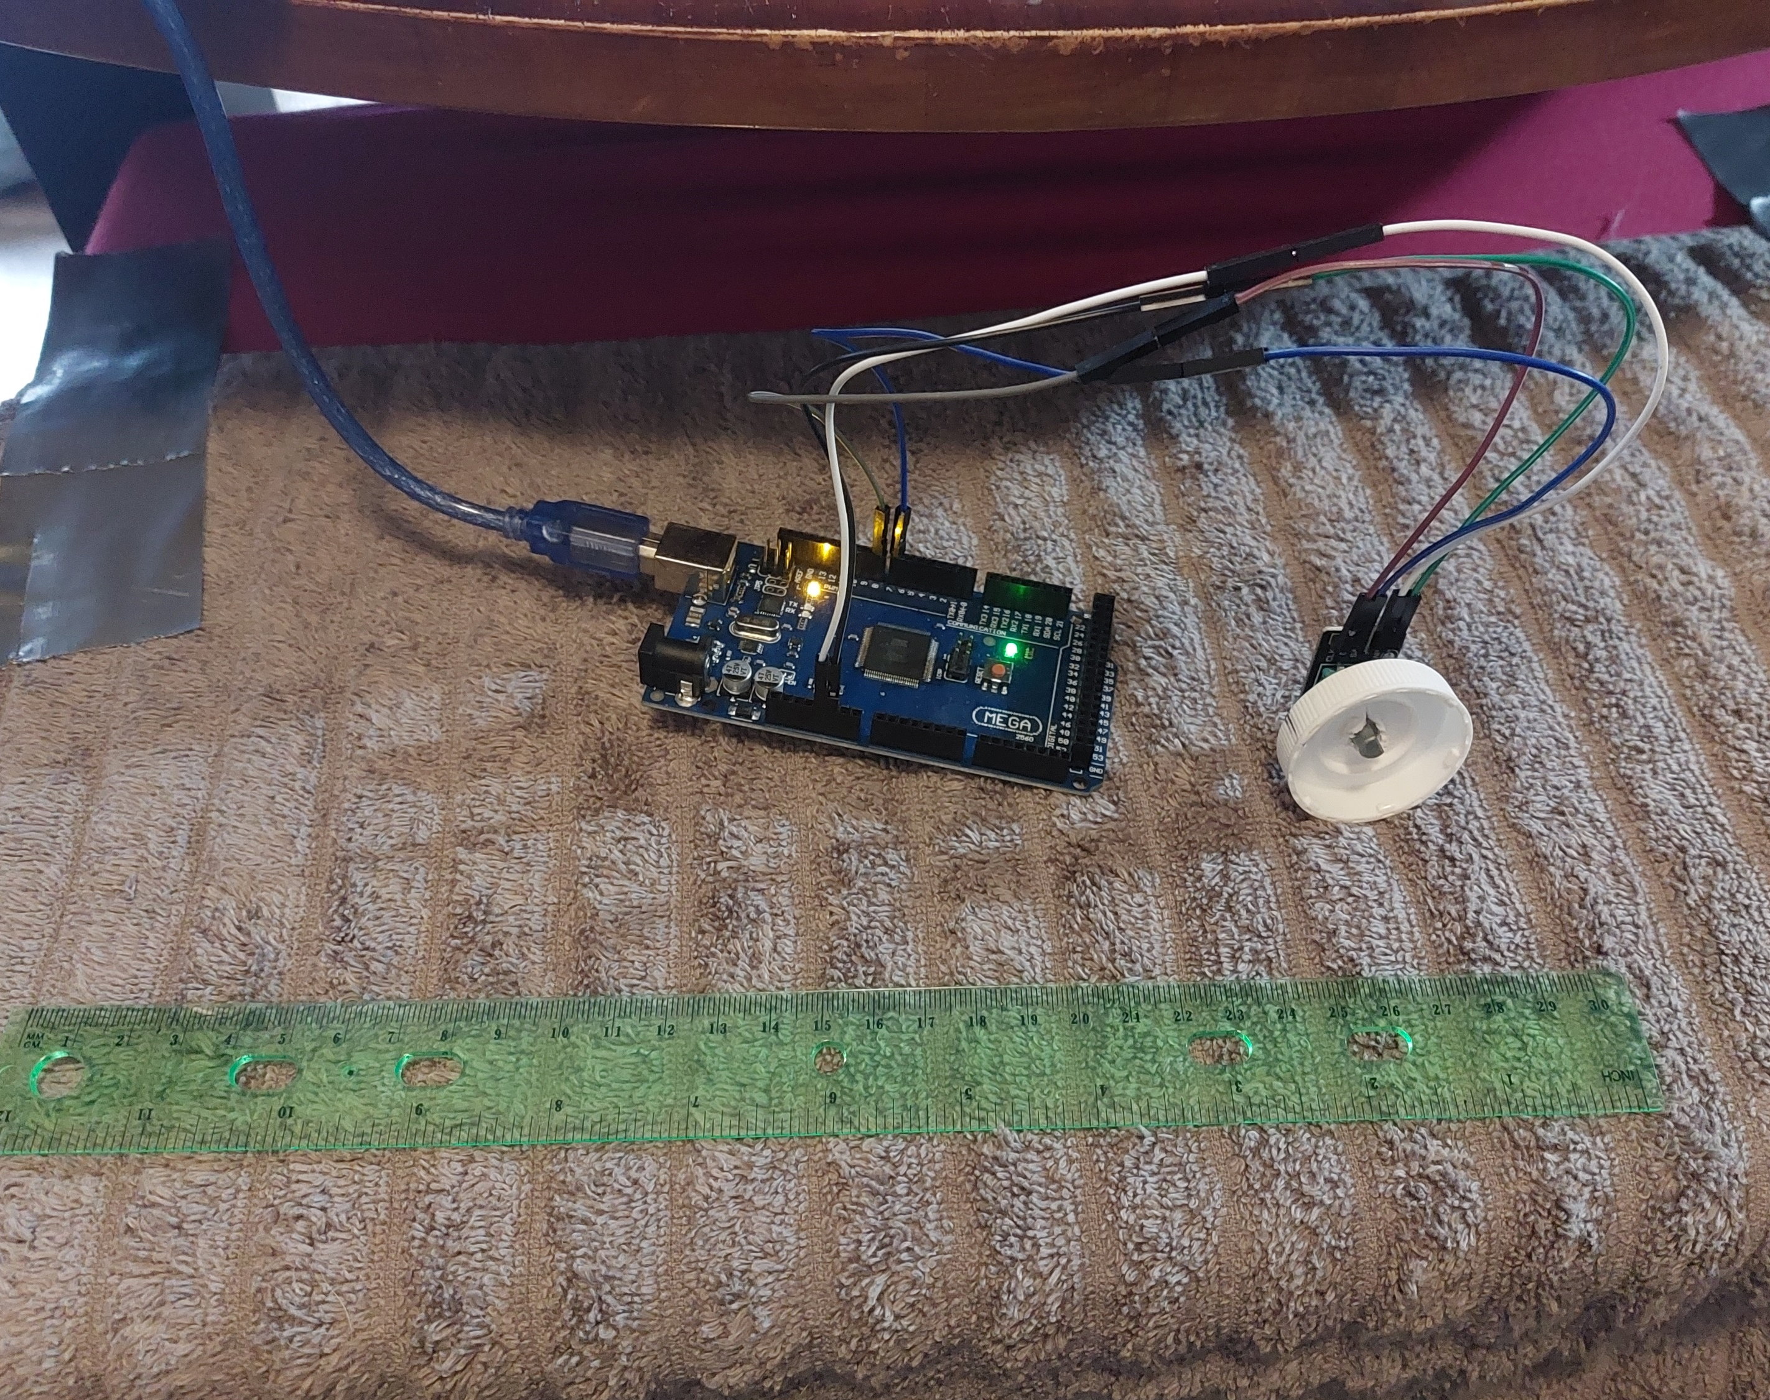
Experimental Set-up (Picture)
Materials List:
Mega 2560 Board
Rotary Encoder Part KY-040
Male to Female Wires
Object to attach onto rotary encoder
(e.g. cork, bottle cap, ball)
Ruler or tape measurer

Slide 31
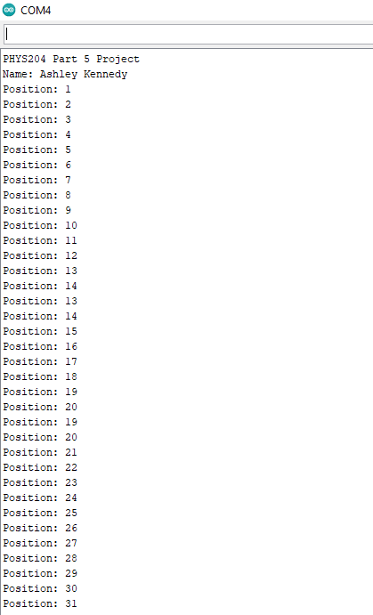
Raw Data (Screenshot)
Screenshot of Serial Monitor from Arduino IDE showing raw data.
Must include your name displayed in the serial monitor.

Slide 32
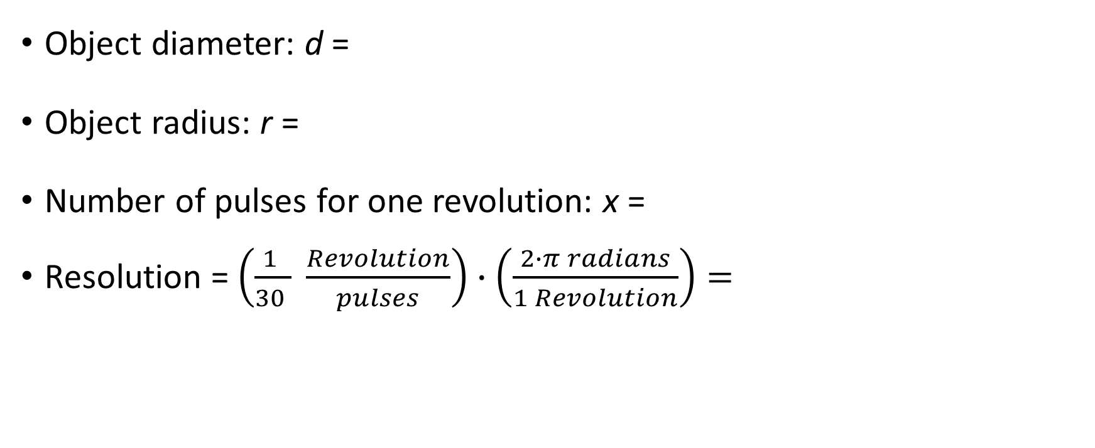
Data Collection
Object diameter: d =
Object radius: r =
Number of pulses for one revolution: x =
Resolution = $\left(\frac{1 }{30 } \frac{Revolution}{pulses}\right)∙\left(\frac{2∙π radians}{1 Revolution}\right)=$
3.9
cm
1.95
cm
30
0.209
Radians/pulse

Slide 33
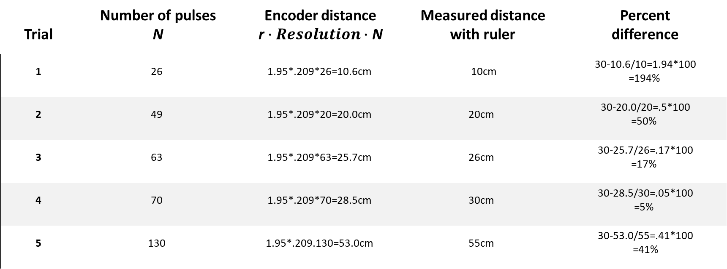
Data Analysis
Trial | Number of pulses N | Encoder distance r$∙Resolution∙$ N | Measured distance with ruler | Percent difference
1 | 26 | 1.95*.209*26=10.6cm | 10cm | 30-10.6/10=1.94*100 =194%
2 | 49 | 1.95*.209*20=20.0cm | 20cm | 30-20.0/20=.5*100 =50%
3 | 63 | 1.95*.209*63=25.7cm | 26cm | 30-25.7/26=.17*100 =17%
4 | 70 | 1.95*.209*70=28.5cm | 30cm | 30-28.5/30=.05*100 =5%
5 | 130 | 1.95*.209.130=53.0cm | 55cm | 30-53.0/55=.41*100 =41%

Slide 34
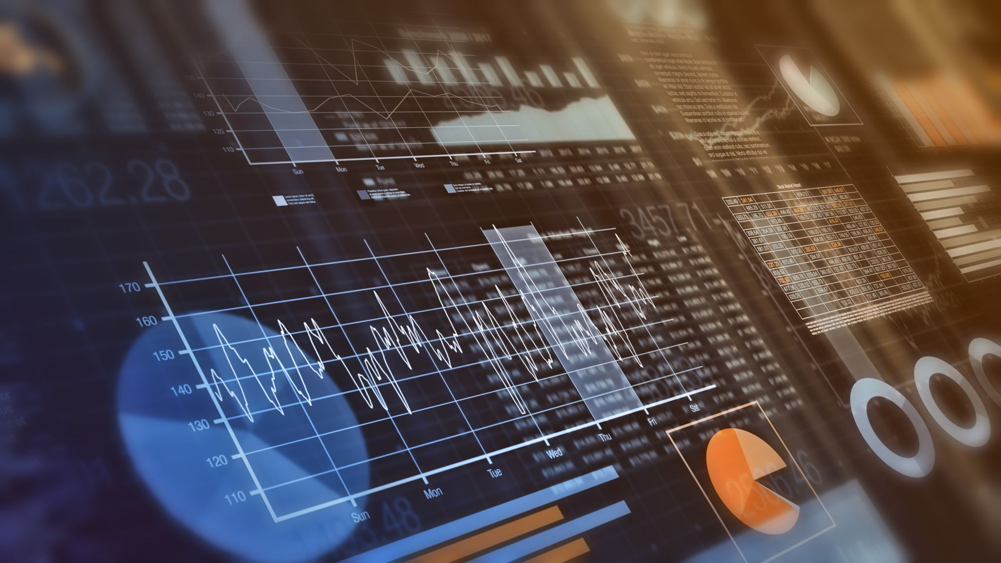
Conclusions
Discuss the results and comment on the sources of error.
  Answer: The % differences seem to have dramatic differences within the experiment noted in the table of the previous slide.
  The rotary sensor slides and it could take several tries to get an accurate reading.
What are some applications of this measuring technique? Could this measuring system be used to measure surfaces that are not flat?
  Answer: I find that this measuring technique isn’t great for measuring even flat surfaces as the size and texture of the object used makes a huge difference in the rotary sensor being reliable and getting functional results. I don’t believe this specific technique with these tools would be any better for non flat surfaces.

Slide 35

PHYS204
Project Part 6
Hall Effect

Slide 36
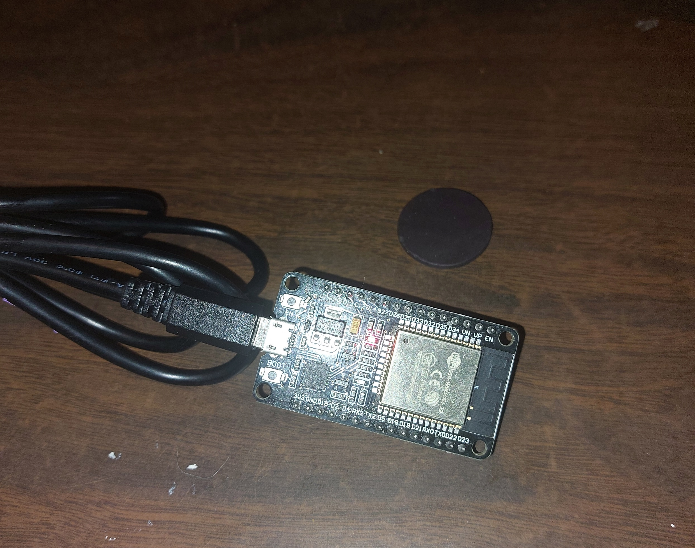
Experimental Set-up (Picture)
Materials List:
ESP32 microprocessor
Micro-USB cable
Magnet

Slide 37
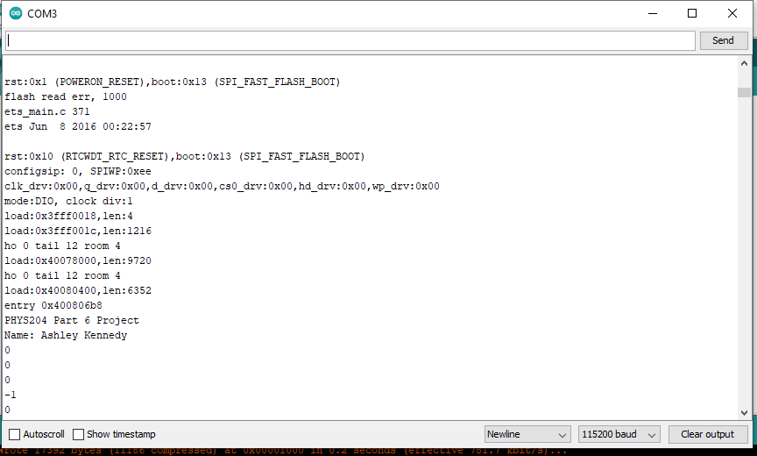
Raw Data (Screenshot)
Screenshot of Serial Monitor from Arduino IDE showing raw data.
Must include your name displayed in the Serial Monitor.
Press EN button to display name.
Unselect “Autoscroll” and scroll all the way up.

Slide 38
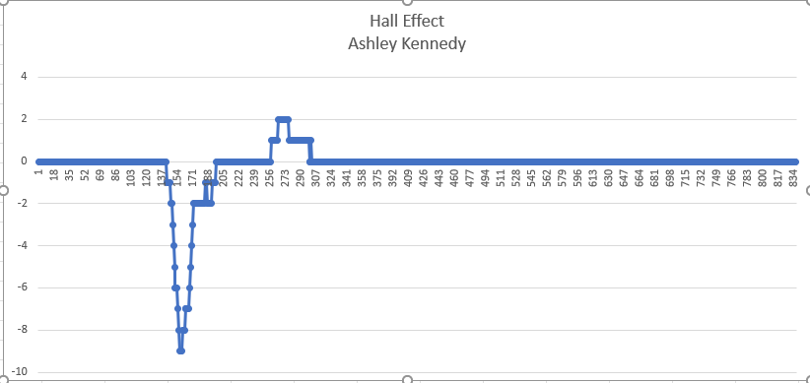
Data Analysis (Screenshot)
Screenshot data plotted in Excel.

Slide 39
Conclusions
Discuss the results and comment on the sources of error.
  Answer: I didn’t have access to a magnet with a stronger force and at times even flipping the magnet didn’t give me an opposite reaction in the serial monitor.
Describe how the Hall sensor works. What are some applications for the Hall effect sensor?
  Answer:” ESP32 microprocessor to measure the proportional voltage under the effect of a magnetic field. The hall effect sensor is located behind the metal lid of the ESP32 chip. The measurements from the sensor can increase or become negative depending on the magnet pole facing the sensor.”-course module Template

Slide 40
Challenges Throughout Project
Percent difference was confusing and hard to convert for me due to large discrepancies in the sensors.
Sensors were unstable causing larger fluctuation in the data
Getting clear readings with sensors and having to do multiple trial runs to get clean figures for the data analysis
Rotary sensor was difficult to use finding the perfect object to attach and a surface with enough traction was a huge challenge in getting that sensor to work properly for testing.

Slide 41

Career skills Obtained from Project
Patience
Broader understanding of Applied Physics
Experience with Sensors wiring and coding
Creating spreadsheets and graphs in Excel
Producing and crafting Power Points
Following instructions
Recording Data

Slide 42
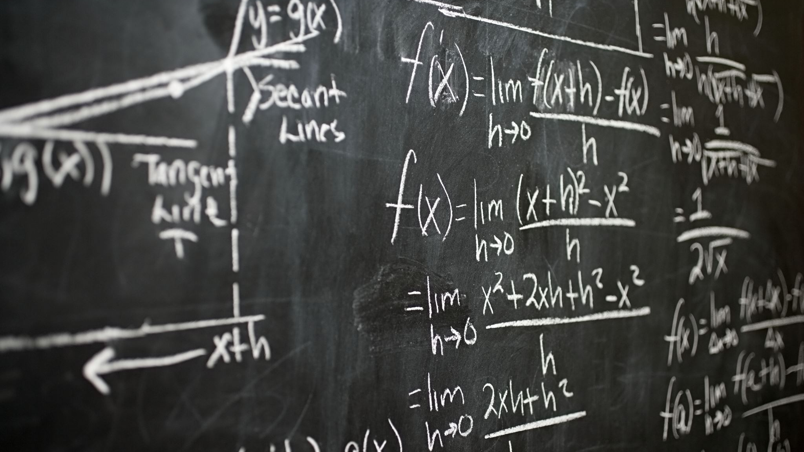
The End

