Slide 1

SEC 290 Fundamentals Of Infrastructure Security
Ashley Kennedy
Sec 290
Professor Scott
DeVry University
April 2024

Slide 2

Contents:
Intrusion Analysis using Wireshark
Basic attack analysis
Open SSL
Creating and testing an SSL/TLS file
Snort
Testing and Creating Snort rules
Memory Analysis
Linux Processes, Process hacker and Process monitor
Firewalls
Time based access

Slide 3
Course Project
SEC290
Fundamentals of Infrastructure Security
Module 2 Intrusion Analysis using Wireshark

Slide 4
Basic attack analysis
1. Look at captures no. 20 and 22. (You can use the “Go” link at the top of the Wireshark screen to quickly go to a specific capture) Both packets are ICMP traffic but there are subtle differences between them. Compare the time-to-live and data field sizes in the two packets. What differences do you see?
Source and destination of 20 and 22 are different as well as the TTL
20: source 192.168.25.1 destination 192.168.25.50 TTL=64
22: source 192.168.25.50 destination 192.168.25.1 TTL=128
2. Do a little Internet research to discover which operating systems use the specific values in their ping commands.
Linux uses TTL=64 for ICMP this helps prevent infinite looping.
Windows typical TTL default is 128
3. What operating system generated the echo request in capture 20?
The operating system used to generate echo request 20 was a Linux operating system.
4. Review packet no. 37 and beyond, what do you think is taking place here? _A pattern of SYN flags followed by reset and acknowledgement. Denied access to file exchange.
5. What is suspicious about the flag settings for capture 14519
The TCP flags for 14519 were FIN, PSH, URG indicating a termination to an active connection a push flag that asks for data and receiving end buffering data be sent to receiving end process and the urgent flag indicates the receiver process the urgent packs before all other packets.
6. What is the IP of the host being targeted? 192.168.25.50
7. Look at capture 22846. What is suspicious about the flag settings in this packet?
The flag indicates that an active TCP connection was severed indicating no more data coming from the sender.
8. What is the IP address of the host being targeted? 192.168.25.1

Slide 5
Course Project
SEC290
Fundamentals of Infrastructure Security
Module 3 Open SSL

Slide 6
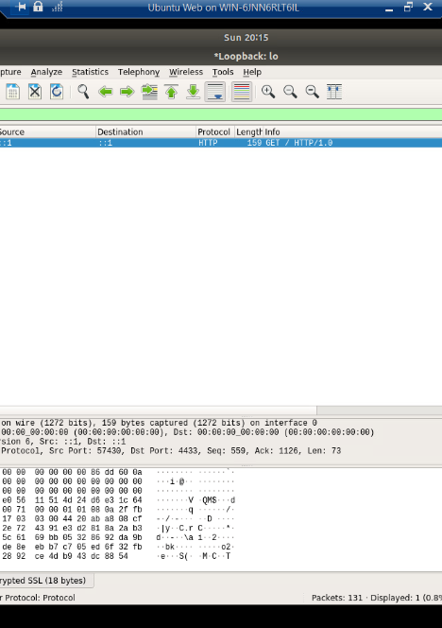
Creating and testing an SSL/TLS file
Take a screenshot of the output in Step 20.
It should show the GET request in the Info column.

Slide 7
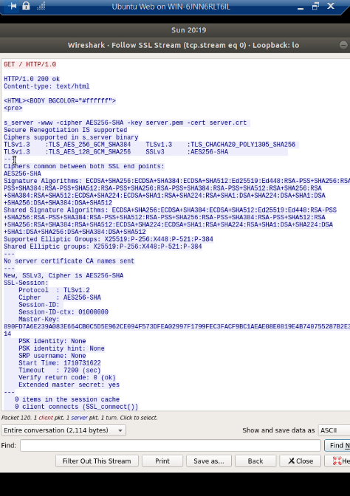
Creating and testing an SSL/TLS file cont’d
Take a screenshot of the output in Step 22.
It should show the decrypted SSL stream.

Slide 8
Course Project
SEC290
Fundamentals of Infrastructure Security
Module 4 Snort

Slide 9
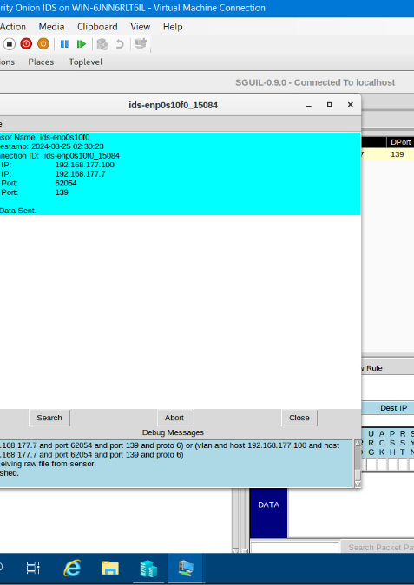
Testing Snort rules
Take a screenshot of the output in Part 1 Step 17.
It should show the transcript of the XMAS scan alert.

Slide 10
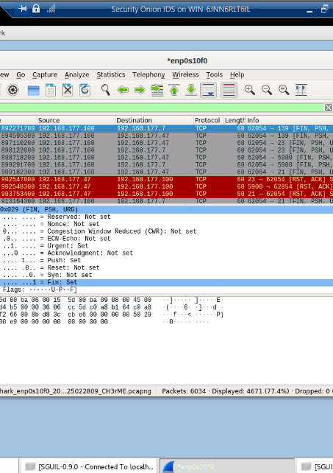
Testing Snort rules cont’d
Take a screenshot of the output in Part 1 Step 20.
It should show the TCP packets generated by the XMAS scan.

Slide 11
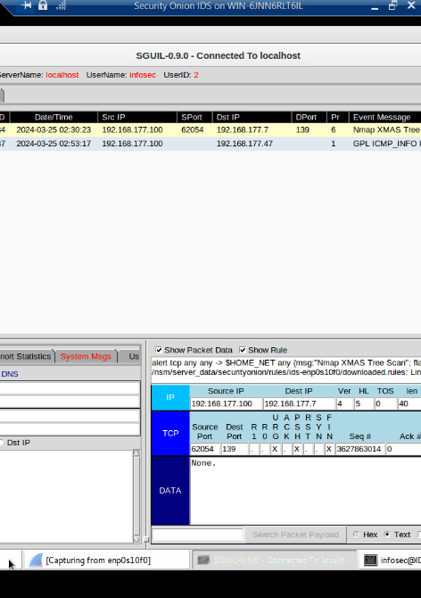
Creating Snort rules
Take a screenshot of the output in Part 2 Step 7.
It should show the ping activity alert.

Slide 12
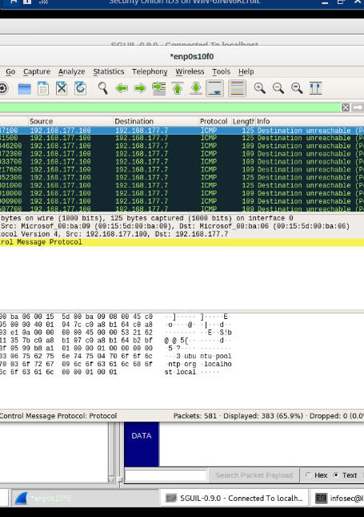
Creating Snort rules cont’d
Take a screenshot of the output in Part 2 Step 8.
It should show the ICMP packets generated by the ping activity.

Slide 13
Course Project
SEC290
Fundamentals of Infrastructure Security
Module 5 Live Memory Analysis

Slide 14
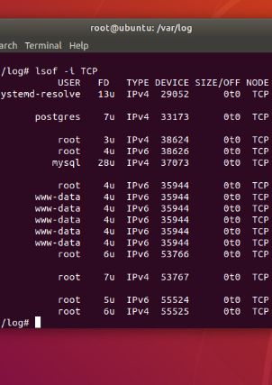
Linux Processes
Take a screenshot of the output in Part 1, Step 16.
It should show port 55000 open for both IPv4 and IPv6.

Slide 15
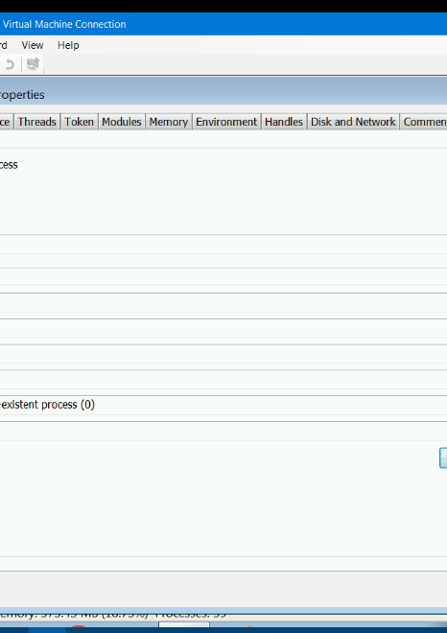
Process Hacker
Take a screenshot of the output in Part 2, Step 5.
It should show properties of a chosen process.

Slide 16
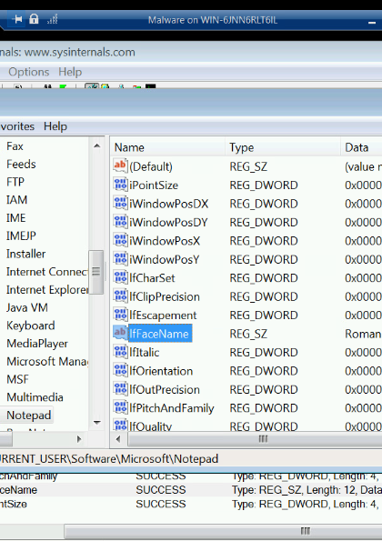
Process Monitor
Take a screenshot of the output in Part 3, Step 13.
It should show ifFaceName in the Path column and Data: Roman in the Detail column.

Slide 17
Course Project
SEC290
Fundamentals of Infrastructure Security
Module 6 Firewall

Slide 18
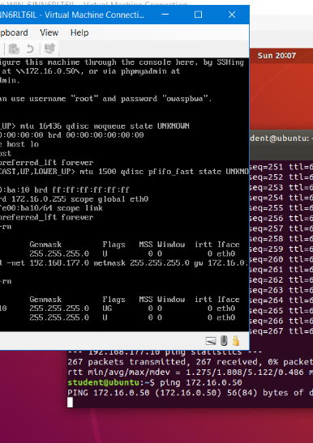
Time-based Access
Take a screenshot of the output in Part 1 Step 21.
It should show the output of the DMZ Route Table.

Slide 19
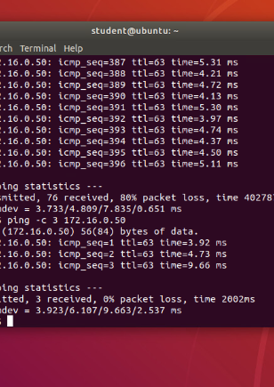
Time-based Access
Take a screenshot of the output in Part 1 Step 26.
It should show a successful ping from the Ubuntu Web VM and the DMZ VM.

Slide 20
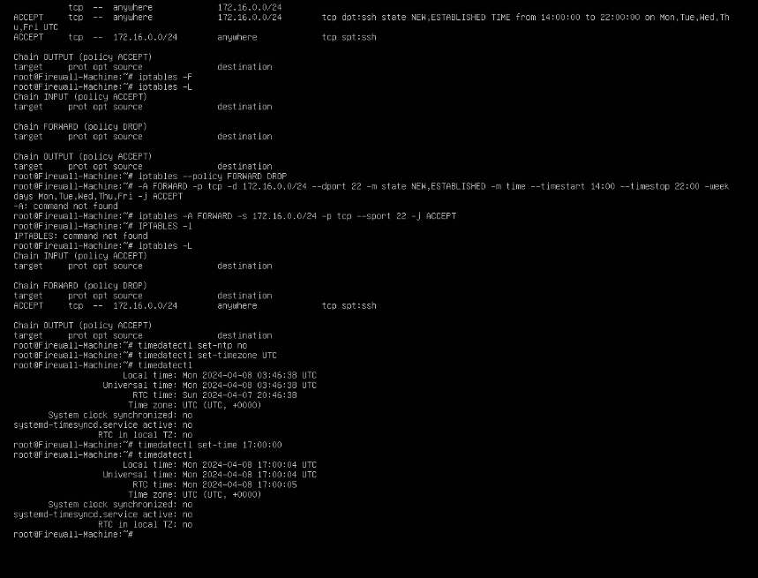
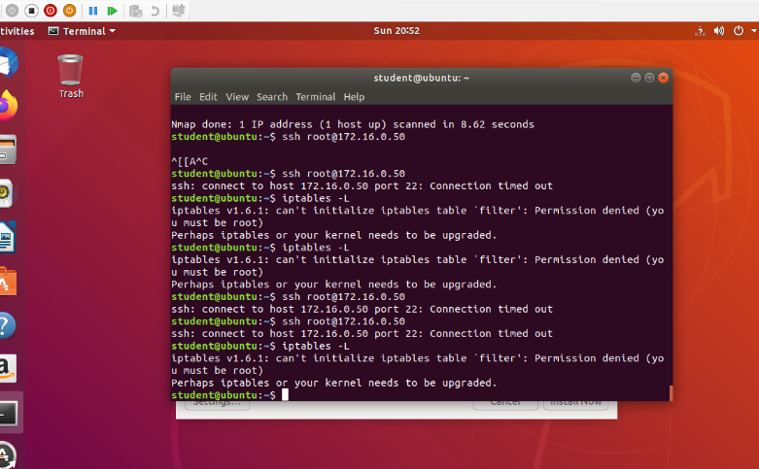
Time-based Access
Take a screenshot of the output in Part 1 Step 34.
It should show two time-based access rules in the FORWARD chain

Slide 21
Conclusion
# Conclusion ## Key Takeaways - **Module 1:** Introduction to IT Security - Understanding the fundamentals and importance of cybersecurity. - **Module 2:** Network Security - Best practices for securing network infrastructure. - **Module 3:** Ethical Hacking - Tools and techniques for penetration testing. - **Module 4:** Cryptography - The role of encryption in protecting data. - **Module 5:** Security Policies - Developing and implementing effective security policies. - **Module 6:** Emerging Threats - Staying ahead of evolving cybersecurity challenges. ## Reflection - Throughout this course, we've explored various aspects of IT security and applied practical skills in ethical hacking and network defense. - The hands-on experience gained from the labs and assignments has prepared us for real-world security challenges. ## Looking Forward - The knowledge and skills acquired in SEC 290 are foundational for any cybersecurity career. - Continuous learning and staying updated with the latest security trends will be crucial as we advance in the field.
Key Takeaways
Introduction to IT Security - Understanding the fundamentals and importance of cybersecurity.
Module 2:** Network Security - Best practices for securing network infrastructure.
Module 3:** Ethical Hacking - Tools and techniques for penetration testing.
Module 4:** Cryptography - The role of encryption in protecting data.
Module 5:** Security Policies - Developing and implementing effective security policies.
Module 6:** Emerging Threats - Staying ahead of evolving cybersecurity challenges.

Slide 22
Reflection
- Throughout this course, we've explored various aspects of IT security and applied practical skills in ethical hacking and network defense.
- The hands-on experience gained from the labs and assignments has prepared us for real-world security challenges.

Slide 23
Looking Forward
- The knowledge and skills acquired in SEC 290 are foundational for any cybersecurity career.
- Continuous learning and staying updated with the latest security trends will be crucial as we advance in the field.

Slide 24
Sources
SEC290
Fundamentals of Infrastructure Security- Devry University
Virtual machine learning
Project instructed step by step video and resources rendered in the course material.

Slide 25
Thank You!
I appreciate the opportunity to learn and grow in this class. - Special thanks to our instructor and peers for their support and insights.

