Slide 1

CEIS 106 Introduction to Operating Systems
Ashley Kennedy Fall 2021

Slide 2

Learning the Linux operating system (Ubuntu and Dhp servers)
Navigating the Linux File system tree
Creating directories and files
Copy and remove directories
Locate directories and files
Create shell script
Change script file permissions
Set Path variable
Make Path name permanent
Add/remove users and groups in CLI
Test user and group settings
Add users in GUI
Discover host IP configurations
Manage network interfaces
Use network utilities
Monitor Linux processes
Monitor user activities
Monitor network bandwidth usage

Slide 3
Navigate the Linux filesystem tree
1. What is the pwd command an acronym for? What about the cd command?
pwd is Print working directory (current directory in the tree). cd command is to change directory. Pwd= print working directory
cd= change directory
2. Explain the differences between a relative path and an absolute/full path in Linux.
Absolute pathname is, The full pathname to a certain file or directory starting from the root directory.
Relative pathname is, The pathname of a target directory relative to your current directory in the tree.

Slide 4
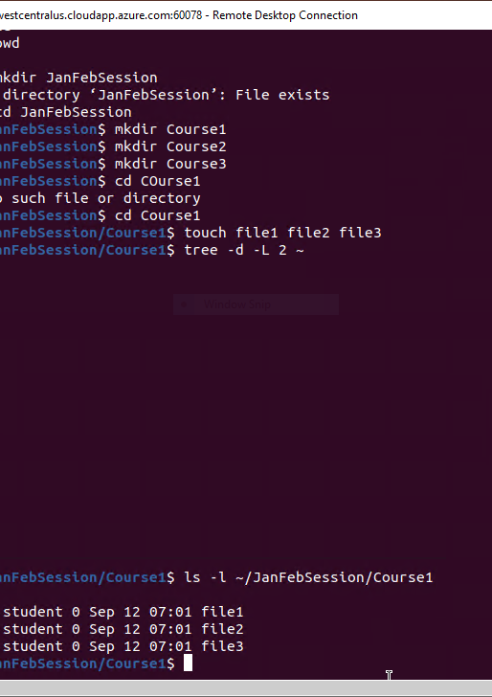
Create directories and files

Slide 5
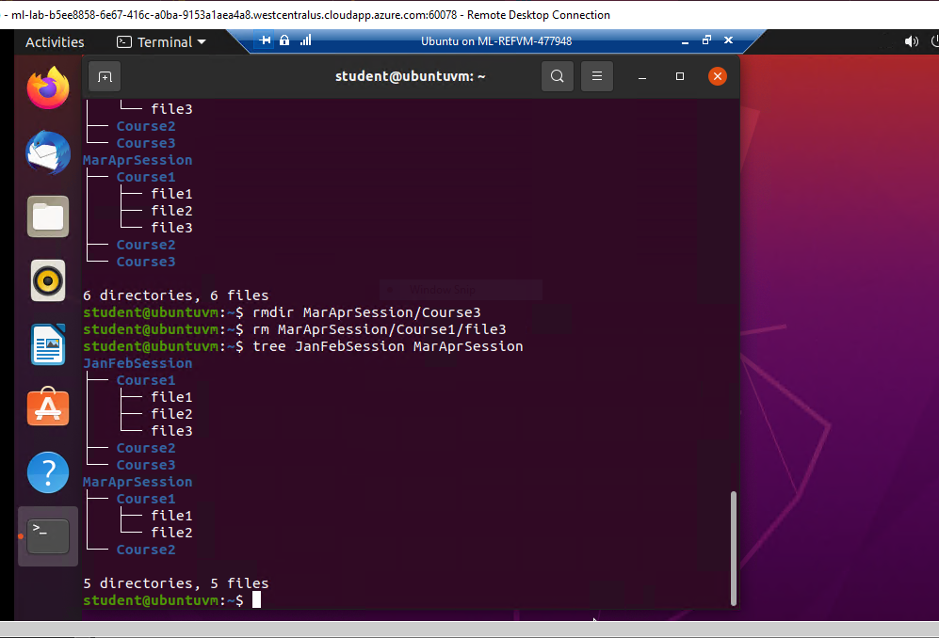
Copy and remove directories and files

Slide 6
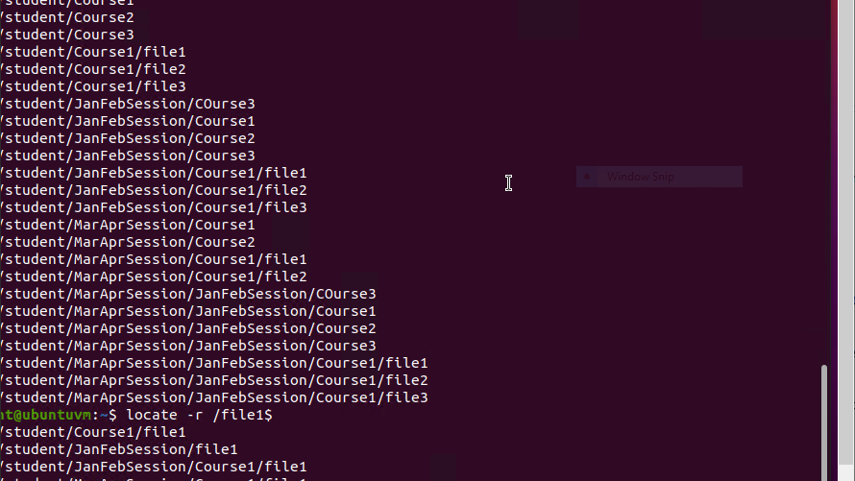
Locate directories and files

Slide 7
Create a shell script
1. What are the file permissions of the script?
The permissions of the file. In order to get that, you need to run ls -l todolist. Then get the permission from the result and paste as answer.
2. What’s the name of the user-defined variable in the script?
The user variable is text
3. Which redirection meta-character is used in the script? What does it do?
The redirection character is >>

Slide 8
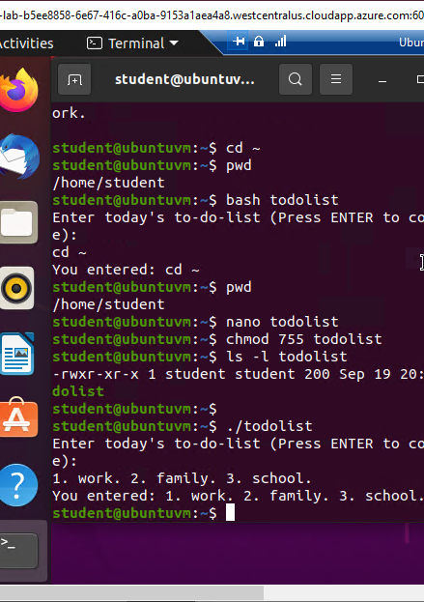
Change script file permissions

Slide 9
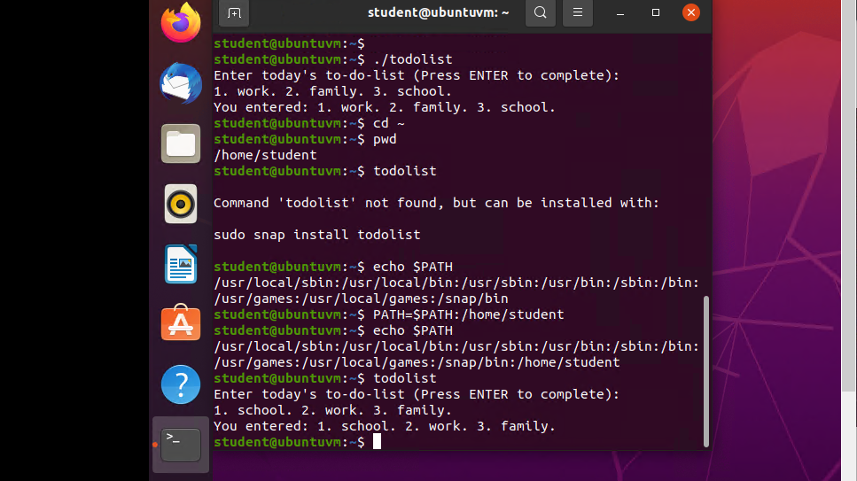
Set the PATH variable

Slide 10
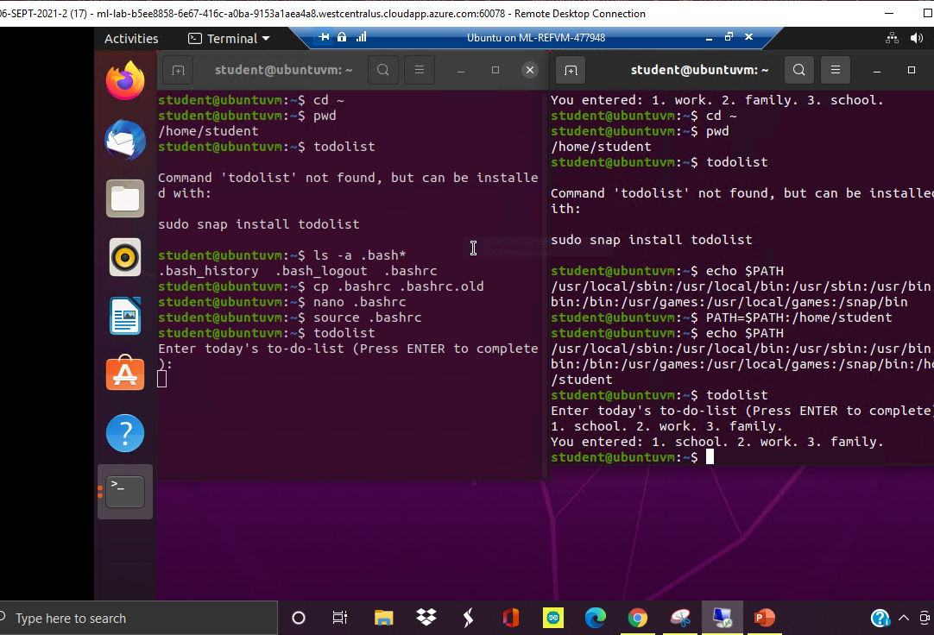
Make the PATH variable permanent

Slide 11
Add users and groups in CLI
1. What does the –m option in the useradd command do?
Creates user directory
2. What does the -3 option in the tail command do?
Shows last 3 lines
3. Which line of the /etc/group file lists members of the “students” group? Copy’d here

Slide 12
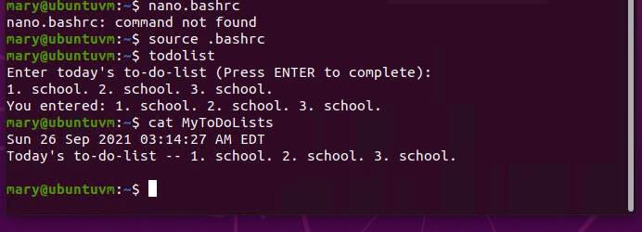
Test user and group settings

Slide 13
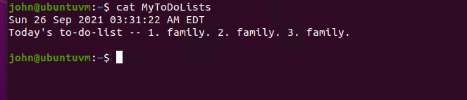
Add users in GUI

Slide 14
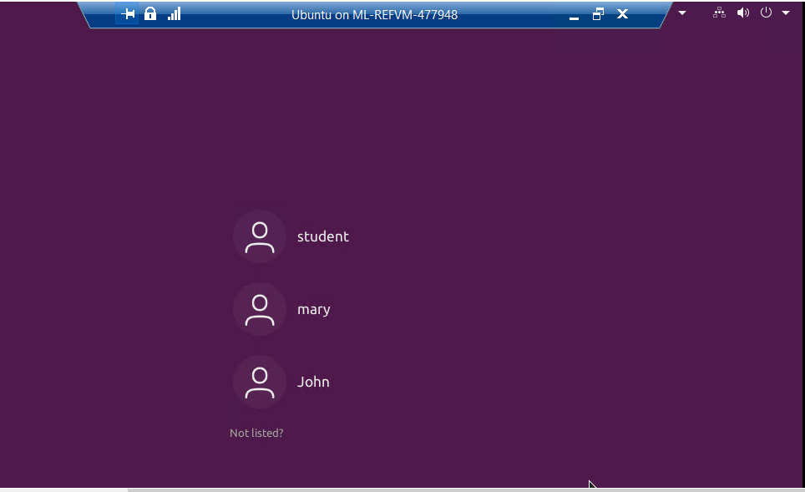
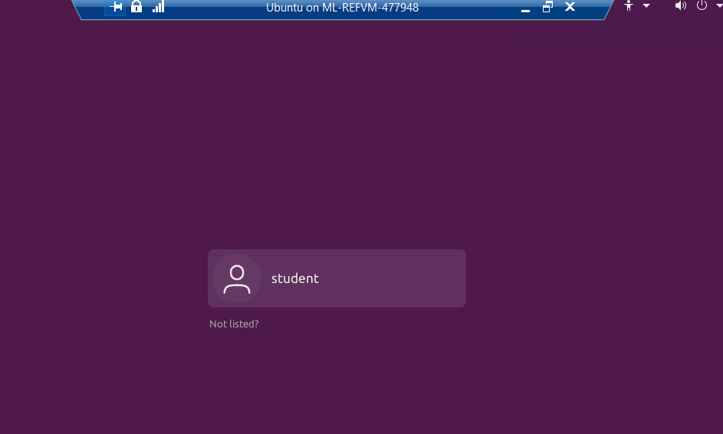
Remove users and groups
A screenshot of the log on page with three user accounts.
A screenshot of the log on page with only your user account (i.e., student).

Slide 15
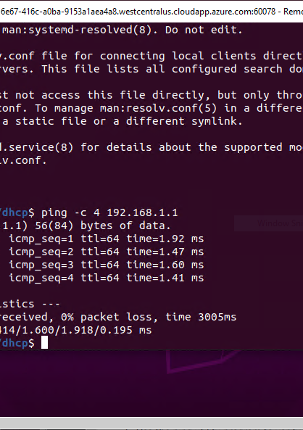
Discover host IP configurations
1. What is the IP address of your Ubuntu machine?
Answer here: 192.168.1.103/24
2. What is the IP address of its default gateway?
Answer here: 192.168.1.1
3. What is the IP address of its DHCP server?
Answer here: 192.168.1.1
4. What is the IP address of its DNS server?
Answer here: 192.168.1.1

Slide 16
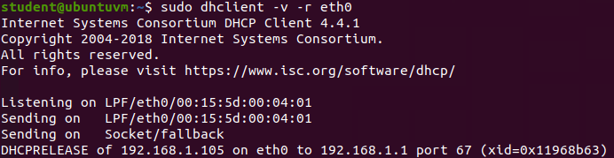
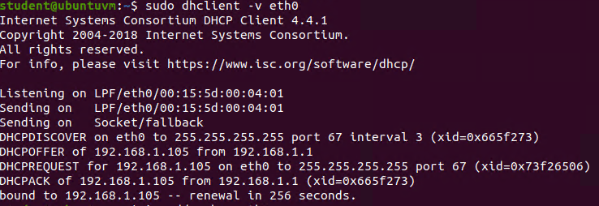
Manage network interfaces
1. Which DHCP message is shown in the output of the sudo dhclient –v –r eth0 command? [hint: the message name is in uppercase.]
Answer here:
2. Which four DHCP messages are shown in the output of the sudo dhclient –v eth0 command? [hint: the message names are in uppercase.]
Answer here:

Slide 17
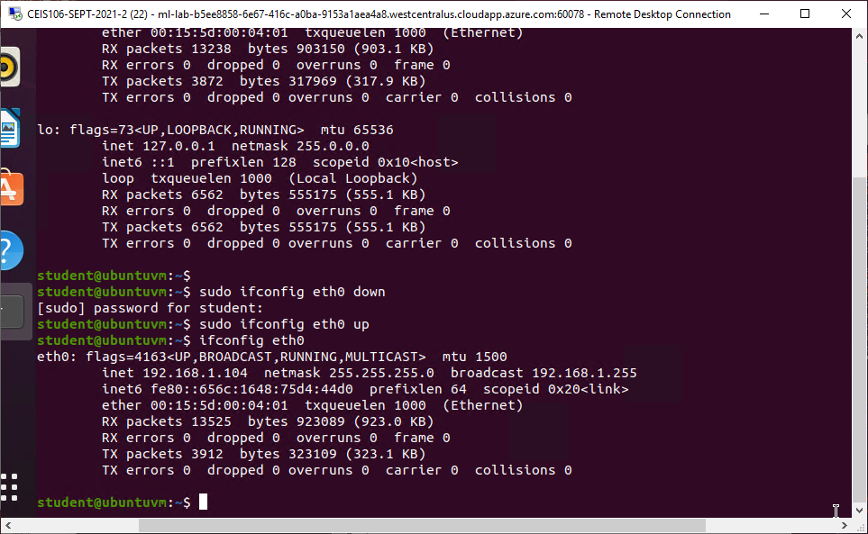
Use network utilities
.

Slide 18
Monitor Linux processes
1. What is the default action of the 15 SIGTERM kill signal?
Kills/terminates the application
2. In the System Monitor window, click on % CPU to sort the processes by CPU load. Which process shows the highest percentage of CPU usage?
system monitor

Slide 19
Monitor user activities
Issue the sudo accton on command to turn on GNC accounting. Run the sudo updatedb command. Enter lastcomm updatedb to check if the updatedb command was executed before. Remember to turn off GNC accounting (sudo accton off) after answering the questions.
1. What flag value is displayed in the output?
Flag should be either S or F
2. Why is the name of the user who ran the processes shown as root, not student?
Because sudo command was used and user was logged in as root

Slide 20
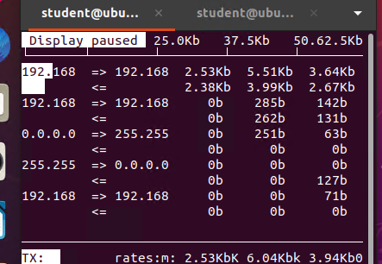
Monitor network bandwidth usage

Slide 21
Challenges in this project
Understanding and learning commands
Troubleshooting where I went wrong to gain proper results
Entering a whole new world of technology and the patience to understand it
Compiling what I learn every week into a small powerpoint

Slide 22
Career skills I obtained
Knowledge in Linux commands
Locating, creating, copying, deleting files and directories
Shell script
Operating a Linux OS
Opening os terminals and DHP servers
Working on virtual machines
Monitoring network and bandwidth

Slide 23

Thank you, akennedy@ubuntu:~$

