Slide 1

CEIS 114
Traffic & Emergency signal
Ashley Kennedy
Feb- 2022

Slide 2

Introduction-
Build Arduino circuit traffic signal prototype.
Wiring and sensors
Coding and serial monitoring
Program ESP 32 microcontroller
Add Emergency signal and motion sensor

Slide 3
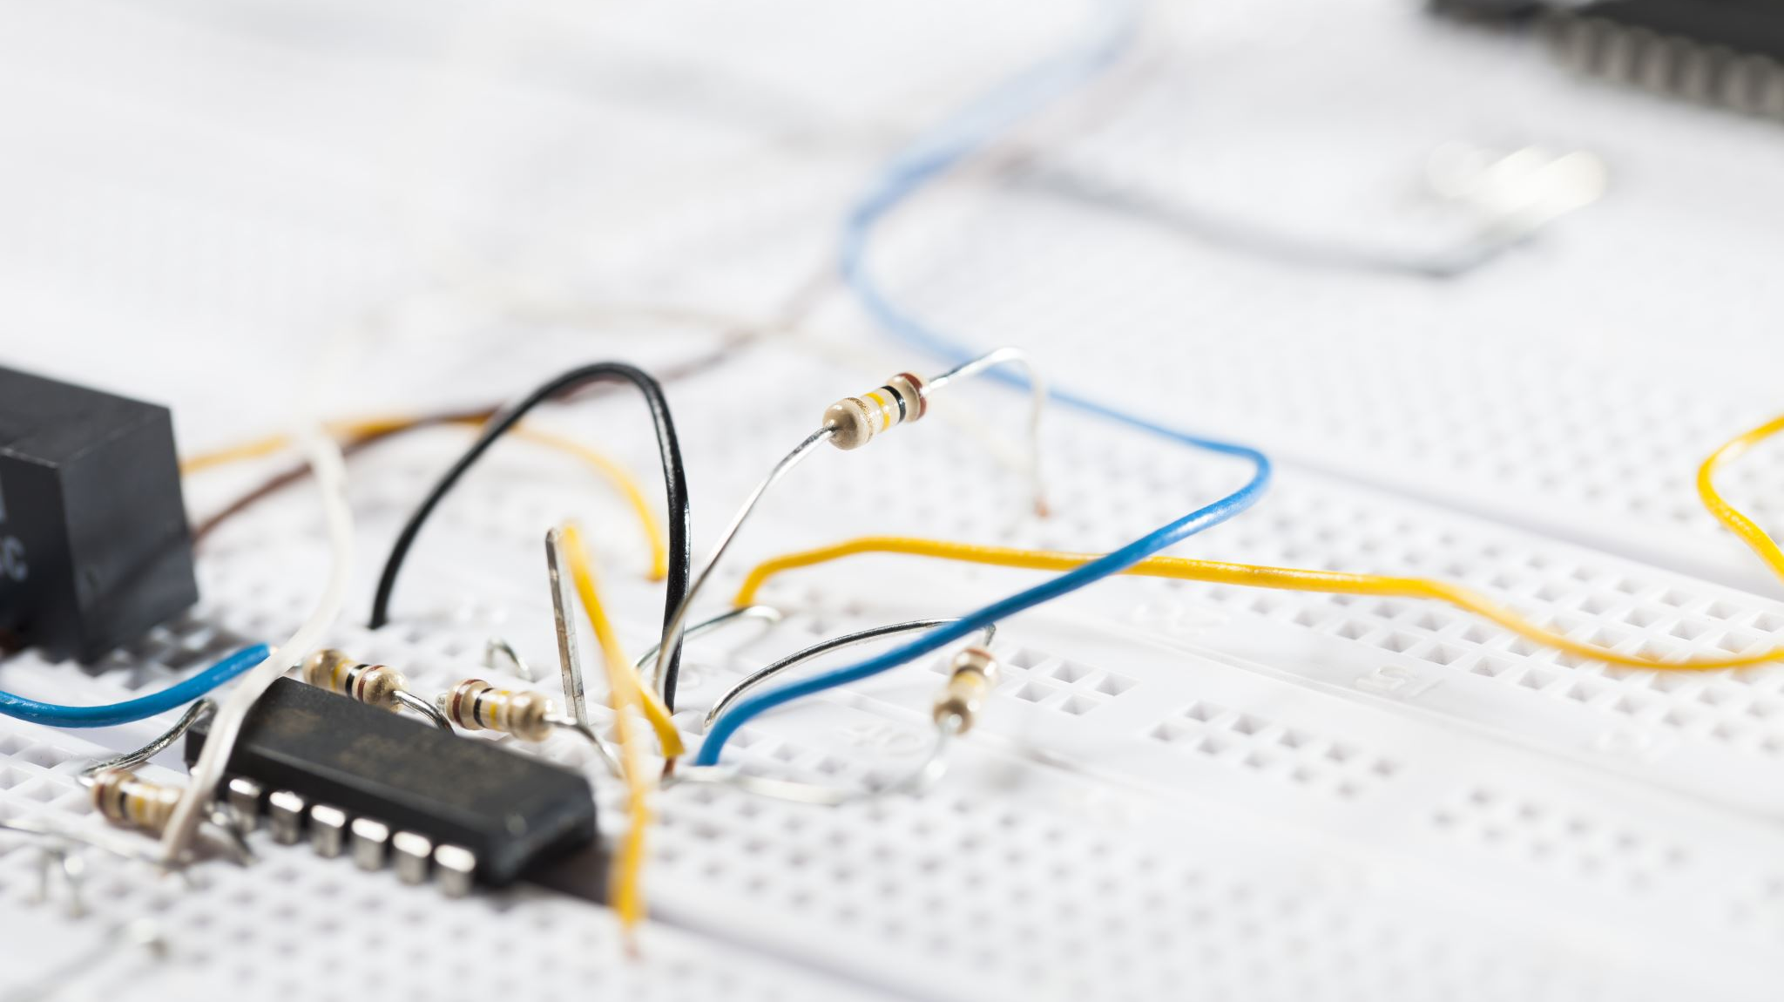
CEIS 114
Module 2
Project Plan for IoT Traffic Controller

Slide 4
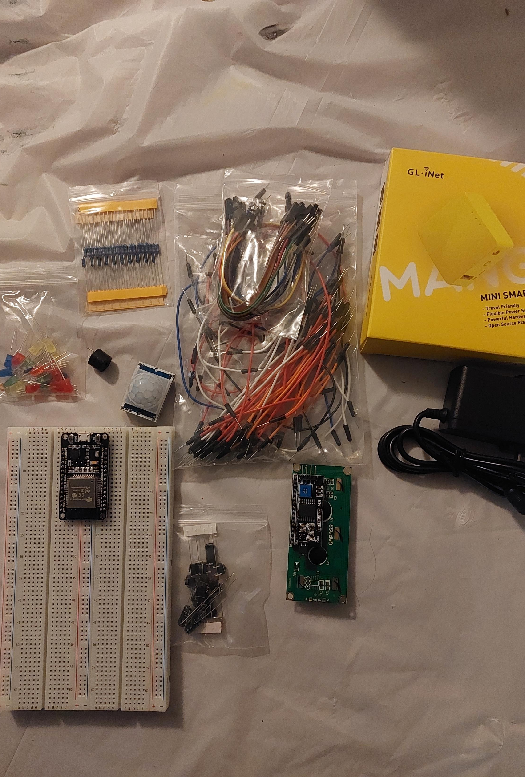
Inventory (Picture)
ESP 32 Board
Colored LEDs: Red, Yellow, Green, and Blue
220 Ohm Resistors (optional)
Wires
Breadboard(s)
LCD Unit with I2C Adapter
Active Buzzer
Mini Router
Push Button(s)
PIR Motion Sensor

Slide 5
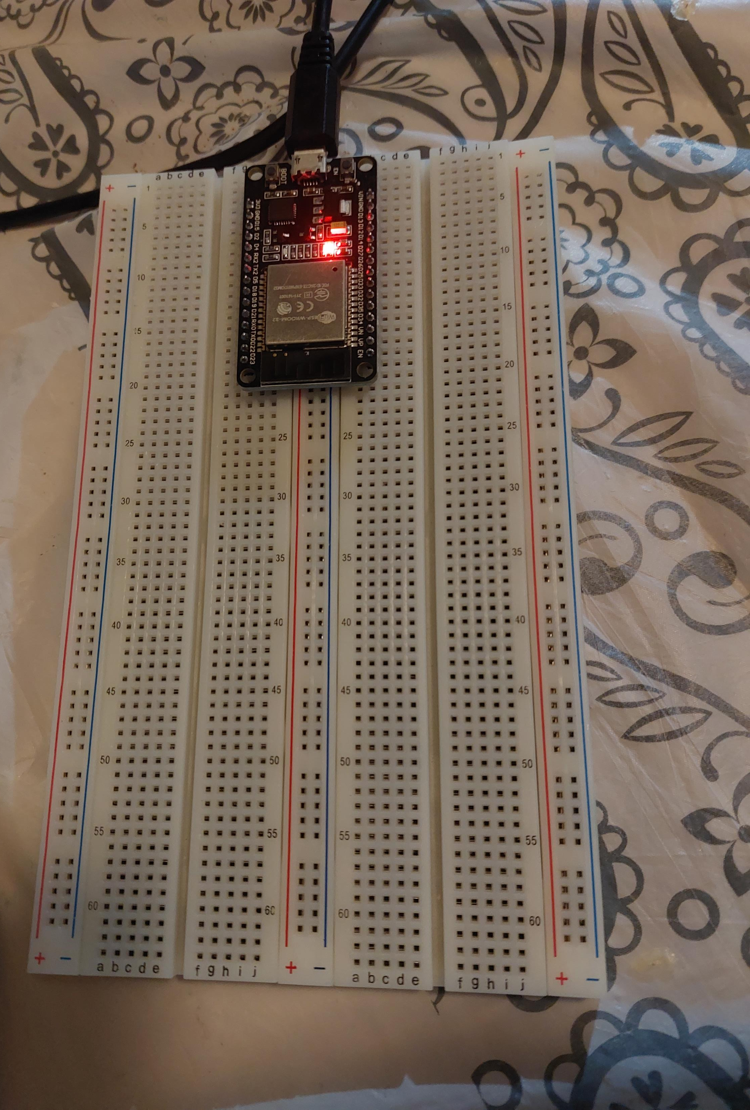
ESP32 (Picture)
Microcontroller mounted and powered ON

Slide 6
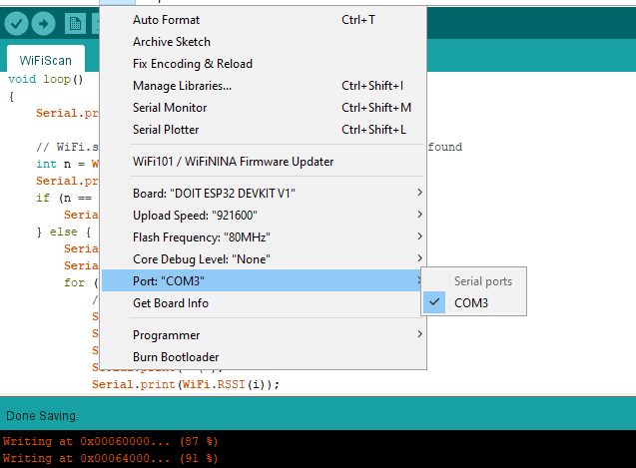
Installation of Arduino IDE
Screenshot of Arduino IDE with Port selected from Tools menu.

Slide 7
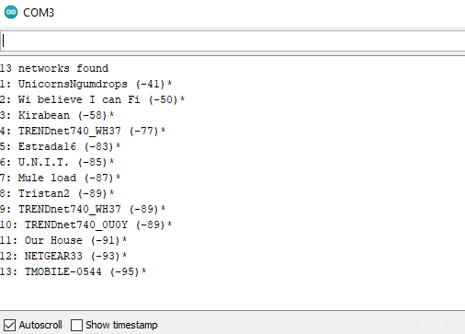
ESP32 WiFi Scan
Screenshot of Serial Monitor in Arduino IDE showing the available networks

Slide 8
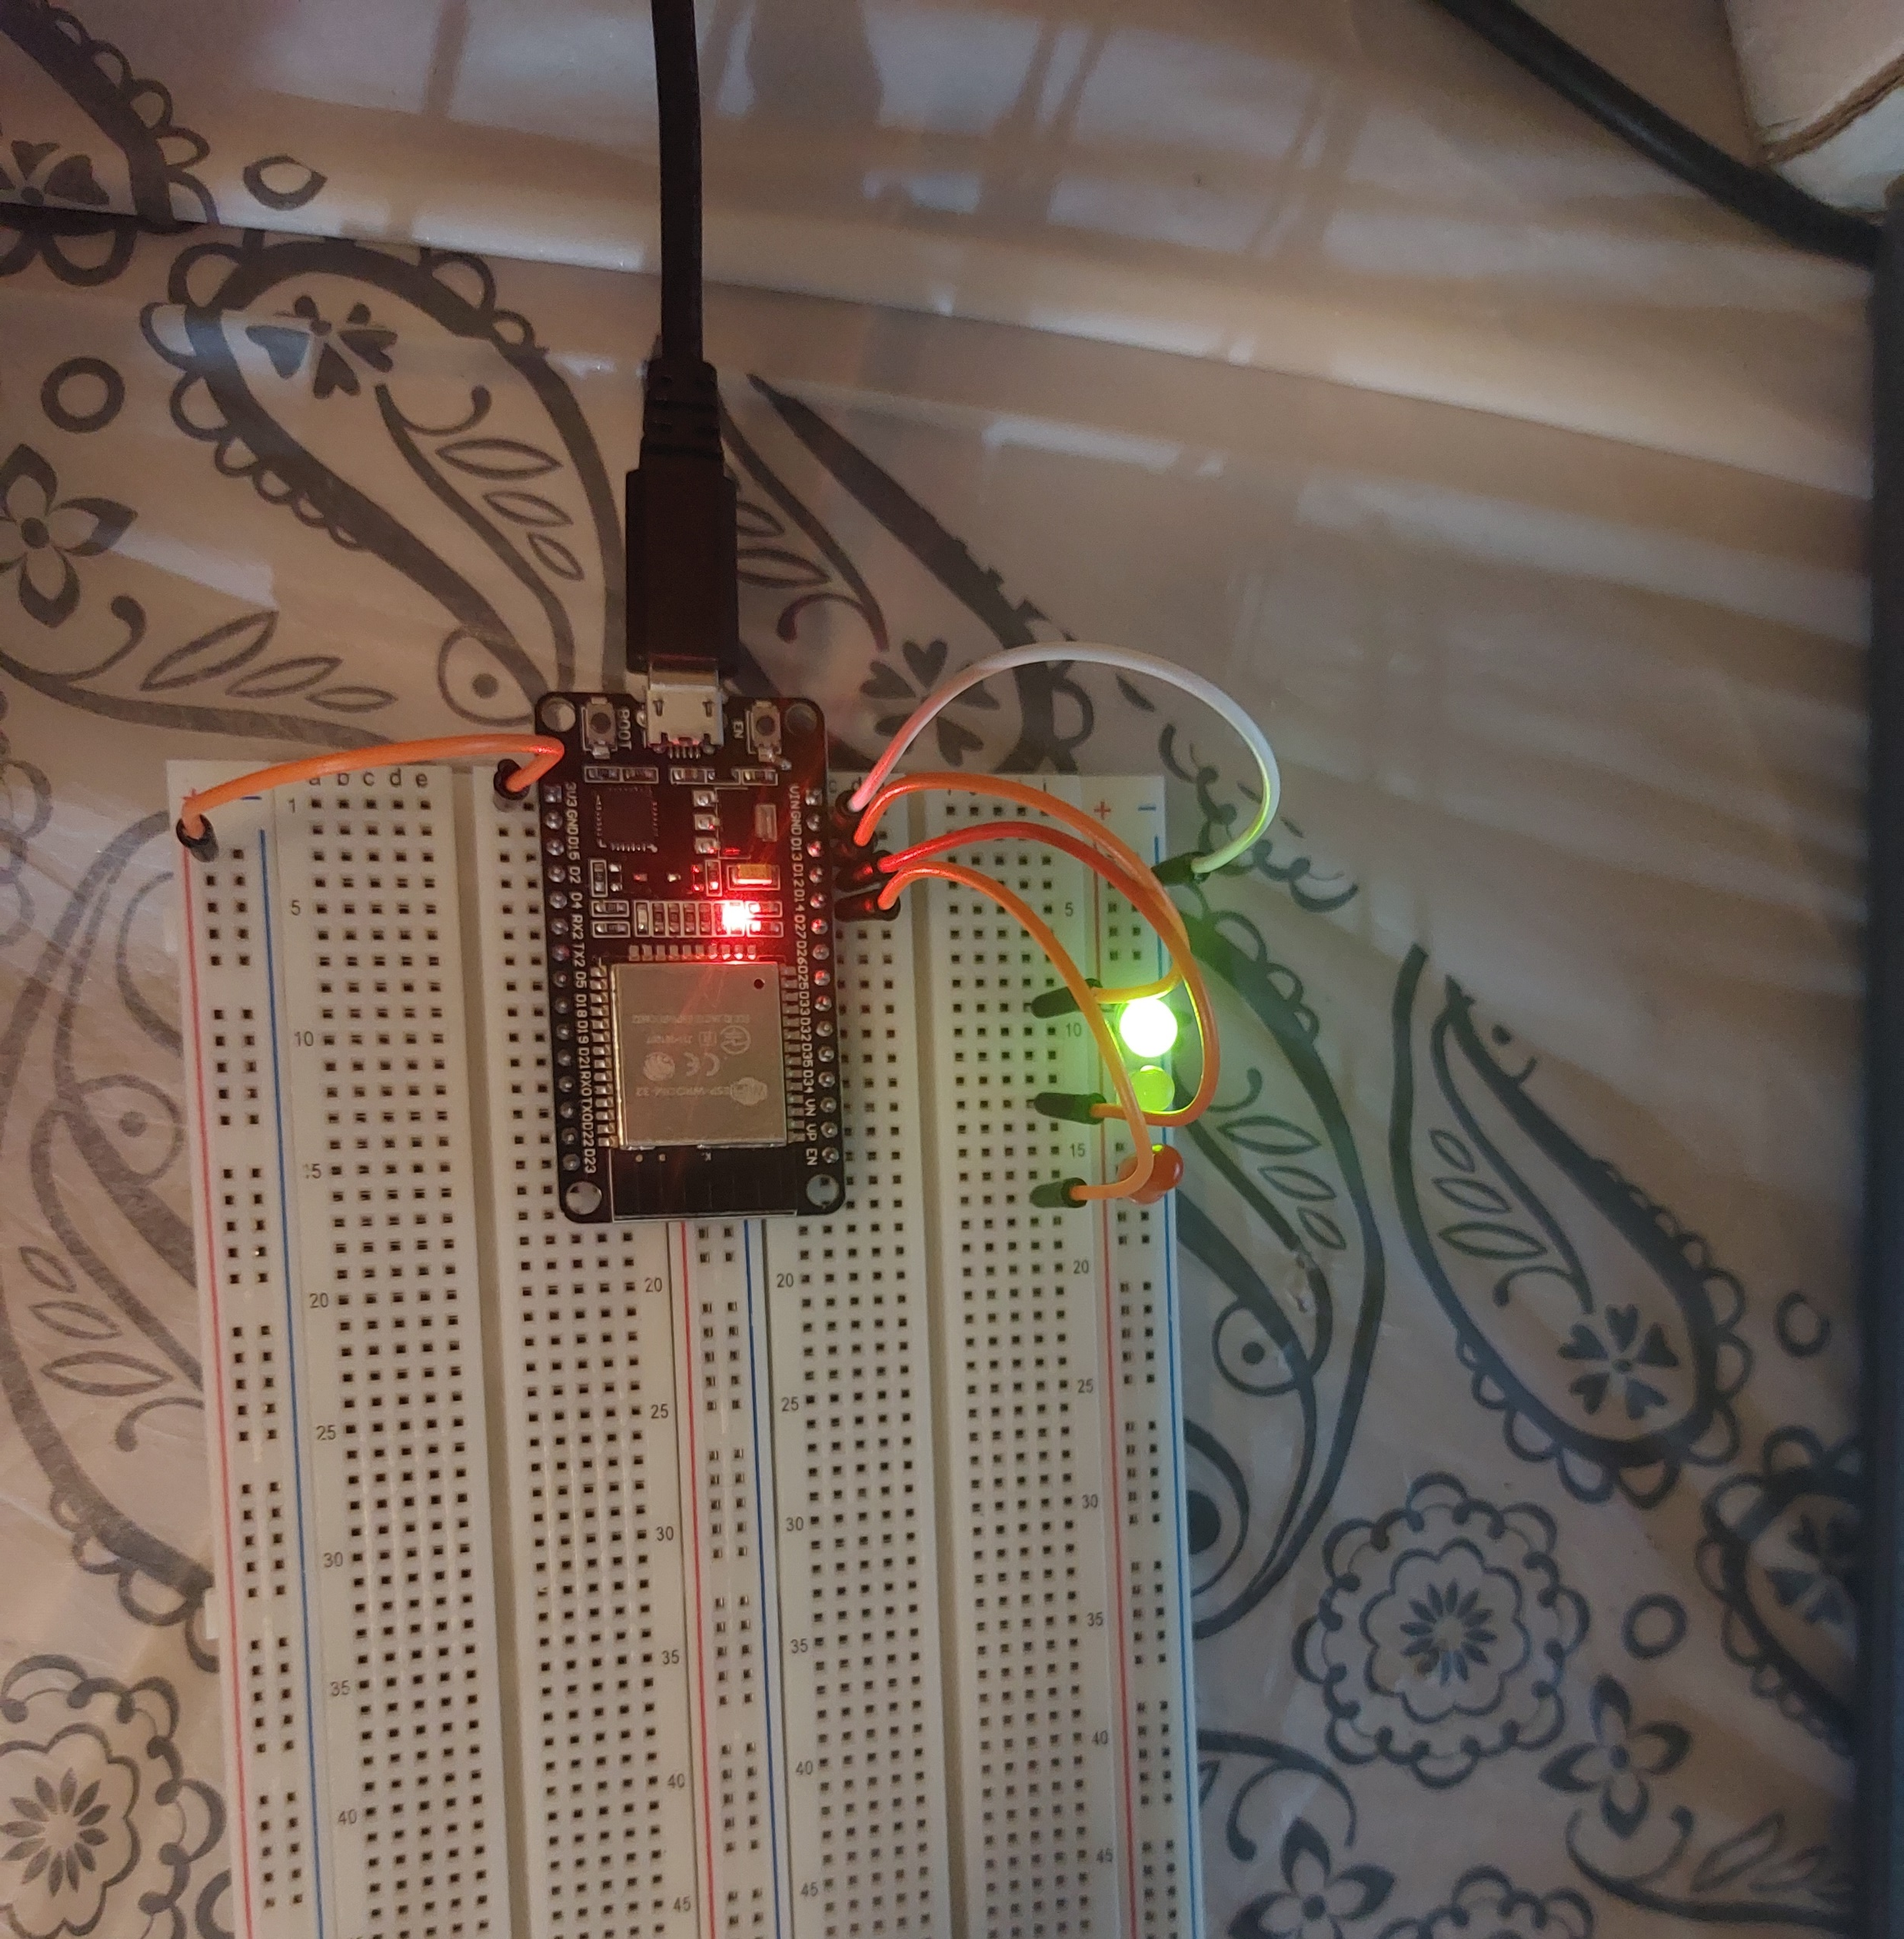
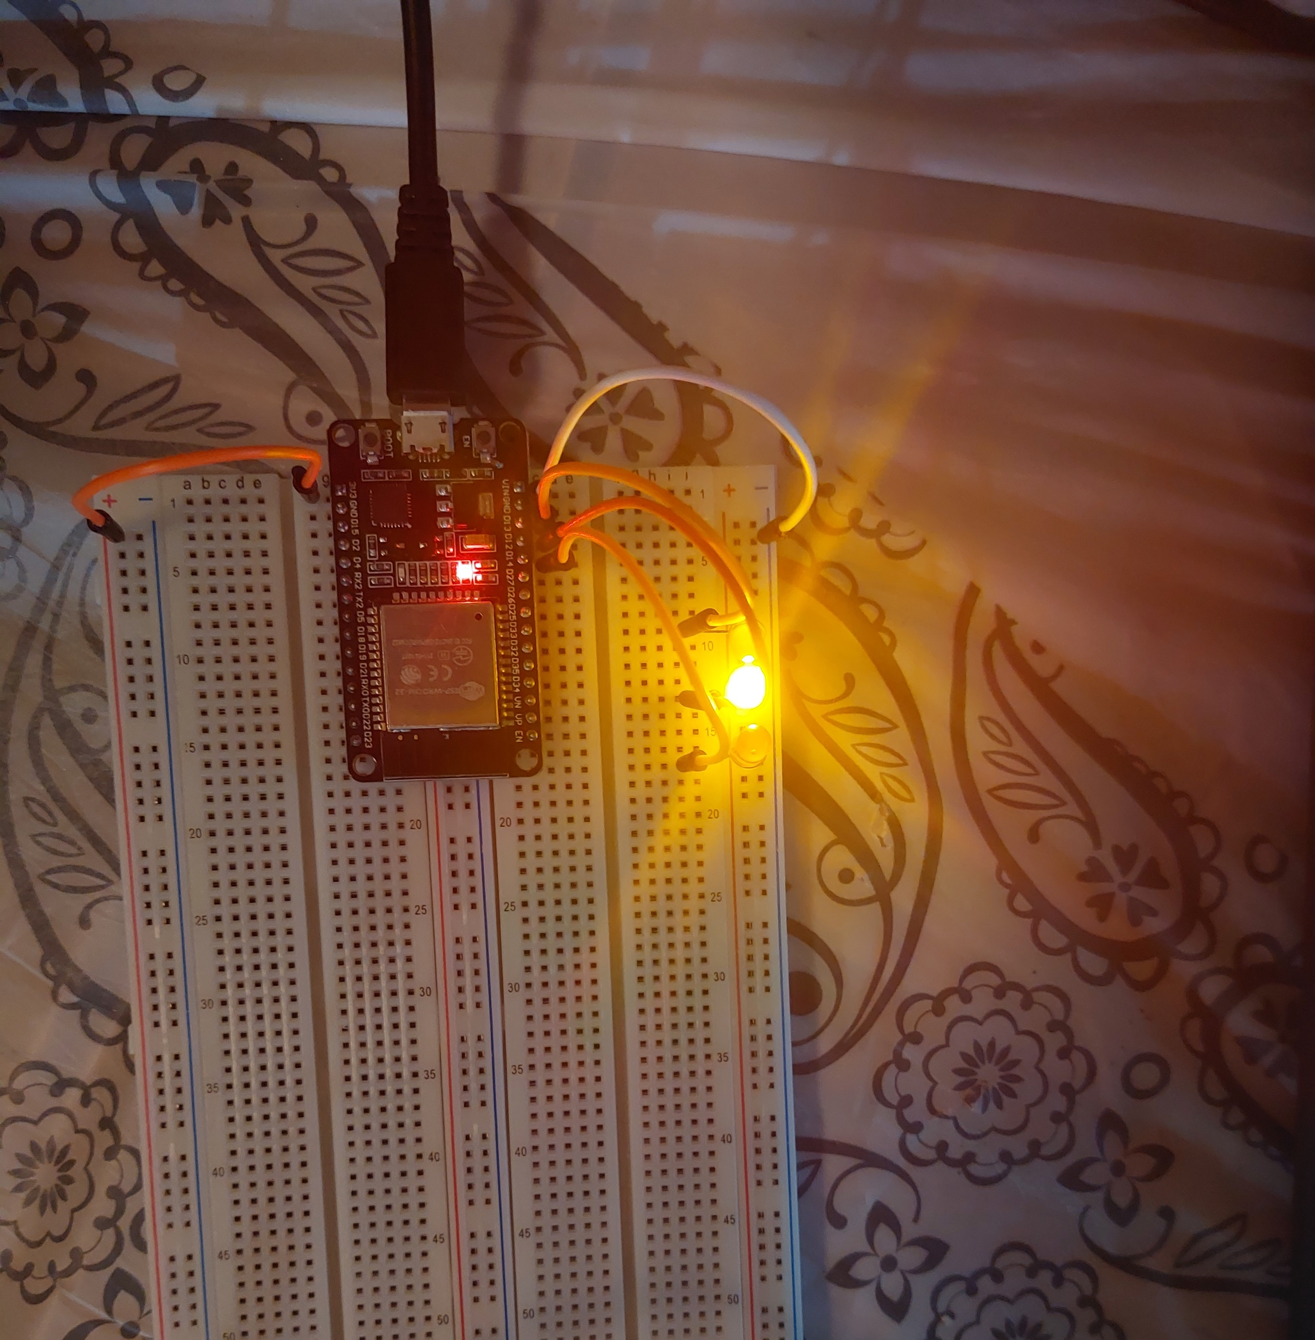
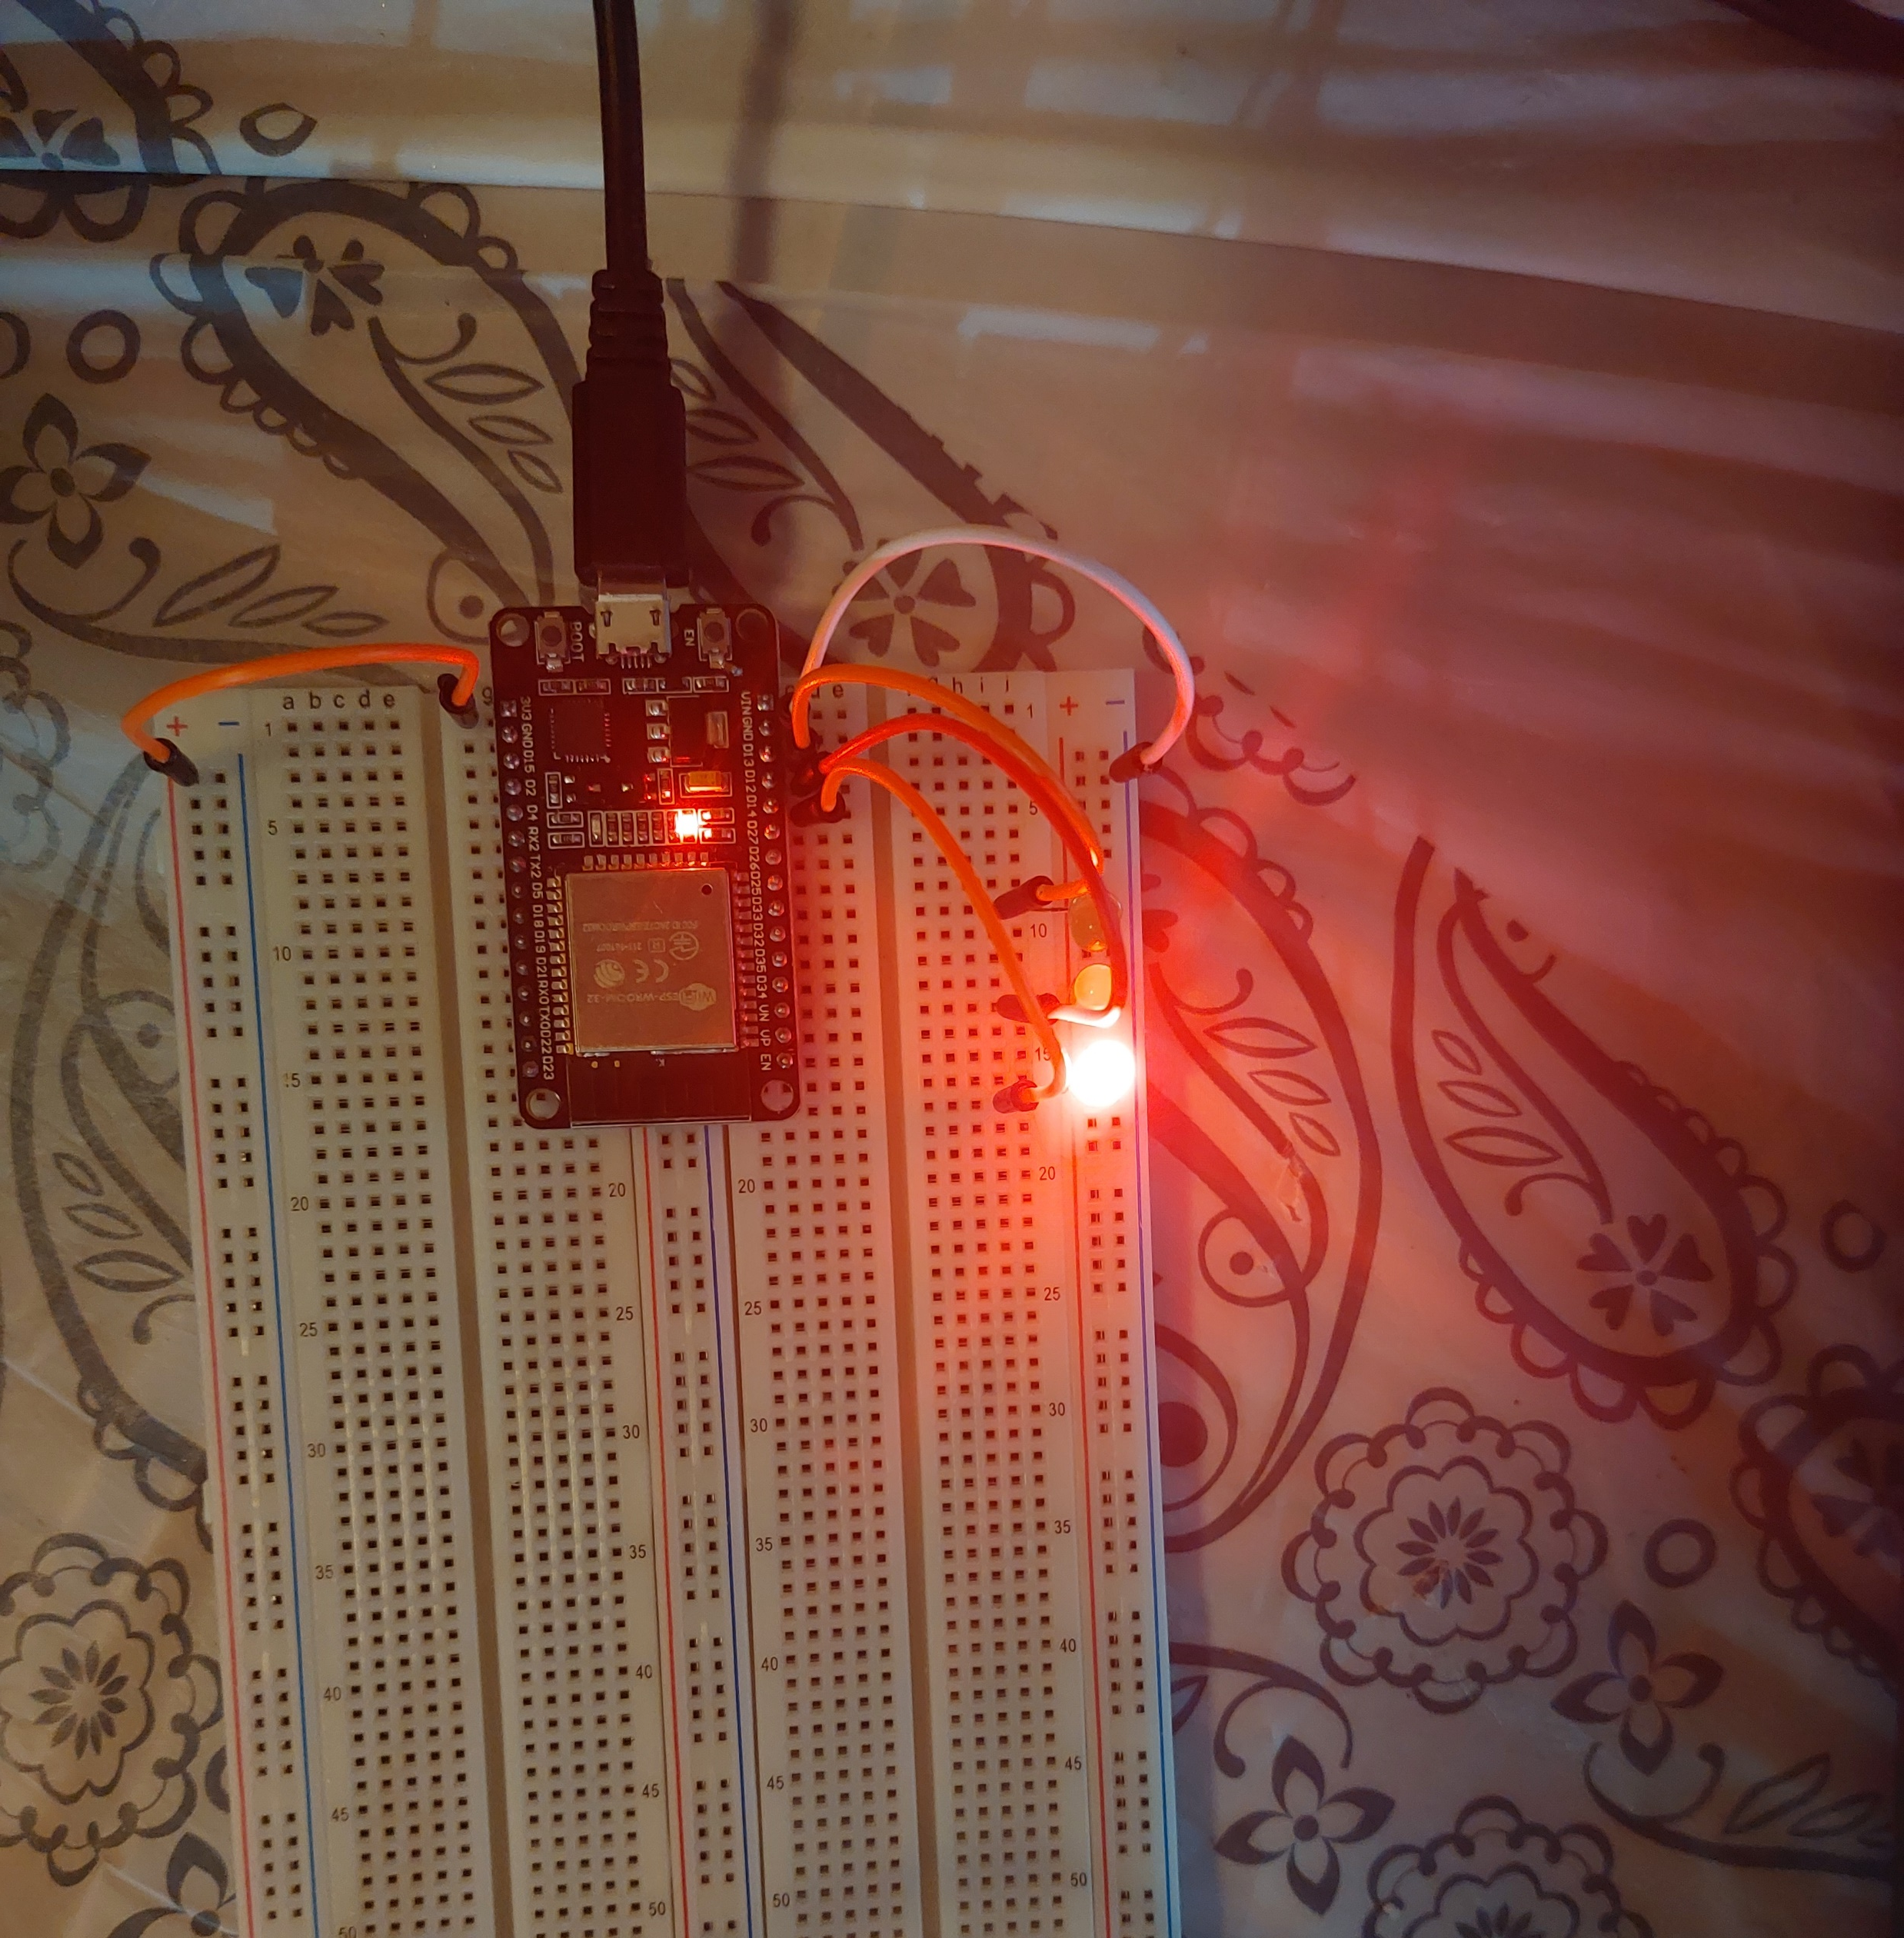
Picture of circuit with working LEDs
ESP 32 Board
Colored LEDs: Red, Yellow and Green
220 Ohm Resistors (optional)
Wires
Breadboard

Slide 9
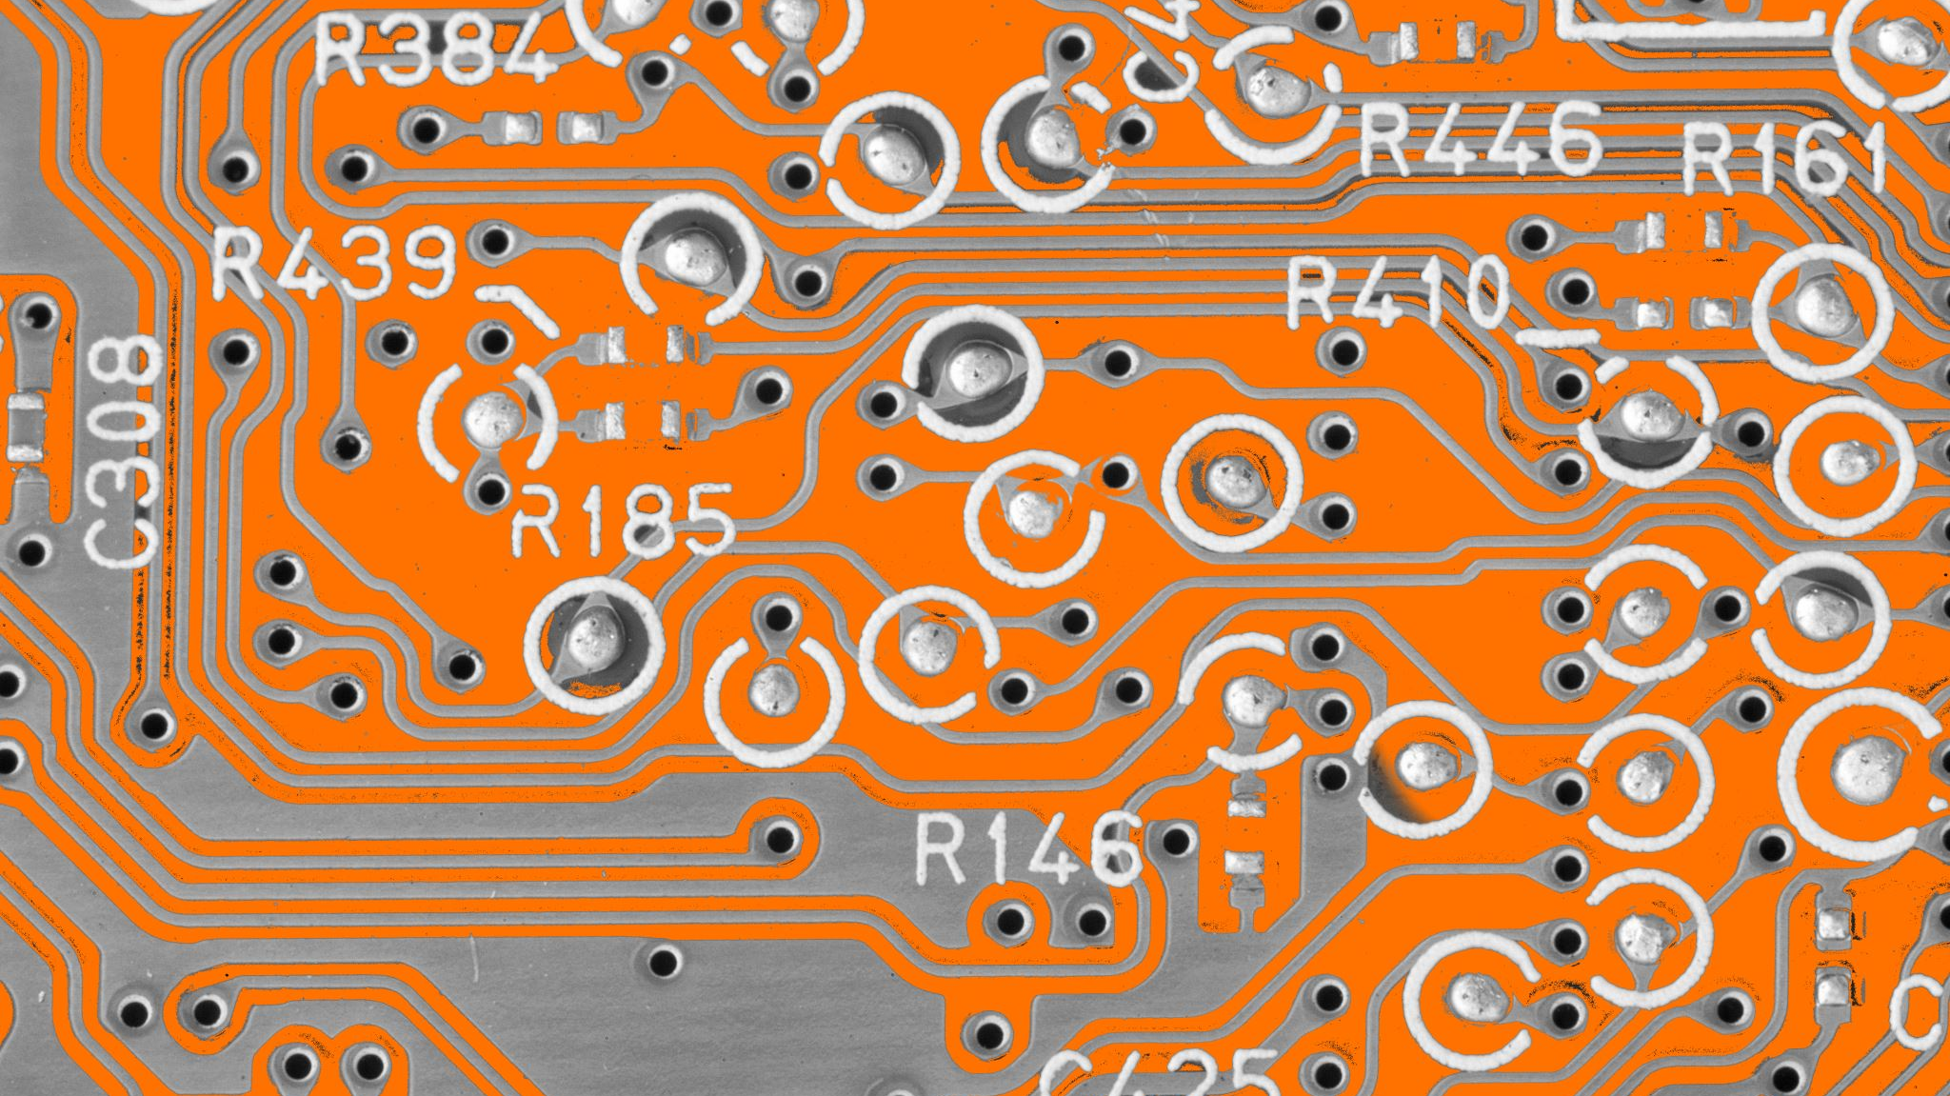
CEIS 114
Module 3
Creating the Traffic Controller

Slide 10
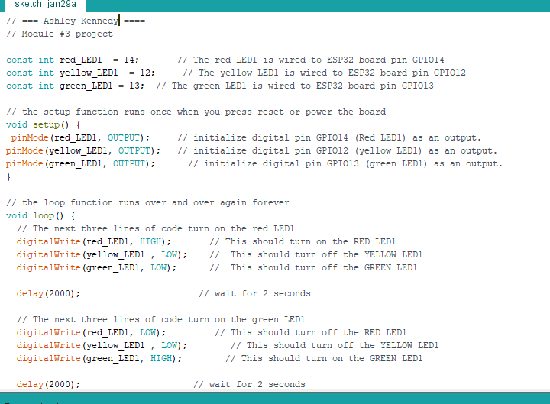
Screenshot of code in Arduino IDE
Screenshot of code in Arduino IDE showing your name in the comment

Slide 11

CEIS 114
Module 4
Creating a Multiple Traffic Light Controller

Slide 12
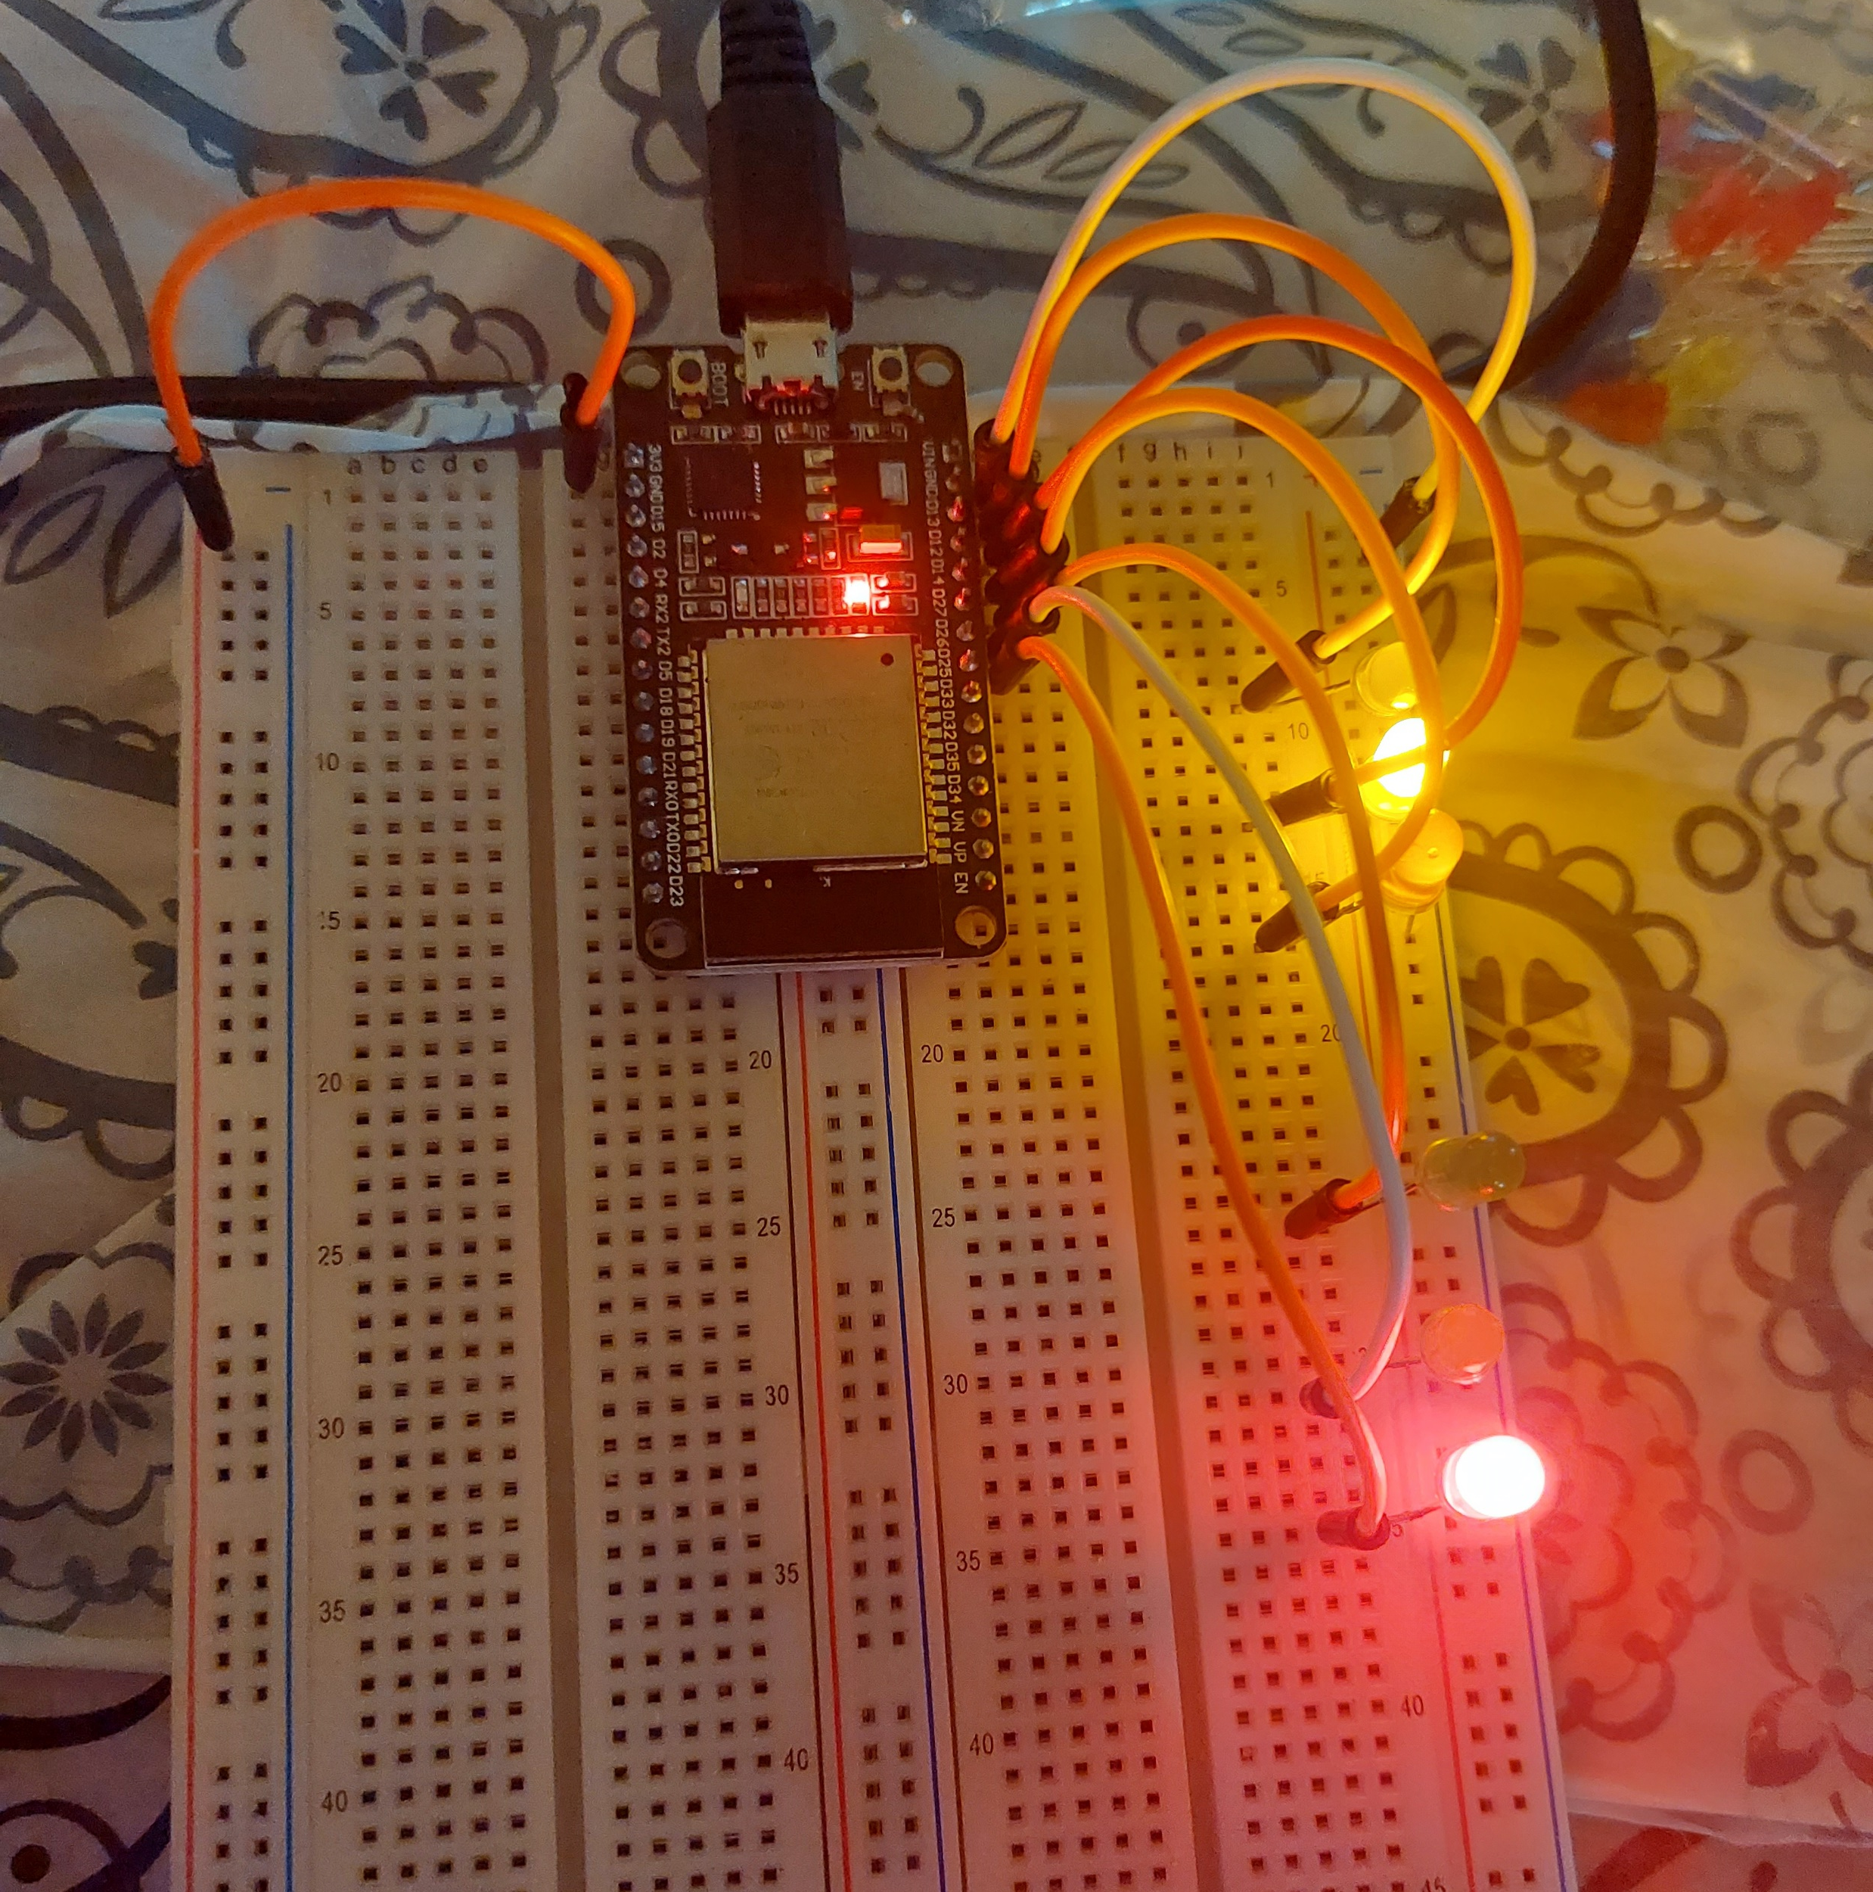
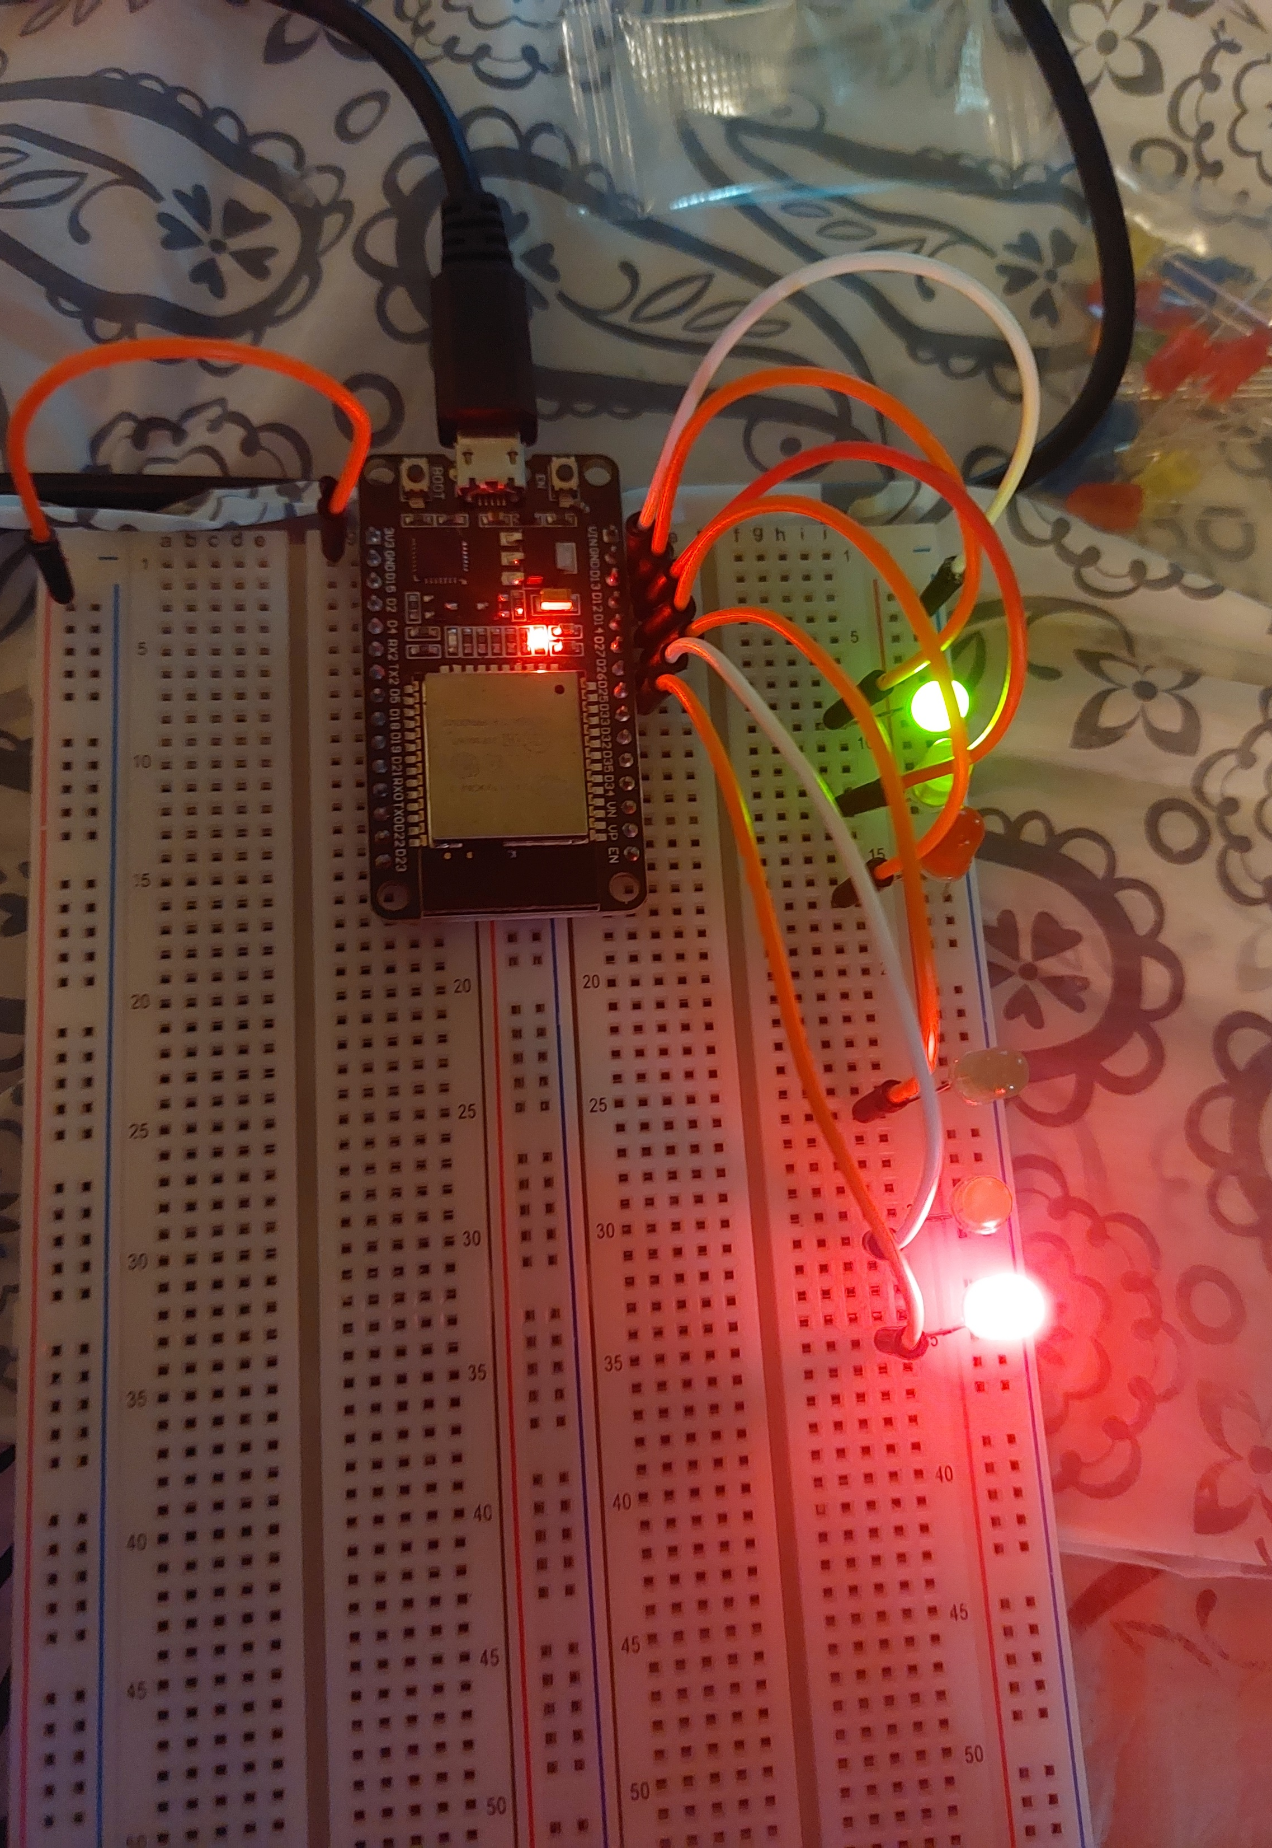
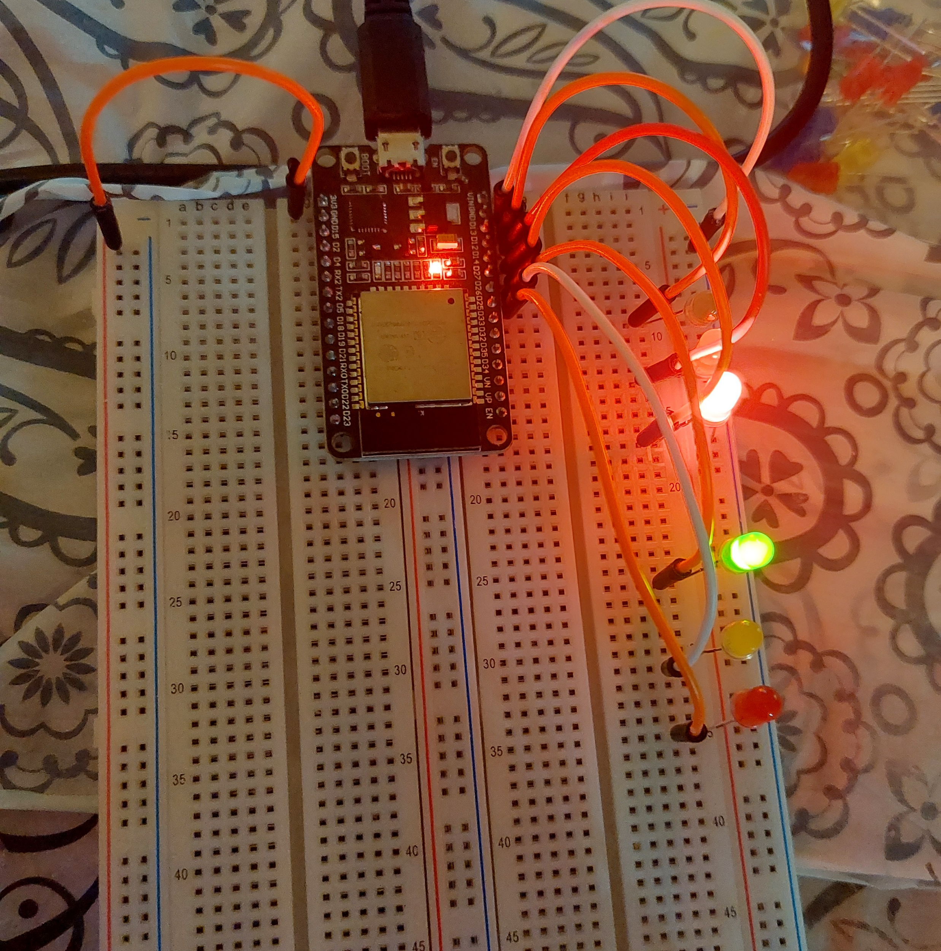
Picture of circuit with working LEDs
ESP 32 Board
Colored LEDs: Red, Yellow and Green (two sets)
220 Ohm Resistors (optional)
Wires
Breadboard

Slide 13
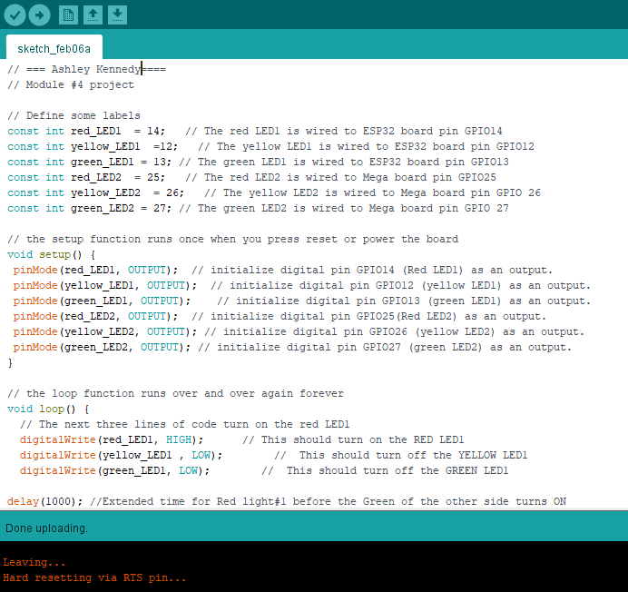
Screenshot of code in Arduino IDE
Screenshot of code in Arduino IDE showing your name in the comment

Slide 14
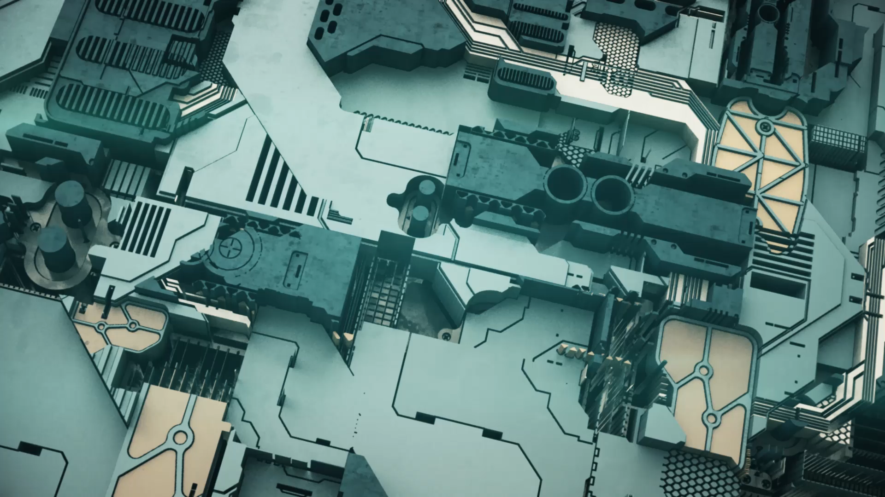
CEIS 114
Module 5
Creating a Multiple Traffic Light Controller with a Cross Walk

Slide 15
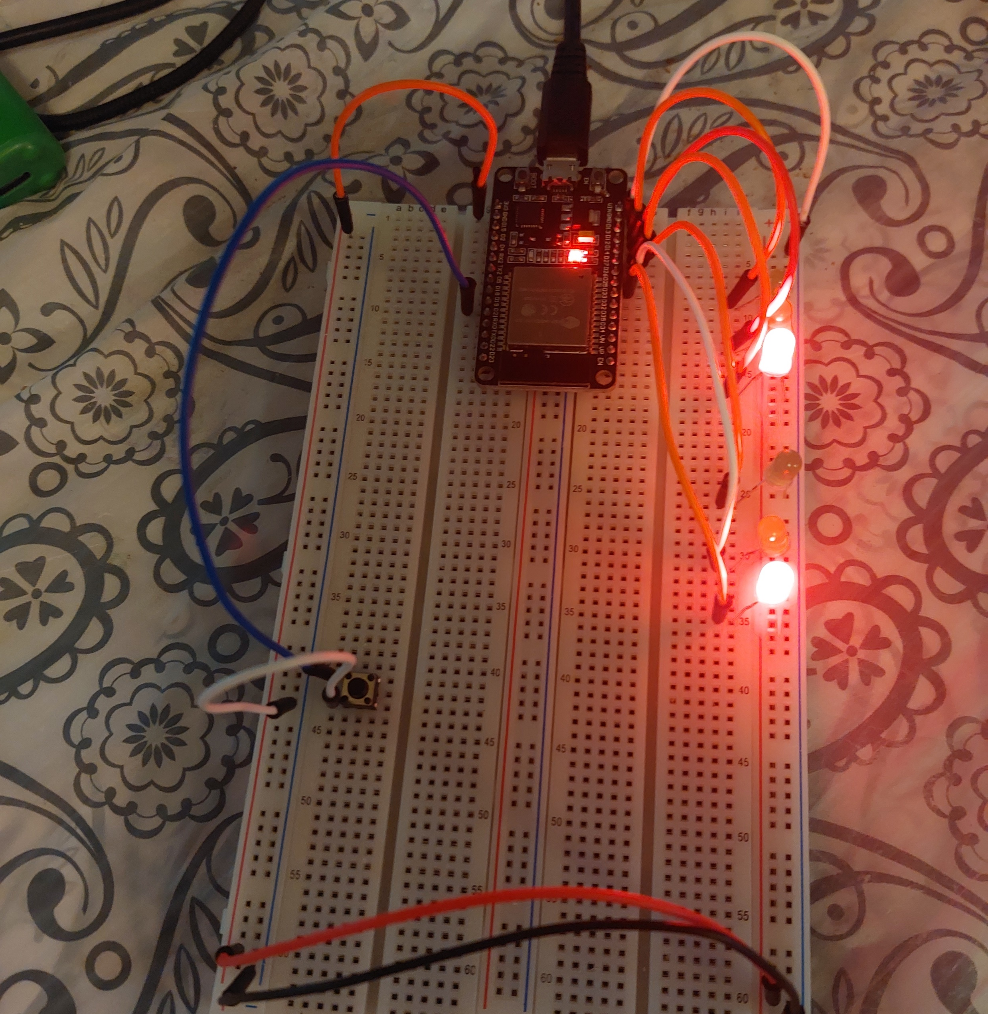
Picture of circuit with working LEDs
ESP 32 Board
Colored LEDs: Red, Yellow and Green (two sets)
220 Ohm Resistors (optional)
Push Button
Wires
Breadboard

Slide 16
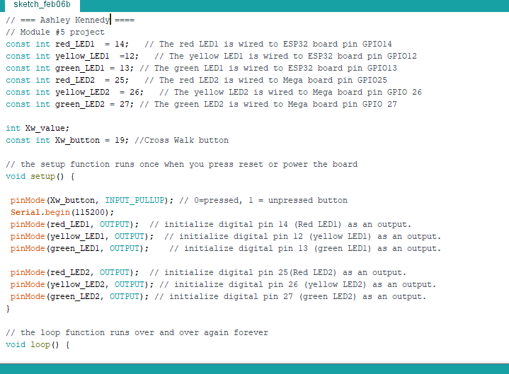
Screenshot of code in Arduino IDE
Screenshot of code in Arduino IDE showing your name in the comment

Slide 17
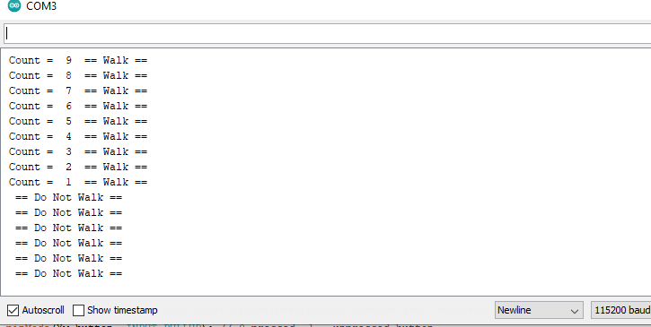
Screenshot of Serial Monitor in Arduino IDE
Screenshot of output in Serial Monitor

Slide 18

CEIS 114
Module 6
Creating a Multiple Traffic Light Controller with a Cross Walk and an Emergency Buzzer

Slide 19
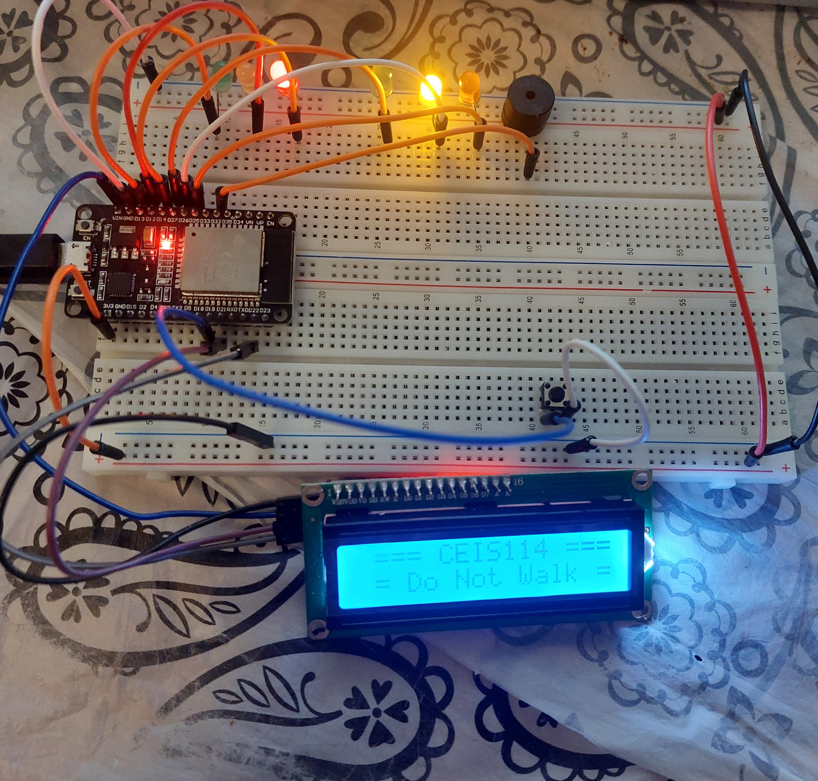
Picture of circuit with working LEDs and LCD display
ESP 32 Board
Colored LEDs: Red, Yellow and Green (two sets)
220 Ohm Resistors (optional)
Push Button
LCD Unit with Message Display
Wires
Breadboard

Slide 20
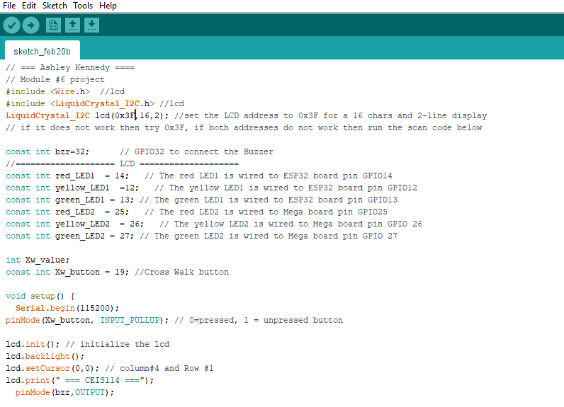
Screenshot of code in Arduino IDE
Screenshot of code in Arduino IDE showing your name in the comment

Slide 21
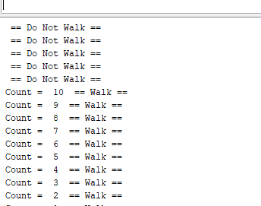
Screenshot of Serial Monitor in Arduino IDE
Screenshot of output in Serial Monitor

Slide 22
CEIS 114
Final Project Component – Option 2
Creating a Multiple Traffic Light Controller with a Cross Walk and an Emergency Buzzer with SMART sensor

Slide 23
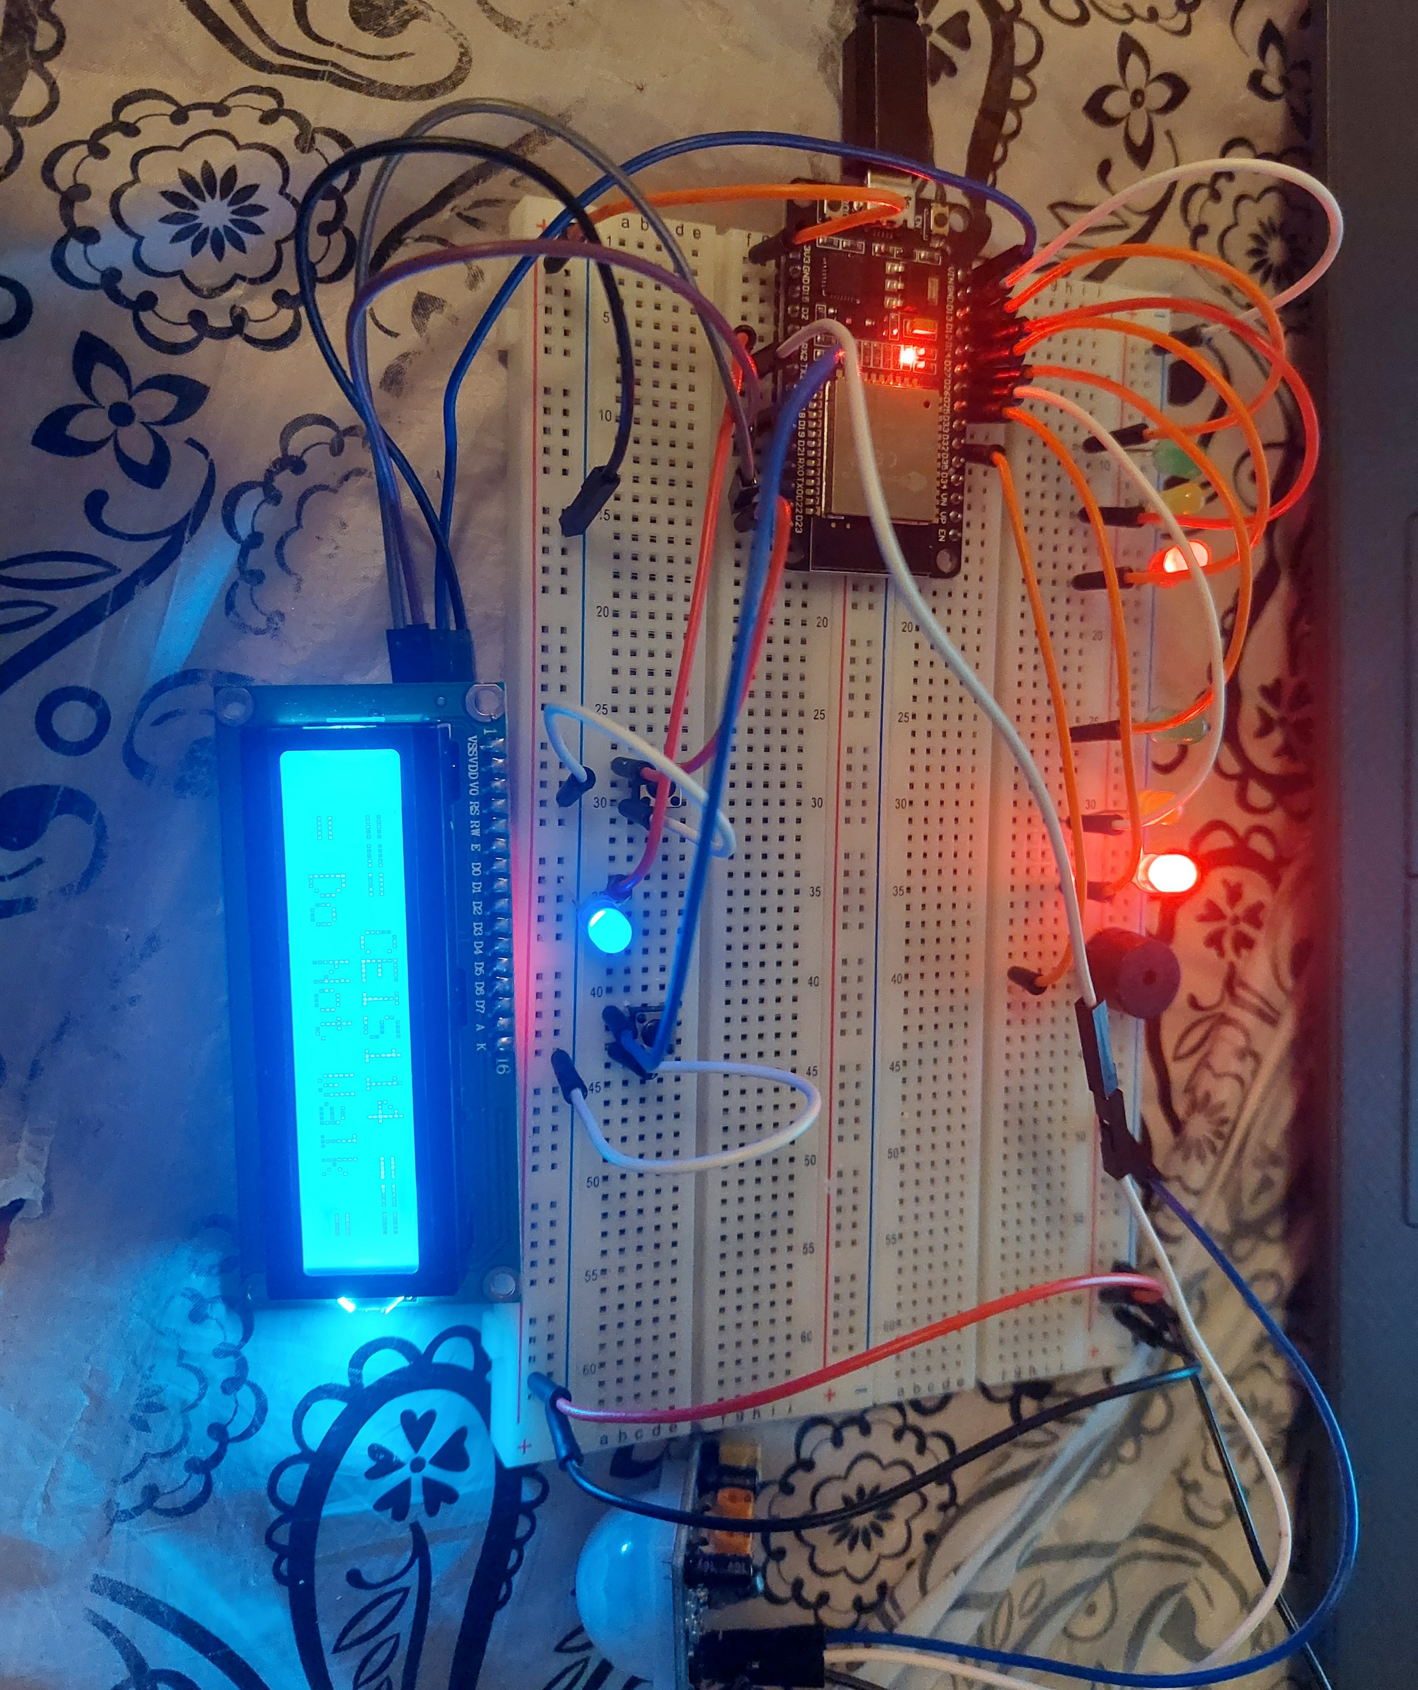
Picture of circuit with working LEDs and LCD display
ESP 32 Board
Colored LEDs: Red, Yellow and Green (two sets)
One Blue LED – Emergency Light
220 Ohm Resistors (optional)
Push Buttons - 2
LCD Unit
Buzzer
PIR Motion Sensor
Router
Wires
Breadboard

Slide 24
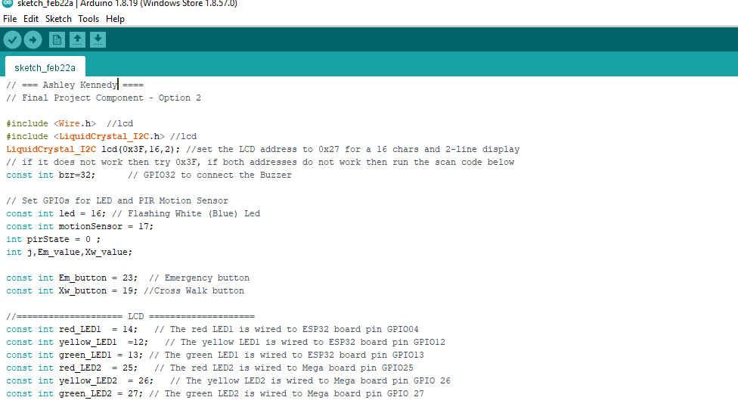
Screenshot of code in Arduino IDE
Screenshot of code in Arduino IDE showing your name in the comment

Slide 25
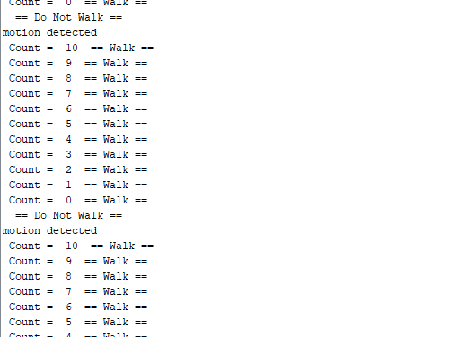
Screenshot of Serial Monitor in Arduino IDE
Screenshot of output in Serial Monitor

Slide 26
Troubles with project
The biggest problem I had with this circuit was the LCD screen. I was able to get the screen to power on but I couldn’t get the message to display. In the project guide and recordings I found a few possibilities but it came down to the screw on the back to adjust the contrast of the screen.

Slide 27
Job skills learned
Microcontrollers
Wiring
Coding
Sensors
Building a prototype
Following instructions and troubleshooting
Arduino IDE & serial monitoring

Slide 28

The End

